Slide 1
Setting up an Anaemia Service at the L&D
by Matt W. Johnson

Slide 2
Wiki Causes of Anaemia
Impaired production[edit]
• Disturbance of proliferation and differentiation of stem cells
• Pure red cell aplasia^{[15]}
• Aplastic anemia^{[15]} affects all kinds of blood cells. Fanconi anemia is a hereditary disorder or defect featuring aplastic anemia and various other abnormalities.
• Anemia of renal failure^{[15]} by insufficient erythropoietin production
• Anemia of endocrine disorders^{[medical citation needed]}
• Disturbance of proliferation and maturation of erythroblasts
• Pernicious anemia^{[15]} is a form of megaloblastic anemia due to vitamin B12 deficiency dependent on impaired absorption of vitamin B12. Lack of dietary B12 causes non-pernicious megaloblastic anemia
• Anemia of folic acid deficiency,^{[15]} as with vitamin B12, causes megaloblastic anemia
• Anemia of prematurity, by diminished erythropoietin response to declining hematocrit levels, combined with blood loss from laboratory testing, generally occurs in premature infants at two to six weeks of age.
• Iron deficiency anemia, resulting in deficient heme synthesis^{[15]}
• Thalassemias, causing deficient globin synthesis^{[15]}
• Congenital dyserythropoietic anemias, causing ineffective erythropoiesis
• Anemia of renal failure^{[15]} (also causing stem cell dysfunction)
• Other mechanisms of impaired RBC production
• Myelophthisic anemia^{[15]} or myelophthisis is a severe type of anemia resulting from the replacement of bone marrow by other materials, such as malignant tumors or granulomas.
• Myelodysplastic syndrome^{[15]}
• anemia of chronic inflammation^{[15]}
Increased destruction[edit]
Further information: Hemolytic anemia
Anemias of increased red blood cell destruction are generally classified as hemolytic anemias. These are generally featuring jaundice and elevated lactate dehydrogenase levels.^{[medical citation needed]}
• Intrinsic (intracorpuscular) abnormalities^{[15]} cause premature destruction. All of these, except paroxysmal nocturnal hemoglobinuria, are hereditary genetic disorders.^{[16]}
• Hereditary spherocytosis^{[15]} is a hereditary defect that results in defects in the RBC cell membrane, causing the erythrocytes to be sequestered and destroyed by the spleen.
• Hereditary elliptocytosis^{[15]} is another defect in membrane skeleton proteins.
• Abetalipoproteinemia,^{[15]} causing defects in membrane lipids
• Enzyme deficiencies
• Pyruvate kinase and hexokinase deficiencies,^{[15]} causing defect glycolysis
• Glucose-6-phosphate dehydrogenase deficiency and glutathione synthetase deficiency,^{[15]} causing increased oxidative stress
• Hemoglobinopathies
• Sickle cell anemia^{[15]}
• Hemoglobinopathies causing unstable hemoglobins^{[15]}
• Paroxysmal nocturnal hemoglobinuria^{[15]}
• Extrinsic (extracorpuscular) abnormalities
• Antibody-mediated
• Warm autoimmune hemolytic anemia is caused by autoimmune attack against red blood cells, primarily by IgG. It is the most common of the autoimmune hemolytic diseases.^{[17]} It can be idiopathic, that is, without any known cause, drug-associated or secondary to another disease such as systemic lupus erythematosus, or a malignancy, such as chronic lymphocytic leukemia.^{[18][18]}
• Cold agglutinin hemolytic anemia is primarily mediated by IgM. It can be idiopathic^{[19]} or result from an underlying condition.
• Rh disease,^{[15]} one of the causes of hemolytic disease of the newborn
• Transfusion reaction to blood transfusions^{[15]}
• Mechanical trauma to red blood cells
• Microangiopathic hemolytic anemias, including thrombotic thrombocytopenic purpura and disseminated intravascular coagulation^{[15]}
• Infections, including malaria^{[15]}
• Heart surgery[medical citation needed]
• Haemodialysis[medical citation needed]
Blood loss[edit]
• Anemia of prematurity from frequent blood sampling for laboratory testing, combined with insufficient RBC production
• Trauma^{[15]} or surgery, causing acute blood loss
• Gastrointestinal tract lesions,^{[15]} causing either acute bleeds (e.g. variceal lesions, peptic ulcers) or chronic blood loss (e.g. angiodysplasia)
• Gynecologic disturbances,^{[15]} also generally causing chronic blood loss
• From menstruation, mostly among young women or older women who have fibroids
• Infection by intestinal nematodes feeding on blood, such as hookworms^{[20]} and the whipworm Trichuris trichiura.^{[21]}
The roots of the words anemia and ischemia both refer to the basic idea of "lack of blood", but anemia and ischemia are not the same thing in modern medical terminology. The word anemia used alone implies widespread effects from blood that either is too scarce (e.g., blood loss) or is dysfunctional in its oxygen-supplying ability (due to whatever type of hemoglobin or erythrocyte problem). In contrast, the word ischemia refers solely to the lack of blood (poor perfusion). Thus ischemia in a body part can cause localized anemic effects within those tissues.
Fluid overload[edit]
Fluid overload (hypervolemia) causes decreased hemoglobin concentration and apparent anemia:
• General causes of hypervolemia include excessive sodium or fluid intake, sodium or water retention and fluid shift into the intravascular space.^{[22]}
Intestinal inflammation[edit]
Certain gastrointestinal disorders can cause anemia. The mechanisms involved are multifactorial and not limited to malabsorption but mainly related to chronic intestinal inflammation, which causes dysregulation of hepcidin that leads to decreased access of iron to the circulation.^{[23][24][25]}
• Helicobacter pylori infection.^{[26]}
• Gluten-related disorders: untreated celiac disease^{[26][25]} and non-celiac gluten sensitivity.^{[27]} Anemia can be the only manifestation of celiac disease, in absence of gastrointestinal or any other symptoms.^{[28]}
• Inflammatory bowel disease.^{[29][30]}

Slide 3
Causes of Anaemia

Slide 4
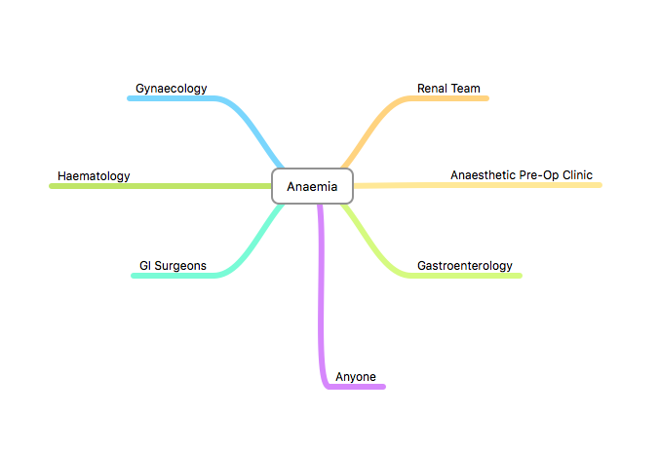
Present GP Referral Pattern

Slide 5
Specialty Approach
When you are a Hammer
To you,
Everything looks like a Nail

Slide 6
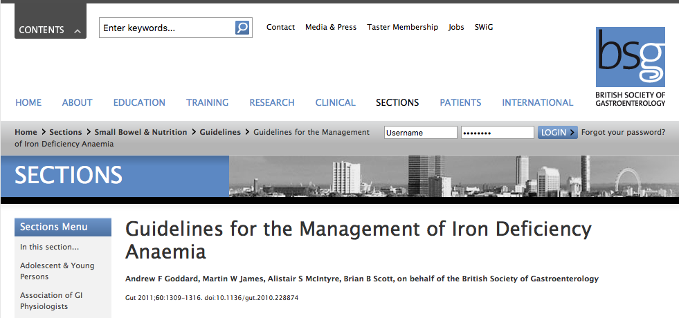
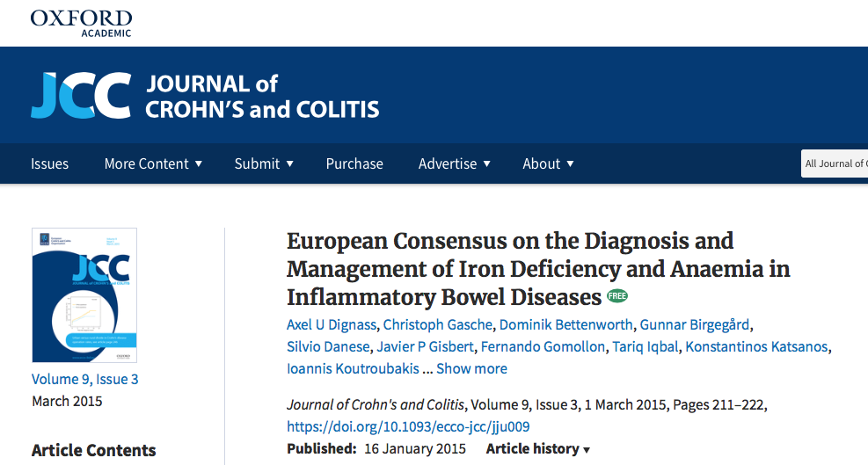
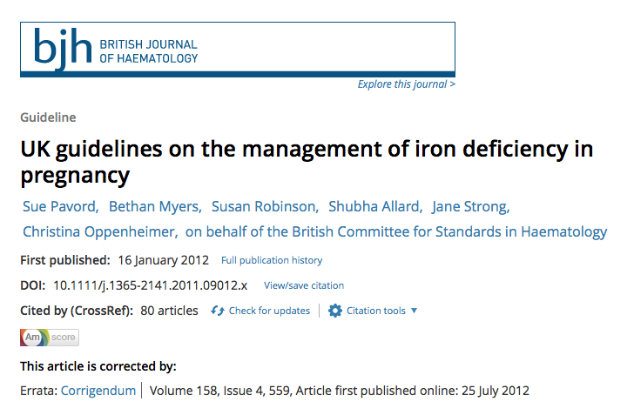
Specialty Guidelines

Slide 7
Anaemia Definitions
fl / rbc

Slide 8
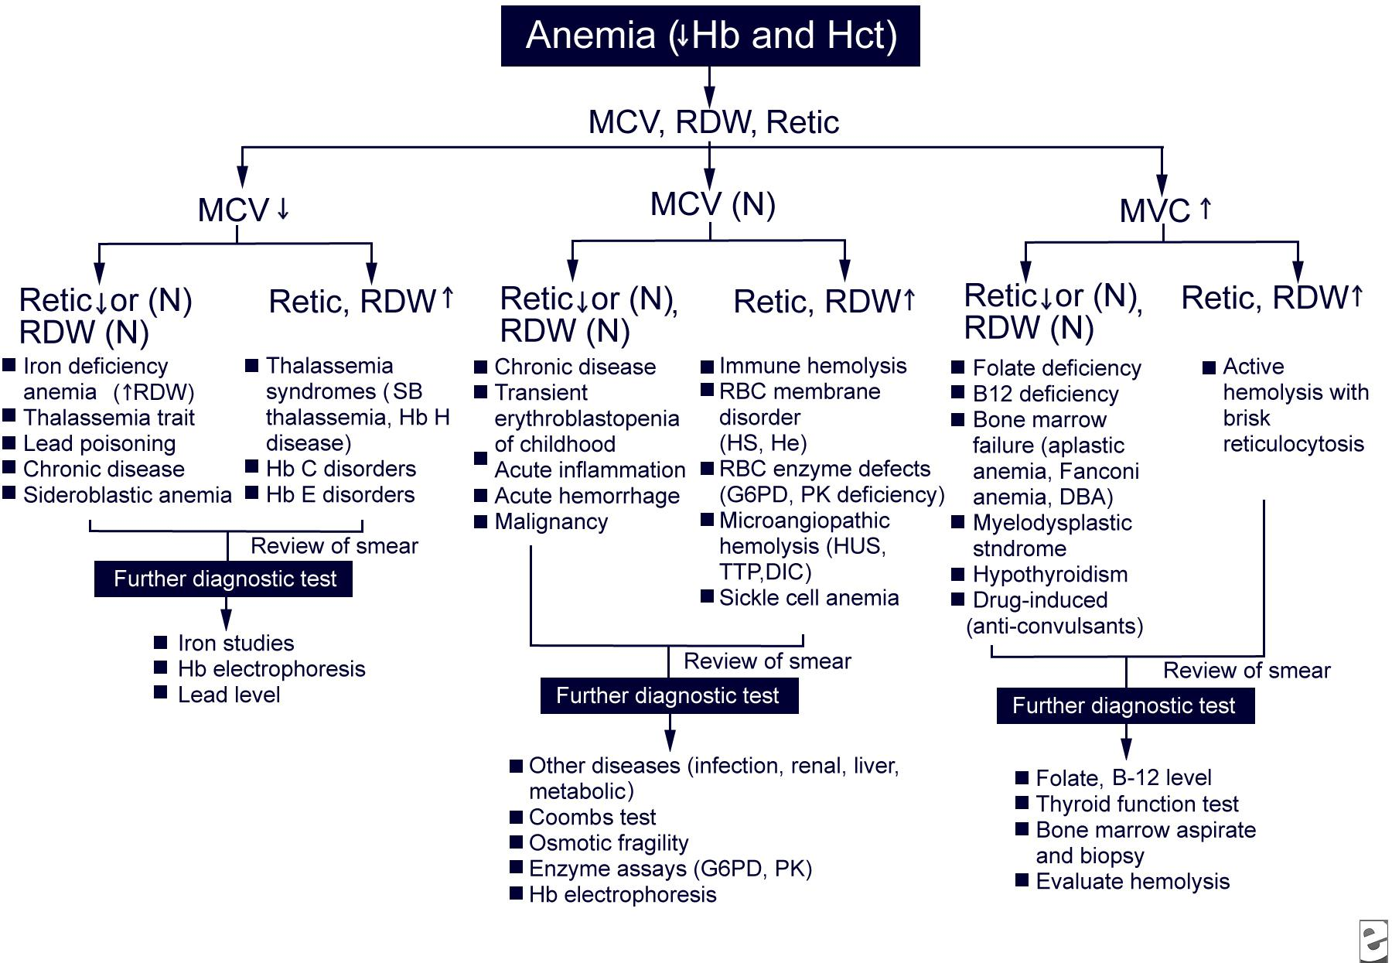
Causes of Anaemia

Slide 9
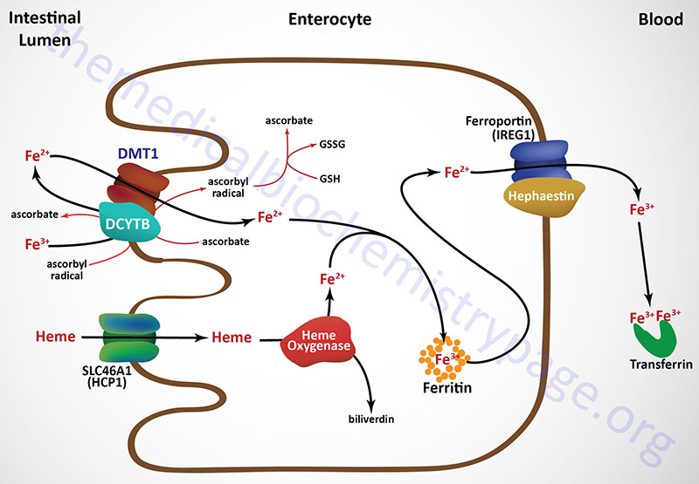
PPIs -
Ferritin

Slide 10
Gastroenterology
Iron Deficiency Anaemia
Hb in Men < 13
Hb in Women < 12
Hb in Pregnant Women <11
Hb in CRD <10
Ferritin <30 ng/ml (Acute phase protein)
Ferritin in Inflammation eg IBD <100 (ECCO)

Slide 11
L&D - 7 Year Retrospective Analysis of IDA
2-5% of the UK population have IDA
4-13(10)% of gastroenterology OPAs
54,976 IDA tests on 34,395 patients (10% of the catchment 330,000)
20,581 (37.4%) were repeated
Median Hb = 12.1 g/L + Ferritin = 17.9ng/ml
Women : Men = 46,169 : 8,807 (5:1)
47,103 (85.7%) by GPs, 385 (0.7%) by Community Services, 6,848 (12.4%) by Hospitals
1,165 (3.4%) received IV iron
Johnson MW. 2017

Slide 12
Anaemia in IBD
In UK 400 in every 100,000 have IBD (0.4%, approx 240,000 in UK) ¹
Prevalence of Anaemia in IBD = 16-74% ²
Of these Iron Deficiency IDA = 60-80% ²
In hospitalised IBD patients, IDA = 68% ²
¹Rubin GP. APT. 2000;14:1553-9
²Stein J. Ann Gastro. 2012;26:1-10

Slide 13
IDA in IBD
Intestinal blood loss
Iron malabsorption
Concomitant use of antacids e.g. PPIs
Reduced dietary intake
Inflammatory up-regulation of Hepcidin
blocks Fe absorption in gut
reduces recycling of Fe from rbc breakdown

Slide 14
L&D - 7 years Retrospective Analysis of Anaemia in IBD
3014 IBD patients in catchment of 330,000 (approx 1%)
633 (21%) had IDA
Median Hb of 118 (130-47) g/L
Median ferritin count of 16.9 (49.8- 2.4) ng/ml
71 (11.3%) had presented 764 times
(average = 10.7 times each)
71 (11.3%) received IV iron
(Median Hb 109 g/L + ferritin 12.7 ng/ml)
{Johnson MW. GUT. 2017;66(2):PTH-070

Slide 15
L&D - 7 years Retrospective Analysis of Anaemia in Coeliac Disease
1430 patients with CD (0.43% of the catchment)
967 blood results confirmed IDA
420 patients (29%) = IDA
(ie. >50% were representing with IDA)
17 (4%) received IV iron
{Johnson MW.GUT. 2017;66(2):PWE-137

Slide 16
IDAnaemia - QOL
Significant morbidity
Impaired QOL
Reduced functioning (reduced O2 uptake)
Increased cardiac output
Left ventricular hypertrophy
Reduced cognition
Reduced libido
Reduced immune responsiveness.
{Gasche C. GUT. 2004;53:1190-7}

Slide 17
Anaemia - Cost
Failure to diagnose and pro-actively manage can have substantial socio-economic cost implications.
? Unnecessary investigation (eg. Endoscopy)
The cost difference IDA Admission between Elective day case Vs Emergency hospital admission = £1,130 per episode
Hospital Episode Statistic Data. 2013

Slide 18
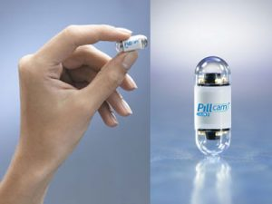
Anaemia - Ix Cost
BSG Guidelines 2011 - True Unexplained Iron Deficiency Anaemia = OGD + Colonoscopy
15% of patients with pathology at one end will also have pathology at the other ¹
NICE - Capsule Guidance - 2014 - 2.1.1
The main indication for this procedure is obscure gastrointestinal bleeding, which is defined as bleeding of unknown origin that persists or recurs after a negative initial endoscopy (colonoscopy and/or upper gastrointestinal endoscopy). Diagnosis may be difficult because bleeding can often be slow and/or intermittent. Patients may experience prolonged blood loss, leading to iron deficiency (anaemia) and a feeling of tiredness. Another important indication is the diagnosis and investigation of Crohn's disease.
¹ Goddard AF. BSG Guidelines for the Management of IDA. GUT. 2011;60:1309-16
¹ NICE Guidance 2014 - Wireless Capsule Endoscopy for investigating the sb

Slide 19
Condition | Sub-type | Ferritin | Serum iron | Transferrin | TIBC | % Transferrin saturation
Iron-deficiency anaemia | Microcytic | Low | Low | High | High | Low
Anaemia of chronic disease | Normocytic Normochromic | Normal or High | Low | Low | Low | Normal or High

Slide 20
Anaemia Clinic
Refer to Haematologist
FBC AbNs / Sickle Cell
Persistent Anaemia
Pancytopenia
Men - Hb <13
Women Hb <12
Refer to Renal
If eGFR <60ml/min/1.73m
+/- Erythropoietin
Further Ix - FBC, Haematinics, U+Es, LFTs, ESR, TTG, TFTs
+/- Sickle / Thal / Urinalysis
Treat Haematinic Deficiencies
Low MCV
< 80 fl
Normal MCV
80-100 fl
HighMCV
> 100 fl
Ferritin
<30
Ferritin 30-50
TSATs <20
Normal or High Ferritin
High ESR
+/- PV
Check
Blood film, Haematinics, LFTs, LDH, Retics, TFT, TTG
Iron Deficiency Pathway
Iron Studies
Hb-opathies
Unexpected Anaemia Abnormal Blood Film
High Reticulocytes
High Bilirubin
Treat Vitamin Deficiencies
Ferritin >50
TSATs > 20
If Unexplained Refer to Gastro
Anaemia of Chronic Disorder
Refer to
Haematology
Refer to Liver or Endocrine Specialists

Slide 21
Anaemia of CKD
HB < 100g/L
Hypochromic rbc >6%
Reticulocyte Hb >29pg
Ferritin <100ug/L
Transferrin Sats <20%
Asymptomatic
Symptomatic
No ESA
Start ESA IDA
Start ESA
No IDA
No IDA
IDA
SC Epoetin 300 IU/kg/w
IV Epoetin 450 IU/kg/w
IV Darbepoetin 1.5mcg/kg/w
Check
Folate + B12
wbc / ESR
No Dialysis
Dialysis
If this fails = Consider ESA Resistance
Options include;-
Increasing the dose of ESA
Blood transfusion (but avoid in those being considered for Renal Tx)
A trial off of ESA
Anti-erythropoietin Abs test
Desferrioxamine test (Al toxicity)
Refer to Haematology
PO Iron
e.g. Ferrous Fumerate
IV Iron
Highest dose Lowest frequency

Slide 22
Pre-Assessment Clinic
Targets
Men Hb >13 + Women >12
Ferritin >30ng/L
If CRP high, Ferritin >100ng/L
Ix Needed
FBC, Retics, Haematinics, TFSats, U+Es, LFTs, CRP
Refer to Haematologist
Generalised FBC AbNs
Persistent Anaemia
Sickle Cell
Pre Op / Anaemia Team
Review bloods and Triage
Non-Correctable Anaemia
B12 or Folate Deficiency Anaemia
IDA
Anaemia with Functional Iron Deficiency
Iron Deficient,
but not Anaemic
Refer back to Surgeon
Ask GP to start Supplements
Treat with PO Iron if > 6 weeks before Surgery
Use IV Iron Protocol if < 6 weeks before Surgery
Decide if further investigation required
Re-Test at least 2 weeks before Surgery
If corrected book for Surgery. If not discuss with Anaesthetist / Surgeon

Slide 23
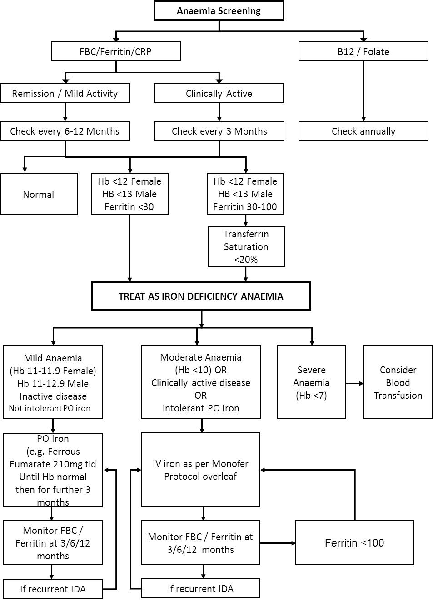

Slide 24
Treating IDA with PO Fe
Lower doses are often better tolerated
Consider adding Ascorbic Acid (co-factor for Fe absorption) 500mg od
Avoid Antacids eg PPIs
Optimise Dietary Fe
Continue for 3 months after the Fe stores have corrected (Ferritin >100) ¹
ECCO Guidance for treating IDA in IBD suggests “Intravenous Iron is more effective and better tolerated [in IDA] than oral Iron supplements” ³
¹ Goddard AF. BSG Guidelines for the Management of IDA. GUT. 2011;60:1309-16
² Stein J. Ann Gastro. 2012;26:1-10
³ Van Assche G. ECCO Guidelines. J of Crohns and Colitis. 2013;7:1-33

Slide 25
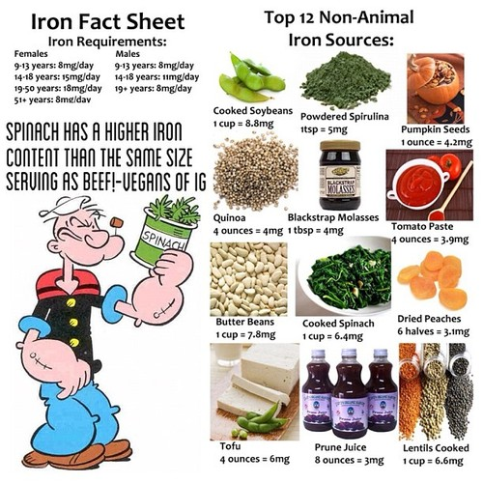

Slide 26
Treating IDA with PO Fe
Ferrous Fumerate (better tolerated)
Remember 90% of ingested (Ferrous) Iron remains unabsorbed and can lead to GI side effects (nausea, diarrhoea and constipation) ^{1, 2}
Non-absorbed Fe²⁺ can generation reactive oxygen species which may exacerbate IBD ^{3,4,5}
Ferric Maltol (Feraccru) ⁶ ⁻ More data awaited
Oral formulation | Elemental iron content per capsule/tablet (mg) | Recommended daily dosing for adults | Total daily elemental iron exposure (mg)
Ferric maltol^{2,3} | 30 | 2 capsules | 60
Ferrous fumarate^{4,5} | 65–70 | 2–3 tablets | 195–210
Ferrous sulphate⁶ | 65 | 2–3 tablets | 130–195
Ferrous gluconate⁷ | 35 | 4–6 tablets | 140–210
¹ Stein J. Ann Gastro. 2012;26:1-10
⁴ Carrier J. APT. 2001;15:1989-99
² Van Assche G. ECCO Guidelines. JCC. 2013;7:1-33
⁵ Erichsen K. ScanJGastro. 2003;38:543-548
³ Carrier J. J Nutri. 2002;132:3146-50
⁶ Gasche C. IBD. 2015 March.;21(3):579-88

Slide 27
Absorption of Ferric Maltol
Unabsorbed ferric maltol is excreted intact in faeces²
Ferric-maltol complex remains intact in the intestinal lumen before absorption via Iron transporter mechanism
Minimises the risk of GI toxicity due to production of free radicals from free iron
Fe³⁺
Ferric -maltol complex dissociated by iron transporter mechanism
Iron transporter mechanism
Ferritin
Maltol is rapidly absorbed by diffusion, eliminated in urine as glucuronide
Fe²⁺
Ferroportin1
Iron uptake with ferric maltol is saturable, avoiding the potential for iron overload
Fe³⁺
Most iron enters the liver and bone marrow
Fe²⁺
Transferrin
Figure adapted from Andews AC (2000). GI, gastrointestinal. 1. Andrews AC. Nat Rev Genet 2000;1:208–17. 2. Barrand MA, Callingham BA. Br J Pharmacol 1991;102:408–14. 3. Barrand MA, et al. Br J Pharmacol 1991;102:723–9. 4. Barrand MA, et al. J Pharm Pharmacol 1987;39:203–11. 5. Barrand MA, et al. J Pharm Pharmacol 1990;42:279–82. 6. Bokemeyer B. Drug Discov Today 2015;20:1037–9. 7. European Medicines Agency. Feraccru. Assessment report, 17 December 2015. 8. Singh S, Hider RC. Anal Biochem 1988;171: 47–54. 9. Stallmach A, Büning C. Expert Opin Pharmacother 2015;16:2859–67.
UK/FER/2016/031c Oct 2016

Slide 28
AEGIS Extension Study:
Mild -Moderate IBD, who already failed on 1x PO Fe
16
RCT (12 weeks)
Open-label extension (52 weeks)
15
Mean (SE) Improvement in Hb in the Ferric Maltol group versus placebo was 2.25 (0.12) g/dL( p < 0.0001)
14
13
Hb concentration (g/dL)
12
 | Mean (SD) Hb (g/dL)
 | Baseline | Week 64
Continued group | 11.00 (1.03) | 13.95 (1.26)
Switch group | 11.10 (0.85) | 13.33 (1.46)
11
10
0
4
8
12
16
20
24
28
32
36
40
44
48
52
56
60
64
Patients, n
Weeks since randomisation
Continued group
64
59
59
58
43
41
40
35
Switch group
64
61
56
53
41
36
37
36
It is not possible to determine the statistical significance of increases in Hb between Week 12 of active treatment and Week 64 due to the study design. Data points are means (±SD). Hb, haemoglobin; RCT, randomised controlled trial; SD, standard deviation.
1. Schmidt C, et al. Aliment Pharmacol Ther. Submitted.
UK/FER/2016/031c Oct 2016
Notes:
Slide demonstrates the initially steep rate of rise of Hb from baseline in active Rx group and plateau off as Hb approaches normal, with iron then going into iron stores. These phases are reproduced once placebo patients are switched to Feraccru at 12 weeks.

Slide 29
AEGIS: summary of key efficacy and safety
The safety and tolerability profile of ferric maltol was generally comparable to that of placebo¹
AEGIS investigated the efficacy and safety of ferric maltol in patients with UC or CD who have had an inadequate response, or had been intolerant to previous OFPs for IDA¹
Ferric maltol achieved a significantly greater increase in Hb from baseline to week 12 compared with placebo (+2.25 g/dL; p<0.0001)¹
Two-thirds of patients on ferric maltol had normalised Hb by week 12¹
In total, 78% of patients achieved normalised Hb levels by Week 16 that were maintained to Week 64 (86%)¹
1. Gasche C, et al. Inflamm Bowel Dis 2015;21:579–88

Slide 30
Ferric Maltose Issues
Absorption of Ferrous (Fe ²⁺) iron is 3:1 > Ferric (Fe ³⁺)
Ferric iron absorption is dependant on Duodenal Ferric Reductase which is dependant on Ascorbic acid (Vit C)
Scottish Medicines Consortium - Dec 2016 “The submitting company did not present sufficiently robust clinical and economic analyses to gain acceptance by SMC.”
Goddard AF. BSG Guidelines for the Management of IDA. GUT. 2011;60:1309-16

Slide 31
When to consider IV Fe ? ¹
a) Failure to respond to oral iron
b) Intolerant to oral iron
c) Impaired GI absorption (Coeliac disease)
d) Active inflammation eg. IBD
e) Patient is on haemodialysis
f) Jehovah's Witness
g) Major surgery < 3-6 weeks
¹ Goddard AF. BSG Guidelines for the Management of IDA. GUT. 2011;60:1309-16

Slide 32
Treating IDA with IV Fe
1st Line - Monofer
- where (depending on weight) up to 1.5/2g can be given as 1x infusion
2nd Line - Ferrinject (for 1 and 2g) ¹
¹ Aidan A. APT. 2017; 46(10): 1303-1318

Slide 34
IV Iron Usuage @ L&D
April 2014 - March 2015
 | Cosmofer | Ferinject | Venofer | Combined
Obs & Gynae | 18 | 2 |  | 20
EAU |  | 4 |  | 4
CCU | 7 | 1 | 3 | 11
DME |  | 6 | 8 | 14
Haematology | 6 | 47 | 2 | 55
Gastroenterology | 52 | 43 |  | 95
Paediatrics | 5 | 3 | 4 | 12
Surgery | 6 | 2 |  | 8
General medical |  | 2 |  | 2
Totals | 94 | 110 | 17 | 221

Slide 35
IV Iron Costings at L&D
 | Cosmofer | Ferinject | Venofer | Current Totals | Alternative with Monofer
Totals (patient numbers) | 94 | 110 | 17 | 221 | 209
Drug Cost | £80 | £150 | £80 |  | £140
Total Drug Costs | £11,280 | £24,750 | £2,040 | £38,070 | £43,890
g of iron @ 1.5g per patient | 141 | 165 | 25.5 | 331.5 | 313.5
Time (hours) inc 30min observation | 470 | 165 | 93.5 | 728.5 | 209
Nursing Cost (band 5 @ £84/hr) | £39,480 | £13,860 | £7,854 | £61,194 | £17,556
Infusion Set Cost @ £6.75 | £635 | £1,485 | £918 | £3,038 | £1,411
No of Appts | 94 | 220 | 136 | 450 | 209
Total Costs | £51,395 | £40,095 | £10,812 | £102,302 | £62,857
Monofer Comparator | £28,271 | £33,083 | £6,905 | £68,259 | Saving £30-40,000

Slide 36
When to Transfuse ¹
1) Hb <7
2) Acute blood loss
3) Cardiac compromise
4) Urgent pre-Sx optimisation ²
¹ Aidan A. APT. 2017; 46(10): 1303-1318
² NICE Guidance 24: Blood Transfusion

Slide 37
Follow Up - IDA
>50% of IBD patients with treated IDA suffer a recurrence within a year ¹
BSG Guidelines = Monitor every 3 months for the 1st year after treatment, and then 1 year later
Goddard AF. BSG Guidelines for the Management of IDA. GUT. 2011;60:1309-16

Slide 38
L&D Anaemia Service 2018
We are not there yet !
Specialty agreement
Funding streams - Not yet agreed
Business case for 2 Anaemia / Coeliac Nurses
Triage patients and direct them to appropriate Specialty + Assessments
reduce inappropriate endoscopy

Slide 39
