Slide 1
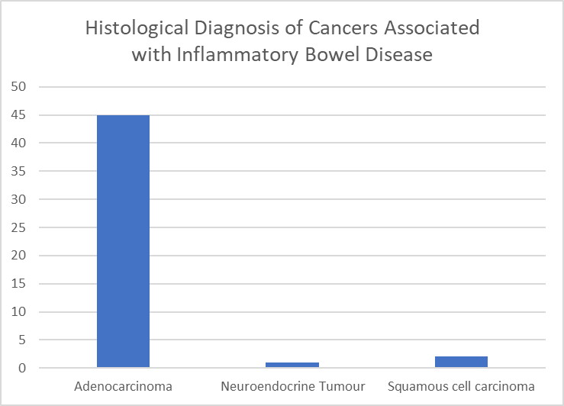
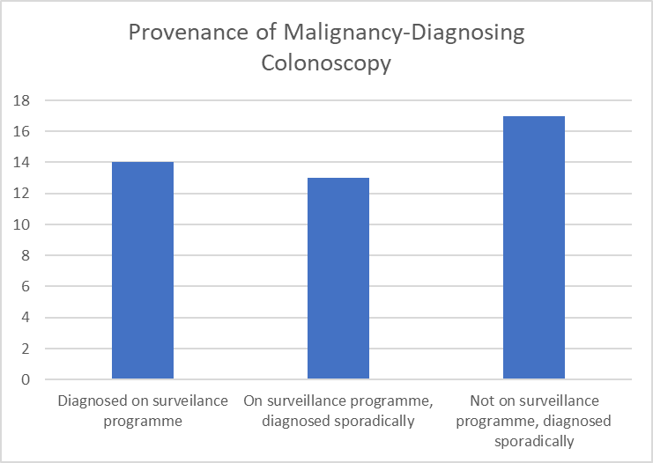
THE OUTCOME OF COLONOSCOPIC SURVEILLANCE AND SURGERY IN A COHORT OF INFLAMMATORY BOWEL DISEASE PATIENTS WHO DEVELOPED COLORECTAL CANCER OVER A 12 YEAR REVIEW PERIOD AT A DISTRICT GENERAL HOSPITAL
MW Johnson¹, LB Johnson², J. Wye¹, K. Kabiru¹
Gastroenterology Unit, Luton & Dunstable FT University Hospital, Luton, United Kingdom
Manchester University, Medical School, Manchester, United Kingdom
Introduction
The annual mortality from colorectal cancer (CRC) in patients with inflammatory bowel disease (IBD) is quoted at 2% per year, and accounts for 10-15% of all the deaths seen in IBD patients. The 5 year survival rate is 50%[1]. Given these risks the British Society of Gastroenterology (BSG) recommends surveillance colonoscopy every 1, 3 or 5 years, starting 8-10 years from the onset of symptoms, depending on the extent and severity of the underlying IBD.
We set out to review the effectiveness of this colonoscopic surveillance programme in our IBD cohort.
Methods
A 12 year retrospective review was made of a district general cohort of IBD patients, cross correlating their outcomes with the documentation and datasets of our local histopathology department, endoscopy unit reporting system and decision making process through the multi-disciplinary cancer team network.
We then assessed;-
whether the BSGs surveillance guidelines were being adhered to and
whether it made an impact to the patients outcome.
Results 1
The data of 2142 local patients listed on the National IBD Registry database (0.65% of the local population) were analysed. 45 patients went on to develop CRC (4%), on average 12.8 years after the onset of their IBD (0-55y, median =9.5y).
Of those 45 IBD patients, 23 had ulcerative colitis (UC) and 22 had Crohn’s disease (CrD).
There were 2x squamous cell cancers, 1x neuroendocrine cancer and 45 adenocarcinomas.
Results 2
3 of the UC patients went on to develop 2 cancers each. 26 (54%) were distal, 6(13%) were left, 15(31%) were right and 1(2%) was small bowel. 9 patients had left sided or distal strictures (1UC +8CrD). 44 of the 45 were diagnosed at colonoscopy. Only 14 of these were diagnosed during their surveillance assessments, 9 of which were compliant with the BSG guidelines and 5 were non-compliant. 30 cases were picked up sporadically (due to symptom assessments), despite 13 of these being actively involved with a regular colonoscopic surveillance programme.
Conclusion 2
Over the 12 year review period 45 (4%) of our IBD patients developed CRC. In total 27 (60%) of these patients were on a colonoscopic surveillance programme, with the intention that these procedures could potentially identified cancers at an earlier stage, and therefore offer better longterm surgical out-comes and survival rates.
14 of the 45 CRCs (31%) were picked up in the surveillance group, leading to an early diagnosis in 9 of these, when the surveillance was compliant with the BSG guidelines. 50% of the surveillance colonoscopic timings were non-compliant with the the BSG’s recommendations, and had not been performed at the recommended time intervals, potentially delaying these asymptomatic pick ups.
A majority of the CRC cases (30, 68%) were picked up sporadically, including 13 of the 27 who were already under-going routine colonoscopic surveillance, but had presented for earlier review due to symptoms.
These results question the effectiveness of our present surveillance programme and highlight the need for organised, dedicated IBD surveillance lists, run by experienced endoscopists, with appropriate time set aside for effective surveillance, to optimise an early pick rate.
References
[1] Colorectal cancer in inflammatory bowel disease: review of the evidence. Tech Coloproctol. 2019 Jan;23(1):3-13. Keller DS, Windsor A, Cohen R, Chand M
The authors declare no conflict of interests
Copyright © 2020 John Wye
john.wye1@nhs.net
Abstract No. P0315

