Slide 1
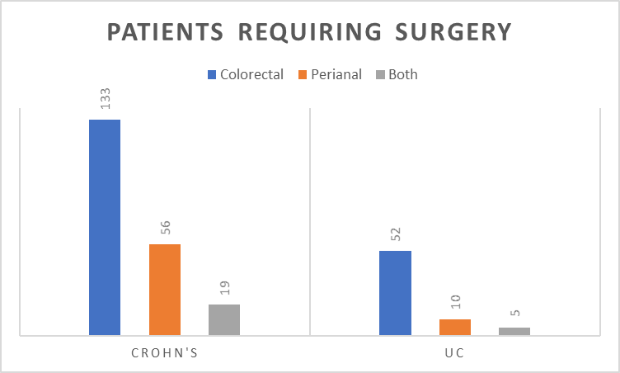
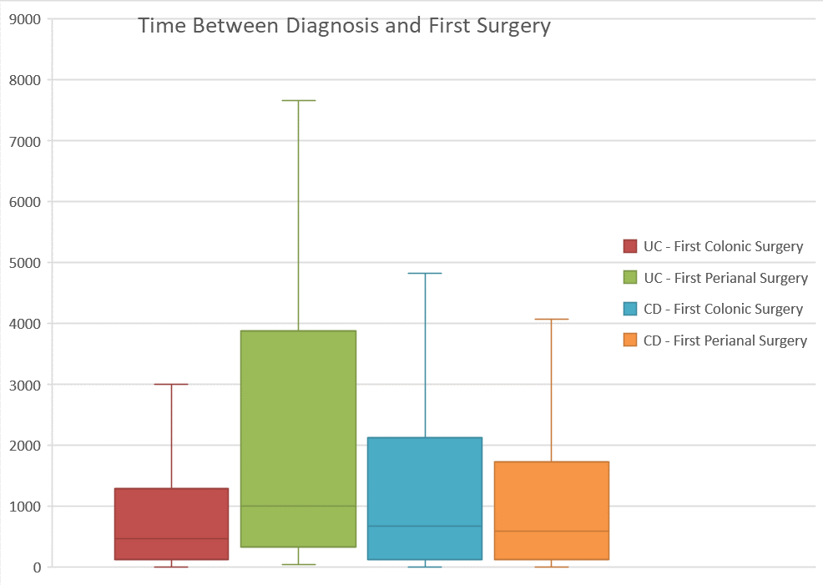
Prevalence of first time surgery amongst inflammatory bowel disease patients at a district general hospital:
A 25 year retrospective review
J. Wye, K. Kabiru, MW Johnson
Gastroenterology Unit, Luton & Dunstable FT University Hospital, Luton, United Kingdom
Introduction
In UK the prevalence of inflammatory bowel disease (IBD) has been quoted at 0.7% of the population [1]. Some of these patients will go on to need surgery, depending on a range of risk factors, such as age and disease type. The risk of needing surgery after 10 years with Crohn's disease (CrD) is said to be as high as 46.6%, which is considerably higher than the the 15.6% seen in patients after 10 years of ulcerative colitis [2]. We performed a 25 year retrospective study in our local IBD cohort to assess the number presenting for the first time requiring surgery within this group of patients.
Methods
3687 IBD patients are listed on our local IBD database, that provides a service for a catchment of 330,000. This indicates a local prevalence of 1.1%. A 25 year retrospective analysis was performed, analysing all the Trust’s coding records on our IBD cohort, to determine the number that subsequently went on to re-quire either colo-rectal or peri-anal surgery. All patients listed to have had endoscopic surgery or haemorrhoids banding were excluded. We performed multivariate analysis on recorded variables to ascertain risk factors for recurrent surgery. Variables analysed included age at diagnosis, gender, location of first surgery, and presence of perianal disease.
Results 1
During the 25 year study period 337 (9.1%) of our 3687 IBD patients underwent surgery for the first time. In total 364 procedures were performed with 259 (7%) of these being colonic surgery and 105 (2.8%) being peri-anal surgery.
Of the 67 UC patients who needed surgery, 57 (85%) underwent colorectal surgery and 15 (22%) needed peri-anal surgery, with 5 patients needing both.
Of the 208 CrD patients who needed surgery, 152 (73%) needed colonic surgery and 75 (36%) needed peri-anal surgery, with 19 requiring both.
Results 2
62 of the patients requiring surgery were listed as having indeterminate colitis.
The time to first surgery for a UC patient on average was 1329 days, with the average time to colorectal surgery being 1110 days, and the average time to peri-anal surgery being 2580 days. The time to first surgery for a CrD patient on average was 1560 days, with the average time to colorectal surgery being 1697 days, and the average time to peri-anal surgery being 1782 days.
A range of risk factors were assessed but only perianal disease was found to be an independent variable risk factor in Crohn’s patients.
Conclusion
Over a 25 year period the prevalence of surgery in our local IBD cohort was lower than expected at 9.1%. 62% had Crohn’s disease, 20% had UC, and 18% were listed as indeterminate colitis. It is possible that over time, as our clinical management has improved with an array of new therapeutic options now available (such as the Biological therapies) that we are finally starting to change the disease course and outcome of these conditions, especially if used earlier in the disease pathway.
More specifically the prevalence of surgery over 25 years in our UC cohort was 3.4%, with the average time from diagnosis to 1st surgery being 1329 days (approximately 3.6 years). The majority of these needed colo-rectal surgery (85%) as compared to per-anal surgery (22%).
Within the larger Crohn’s disease cohort the prevalence of surgery was slightly higher at 5.6%, with a larger proportion of peri-anal surgery. The average duration of disease prior to 1st surgery was 1560 days (approximately 4.3 years). Perianal disease was the only independent variable found that predicted surgery in Crohn’s patients.
References
[1] BMJ Open. 2020 Jul 19;10(7): e036584
[2] Gastroenterology. Vol 145, Issues 5, P996-1006, Nov 01, 2013
The authors declare no conflict of interests
Copyright © 2021 John Wye
john.wye1@nhs.net
Abstract No. P0512

