Slide 1
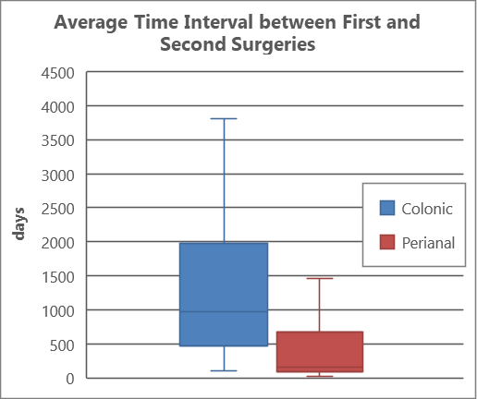
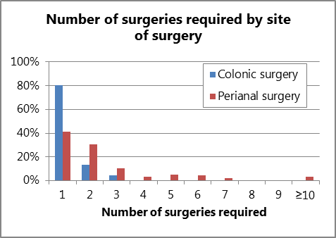
Redo Surgery in IBD Patients: What is the Time Interval and Is This Affected by Specific Risk Factors?
J. Wye, K. Kabiru, MW Johnson
Gastroenterology Unit, Luton & Dunstable FT University Hospital, Luton, United Kingdom
Introduction
Within our local catchment we have a higher than average prevalence of IBD of 1.1% (3687/330,000).
Previous studies have suggested that for those with Crohn’s disease the risks of surgery at 1, 5, and 10 years (after diagnosis) are 16.3%, 33.3% and 46.6%, respectively.
For Ulcerative colitis these risks at 1, 5, and 10 years (after diagnosis) are 4.9%, 11.6%, and 15.6%, respectively [1].
Less is known about the risks of redo-surgery after the first episode.
Methods
A 25 year retrospective analysis was performed on a local cohort of 3687 IBD patients, who had been coded as having undergone colo-rectal or peri-anal surgery. All patients listed to have had endoscopic surgery or haemorrhoids banding were excluded.
We performed multivariate analysis on recorded variables to ascertain risk factors for recurrent surgery. Variables analysed included age at diagnosis, gender, location of first surgery, and presence of perianal disease.
Results 1
337 (9.1%) of our 3687 IBD patients underwent 464 surgical procedures over the 25 year study period. 103 of these patients required 230 repeat surgical procedures during the study period. In total 259 (7.0%) had colonic surgery, of which 43 (17%) went on to have a further 52 colo-rectal surgical procedures. In total 105 (2.8%) had peri-anal surgery, of which 52 (49.5%) went on to have a further 151 procedures.
Results 2
For those undergoing the colonic surgery 83% required just 1 operation, 14% required 2, 3% required 3 procedures and 0% required 4 or more. For those undergoing perianal surgery, 50% required 1 procedure, 25% required 2, 10% required 3, with 15% requiring more than three procedures, including 3% who required more than 10 procedures.
The average time interval between 1st and 2nd colo-rectal and peri-anal surgeries were 1204 days (3.3 years) and 591 days (1.6 years), respectively.
Conclusion
Over a 25 year period the prevalence of surgery in our local IBD cohort was lower than expected at 9.1%. However, once a patient has surgery, the need for repeat (redo) surgery was 30.5%, of which 29% were colonic and 71% were peri-anal procedures.
Over a 25 year period the prevalence of surgery in our UC cohort was 3.4%, whilst in our Crohn’s disease cohort this prevalence was found to be slightly higher at 5.6%.
After colo-rectal surgery the chances of needing further colo-rectal surgery was 17%. The average duration between the 1st and the need for a 2nd colo-rectal surgical procedure was 3.3 years.
After having per-anal surgery the chances of needing repeated peri-anal surgery was 49.5%. The average duration between the 1st and the need for a 2nd peri-anal surgical procedure was 1.6 years.
Perianal disease was the strongest predictor for repeat surgical intervention.
References
[1] BMJ Open. 2020 Jul 19;10(7): e036584
[2] Gastroenterology. Vol 145, Issues 5, P996-1006, Nov 01, 2013
The authors declare no conflict of interests
Copyright © 2021 John Wye
john.wye1@nhs.net
Abstract No. P0513

