Slide 1
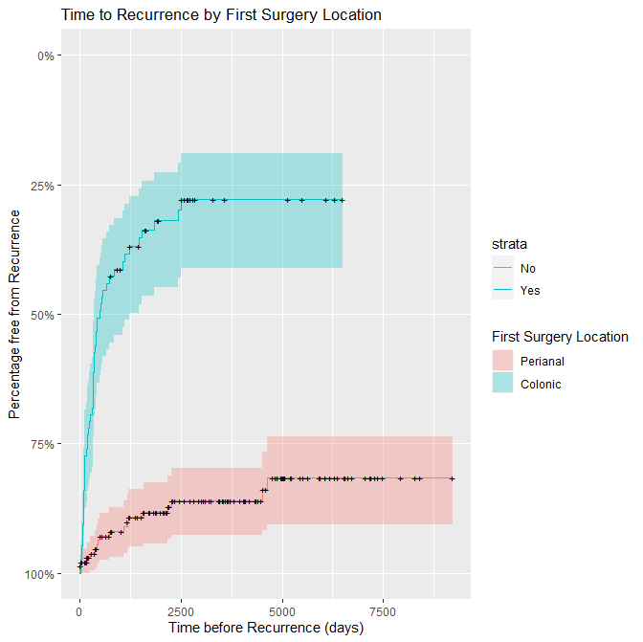
Does the type of surgery or disease location predict the need for subsequent surgeries in IBD patients?
J. Wye, K. Kabiru, MW Johnson
Gastroenterology Unit, Luton & Dunstable FT University Hospital, Luton, United Kingdom
Introduction
The prevalence of IBD in UK is said to be approximately 0.7% [1]. There is a high 1.1% (3687/330,000) prevalence of IBD within the local population. A proportion of these patients will require surgery. The estimated risk depends on a range of factors such as age and disease type.
The risks of surgery at 1, 5, and 10 years after diagnosis with Crohn's disease have been shown to be 16.3%, 33.3% and 46.6%, respectively.
The risks of surgery at 1, 5, and 10 years after a diagnosis of ulcerative colitis (UC) are 4.9%, 11.6%, and 15.6%, respectively [2].
Objective - We performed a 25 year retrospective review of all the lower GI surgery performed in our local IBD patients, to see if the type of surgery or disease location influenced the risks for subsequent surgeries.
Methods
In this 25 year retrospective cohort analysis we analysed the 3687 IBD patients on our local IBD database who had previously been coded by the Trust to have undergone colorectal or perianal surgery. All patients listed to have had endoscopic surgery or haemorrhoids banding were excluded. We performed multivariate analysis on recorded variables to ascertain risk factors for recurrent surgery. Variables analysed included age at diagnosis, gender, location of first surgery, and presence of perianal disease.
Results 1
During the 25 year study period 337 (9.1%) of our 3687 IBD patients underwent surgery. 259 (7%) had colonic surgery and 105 (2.8%) had peri-anal surgery, with 27 requiring both. 103 (2.8%) needed repeat surgery (>2 procedures). The overall risk of needing repeat surgery was 30.6% (103/337), however if their first surgery had been colonic, then the risk of requiring colonic surgery again over the 25 year review period was 16.6% (43/259). If the first surgery had been peri-anal the risks of further peri-anal surgery were 49.5% (52/105).
Results 2
In essence, 49.5% of patients who underwent perianal surgery for the first time, went on to have additional peri-anal surgeries over the 25 year review period. For those undergoing perianal surgery, 50% required 1 procedure, 25% required 2, 10% required 3, with 15% requiring more than three procedures, including 3% who required more than 10 procedures.
In those whose first procedure was a colorectal procedure, just 16.6% of patients went on to require further colorectal procedures (p<0.05). 83% required just 1 operation, 14% required 2, 3% required 3 procedures and 0% required 4 or more. The presence of perianal disease had no effect on the need for additional colorectal surgery.
Conclusion
Perianal disease was the only variable demonstrated to influence the need for “redo” additional surgery. Its presence strongly predicted the requirement for repeat peri-anal surgical intervention in 49.5% of Crohn’s disease patients. The presence of peri-anal disease did not appear to increase the need for colonic surgery in this cohort.
References
[1] BMJ Open. 2020 Jul 19;10(7): e036584
[2] Gastroenterology. Vol 145, Issues 5, P996-1006, Nov 01, 2013
The authors declare no conflict of interests
Variable | HR | 95% CI | p-value
Sex: Male (vs Female) | 1.1685 | 0.7162-1.906 | 0.533
Age at Diagnosis: Over 50 (vs Under 50) | 0.9415 | 0.3980-2.227 | 0.891
Age at first surgery: Over 65 (vs Under 65) | 1.8426 | 0.4648-7.304 | 0.384
Year of Diagnosis: After 2010 (vs Before 2010) | 0.9287 | 0.5352-1.611 | 0.793
Presence of Perianal Disease | 5.2805 | 3.1308-8.906 | <0.000001
The Cox’s proportional hazards model showed that of the variables analysed, only the presence of perianal disease predicted the need for a second surgery (p<0.01).
Copyright © 2021 John Wye
john.wye1@nhs.net
Abstract No. P0514

