Slide 1
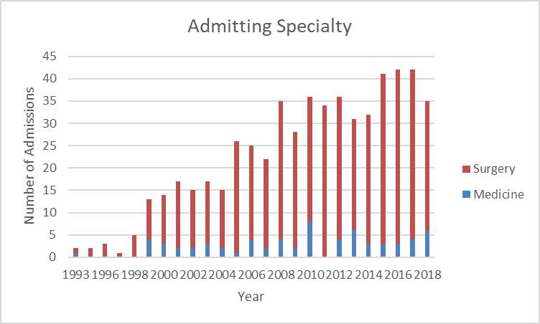
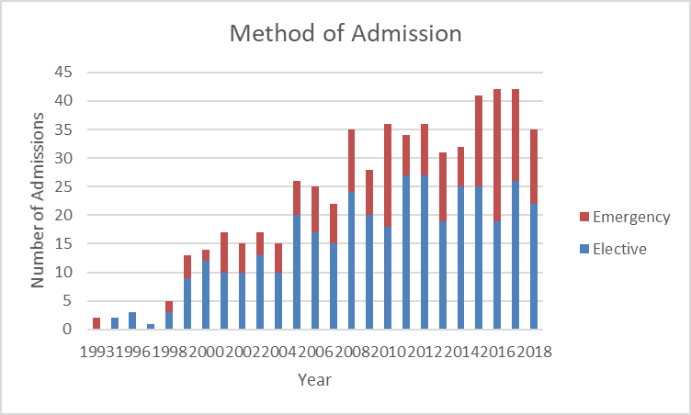
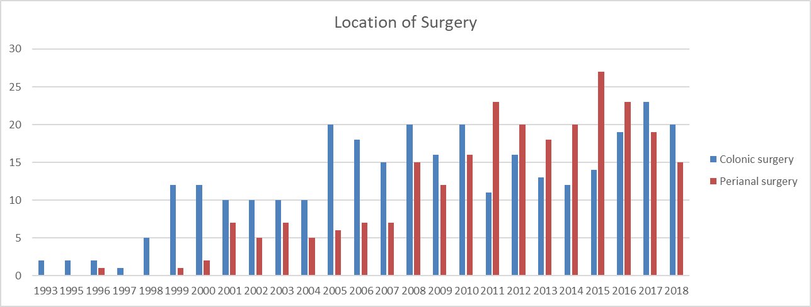
The changing trends seen with surgery in patients with inflammatory bowel disease over a 25 year review period
J. Wye, K. Kabiru, MW Johnson
Gastroenterology Unit, Luton & Dunstable FT University Hospital, Luton, United Kingdom
Introduction
In days gone by surgery was seen as the main stay of treatment for IBD patients whose condition failed to settle on traditional systemic steroids. Since then we have had clinical practice engage with mesalazine, immuno-modulators and more recently biological and disease modifying drugs. The role of the surgeon still remains critical within the team, especially in the emergency situations and when these alternative therapies fail. We were keen to explore the impact that this may have had on surgical demand.
Methods
In this 25 year retrospective cohort analysis we analysed the 3687 IBD patients on our local IBD database who had previously been coded by the Trust to have undergone colo-rectal or peri-anal surgery. All patients listed to have had endoscopic surgery or haemorrhoids banding were excluded. We performed multivariate analysis on the number of procedures being performed year on year over that 25 year period to see if the introduction of immunomodulators and biologics had any impact on the surgical rates at our local DGH.
Results
Immunomodulators were infrequently used until 2009, but by 2014 greater than 600 patients were prescribed a range of azathioprine, 6-mercaptopurine, and methotrexate. Likewise, biologics were introduced in 2011 for local IBD patients, and their use has steadily increased to 100 in 2015, 320 by 2018 and 417 by March 2021. Annual colorectal surgical rates steadily climbed from 2 per year in 1991, to 20 in 2005, before hitting a plateau of 20 by 2018. Annual peri-anal surgical rates also climbed from 1 in 1996 to a peak of 27 in 2015, before steadily dropping down to 15 in 2018.
Conclusion
The demand on surgery amongst our local cohort of IBD patients seems to be falling in the last 2-4 years. The introduction of immunomodulators in 2009 seems to have had a temporal effect on plateauing the increasing need for colorectal surgery, whilst the introduction of biological therapy in 2011 seems to have had more of a temporal effect on reducing the rates of peri-anal surgery from 2015.
The authors declare no conflict of interests
Copyright © 2021 John Wye
john.wye1@nhs.net
Abstract No. P0515

