Slide 1
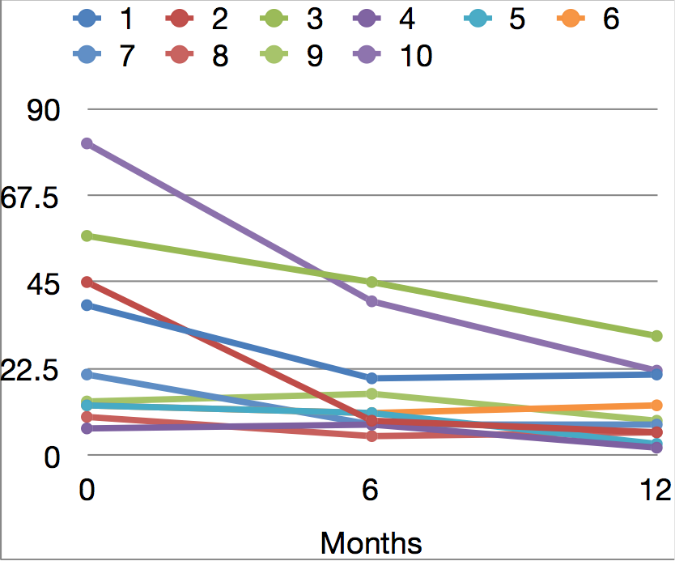
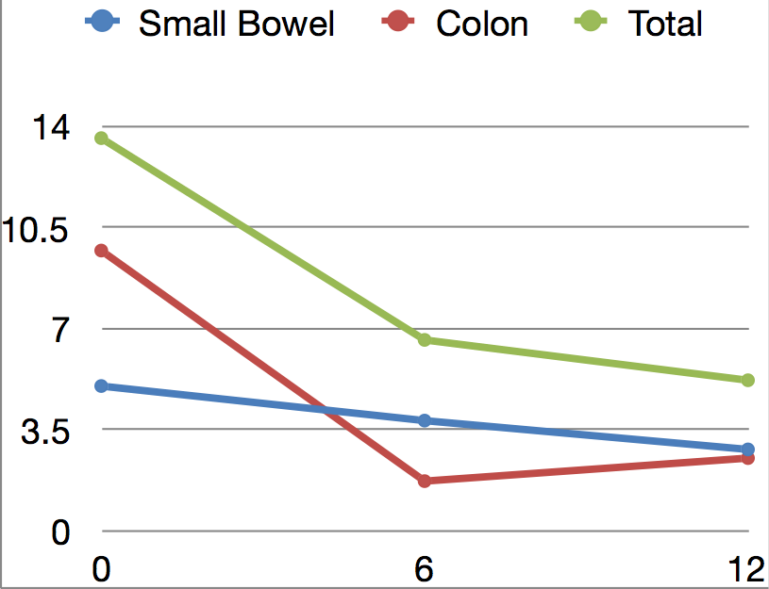
THE USE OF PANENTERIC CROHN’S CAPSULES TO ASSESS TREATMENT OUTCOME OF VEDOLIZUMAB IN IBD PATIENTS:
A 1 YEAR PROOF OF CONCEPT STUDY
MW Johnson¹, LB Johnson², J. Wye¹, K. Kabiru¹
Gastroenterology Unit, Luton & Dunstable FT University Hospital, Luton, United Kingdom
Manchester University, Medical School, Manchester, United Kingdom
Introduction
Vedolizumab has been shown to be an effective biological agent in the treatment of both ulcerative colitis (GEMINI 1)[1] and Crohn’s disease (GEMINI 2+3)[2]. These studies largely concentrated their endoscopic analysis on the improvements seen within the colonic mucosa. Little is known about the effects of Vedolizumab on the small bowel presentation of Crohn’s disease. We set out to evaluate the symptomatic, clinical and endoscopic improvements seen in a group of IBD patients over a 1 year treatment course of Vedolizumab, using the new PanEnteric Crohn’s Capsule.
Methods
Over the course of 1 year 10 IBD patients were started on Vedolizumab and underwent a series of treatment evaluations at 0, 6 and 12 months. 9 of these patients had a combination small and large bowel Crohn’s disease and 1 had pan-colonic ulcerative colitis (UC). They were reviewed using ESR, Calprotectin and symptomatic scores (HBI or mUCDAI). PanEnteric evaluation was performed using using the new Medtronic’s (Given) PanEnteric Crohn’s Capsules (PECCs) and the extent and severity of the underlying IBD was assessed using the in-built validated Eliakim score.
Results 1
Over the year, the average ESR reduced from 30 (7-81) on entering the trial to 12.1 (2-31) after 1 year of Vedolizumab. Likewise, the average faecal calprotectin dropped from 1263.6 (189->1800) to 440.1 (30-1460). The modified UCDI score and modified HBI reduced from 5 to 0, and 7.5 to 3.5, respectively. The average small bowel PillCam Crohn’s Capsule Score reduced from 5 to 2.8, whilst the full PanEnteric Crohn’s Capsule (Eliakim) Score dropped from 13.6 (6-30) to 5.2 (0-22).
Results 2
On average the 10 trial patients had undergone 6 previous endoscopic investigations (1-20) and had rated their endoscopic experience as 5/10 (range 1-10). Their overall experience with PECCs ranged from Good to Excellent. 1 patient initially found the PillCam difficult to swallow, but this improved as the study progressed. Comfort was rated on average as 9.5/10.
Conclusion 1
Medtronic’s PanEnteric Crohn’s Capsules (PECCs) provides an excellent evaluation of the pan-intestinal extent and severity of IBD, and the effects of different treatment regimes.
As an alternative to invasive endoscopy it was deemed much more acceptable and preferred by all. As an alternative to invasive endoscopy it was deemed much more acceptable and preferred. Other patient benefits included; “less painful”,”didn’t have to take time off from work”, “no after-effects from sedation”,”didn’t have to stay in hospital” and “didn’t have to be accompanied by a family member”.
We feel PECCs should be considered as a less invasive 1st line assessment tool when evaluating the effectiveness of Biological therapy in IBD patients, especially those with small bowel Crohn’s disease.
Whilst Vedolizumab has already been shown to be beneficial in the treatment of colonic inflammation, this proof of concept study also demonstrated its beneficial effect in reducing intestinal inflammation, across all 3 segments of the small bowel.
References
GEMINI 1 - N Engl J Med 2013; 369:699-710
GEMINI 2+3 -N Engl J Med 2013; 369:711-721
We are grateful for the support provided by Takeda UK Ltd. and Medtronic UK. Both the capsules and the Vedolizumab were provided freely for the sole purpose of this study
Outside of this the authors declare no conflict of interests
Eliakim Scores at Month 0, 6 and 12
 | 0 | 6 | 12
Small Bowel | 5 | 3.8 | 2.8
Colon | 9.7 | 1.7 | 2.5
Total | 13.6 | 6.6 | 5.2
COMPARATIVE ASSESSMENT OF THE DIFFERENT
MANAGEMENT SUPPORT PROGRAMMES
AVAILABLE TO IBD PATIENTS AT A DGH
ESR
Results
Eliakim
Scores
ESR, Calprotectin and Symptom Scores
 | 0 | 6 | 12
ESR | 30 | 17.3 | 12.1
Calprotectin | 1263 | 852 | 440
Symptom Scores | 7.3 | 1.9 | 3.1
Copyright © 2020 Matt W. Johnson
matthew.johnson@ldh.nhs.uk
Abstract No. P0316

