Slide 1
Pan-Enteric Capsule Endoscopy
as a means to evaluating the treatment outcomes from Vedolizumab
Dr. Matt W. Johnson

Slide 2
What is Capsule Endoscopy

Slide 3
Small Intestinal Capsule
Notes:
Slide 138
Wireless video capsule
[Pillcam SB]– component parts. Images are obtained with a CMOS chip and transmitted via an 8 piece sensor array to a recording device/ battery pack. Eight hours after ingestion the recording ceases. The digital data can then be transferred to a workstation where the images are processed into a video. The video is then reviewed by the gastroenterologist.

Slide 4
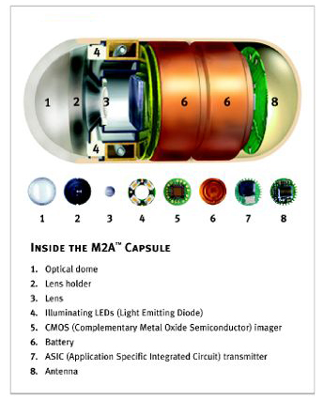
BSG - Capsule Endoscopy Uses
Small bowel (NICE)
Obscure GI bleeding
Crohns assessment
Coeliac assessment
Small bowel tumours
Oesophageal
Varicies
Barrett’s Esophagus

Slide 5
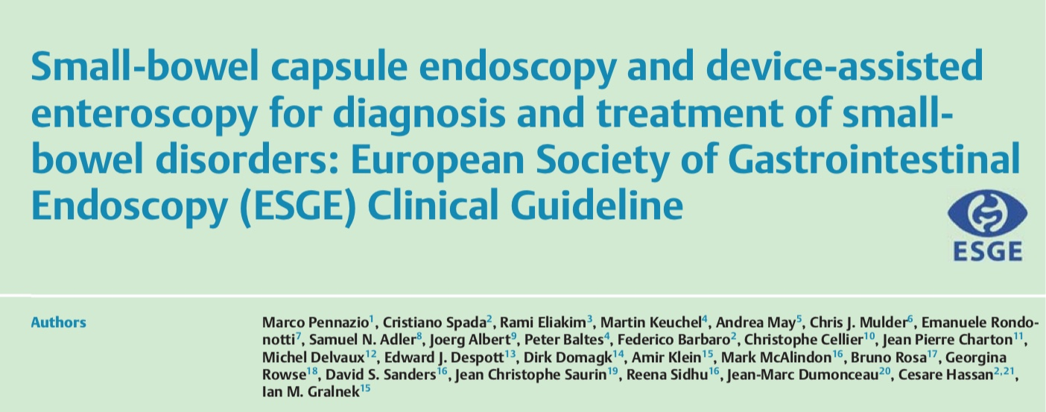
Iron-deficiency anaemia
ESGE recommends a small-bowel capsule endoscopy, after
Complete medical history (diet, medication, co-morbidities, and gynaecological history)
OGD + Colonoscopy (with duodenal and gastric biopsies) (strong re- commendation, low quality evidence)
………Normally we would also request TFT, TTG and Haematinics
In IDA, if the OGD & Colonoscopy are normal, ESGE recommends small-bowel capsule endoscopy as a first-line examination, when small-bowel evaluation is indicated (strong recommendation, moderate quality evidence).
Endoscopy 2015; 47: 352–376

Slide 7
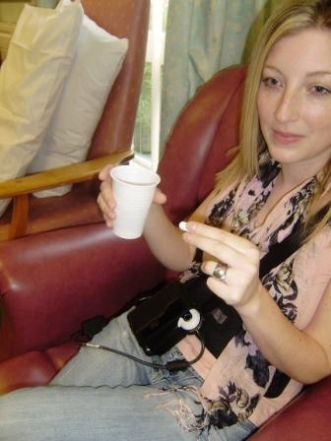
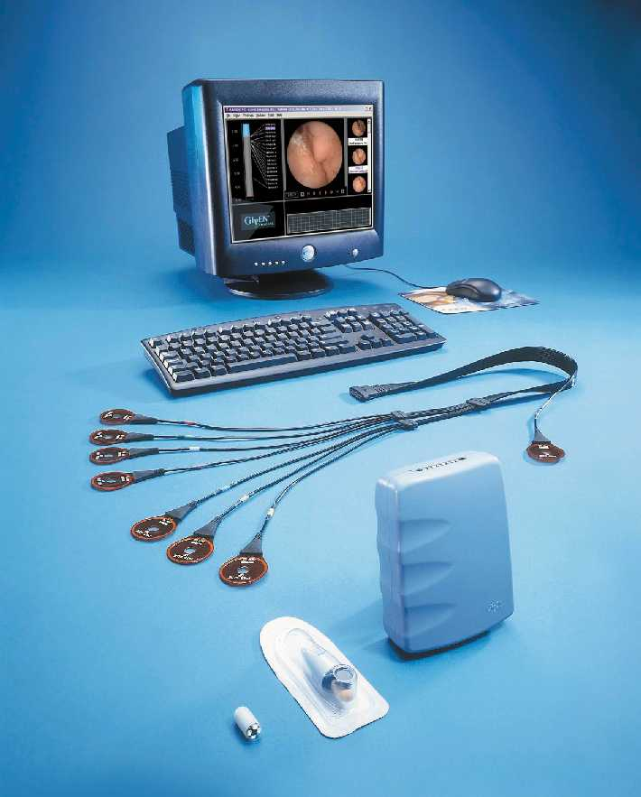
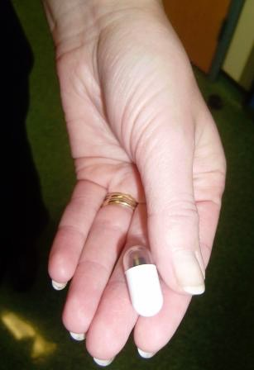
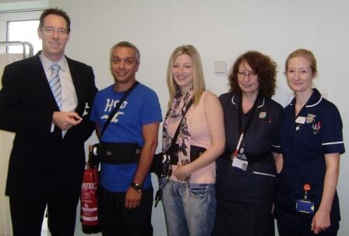
Capsule Endoscopy – Small Bowel
Process:
Bowel prep
Sensor Belt
Ingest Capsule
Return module (following day)

Slide 8
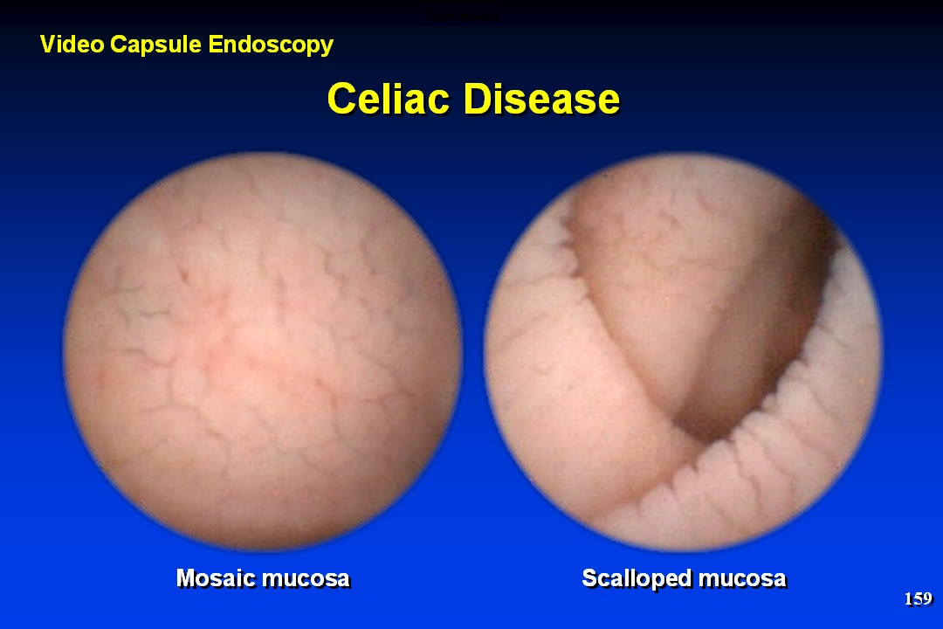
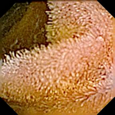
SBCE Images of Coeliac Disease
Normal

Slide 9
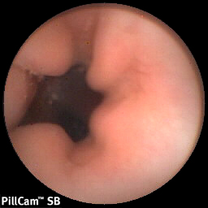
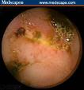
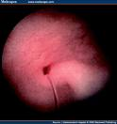
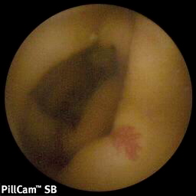
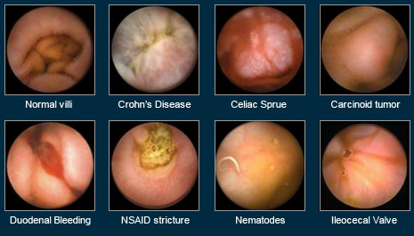
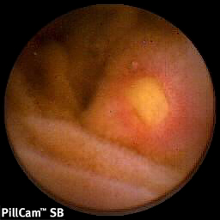
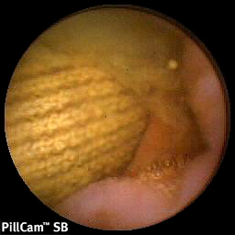
Capsule Endoscopy Images

Slide 10
Capsule Endoscopy
Clinical efficacy
Meta-analysis of 14 studies reported yields
63% for CE compared with 28% for PE (Push Enteroscopy)
Triester et al American Journal of Gastroenterolgy 2005
Yield of CE superior to barium follow through and CT enteroclysis
Nakamura et al Endoscopy 2006
Further meta-analysis of 17 studies shows CE superior to all other modalities (including sb MRI). Rate of positive finding in CE 95% compared with 44%
Marmo et al. Alimentary Pharmacology and Therapeutics 2005

Slide 11
ESGE recommends:-
SBCE 1st-line investigation for Obscure GI bleeding (strong recommendation, moderate quality evidence).
In Overt obscure GI bleeding = Optimal ASAP <14 days to maximize the diagnostic yield (strong recommendation, moderate quality evidence).
Ileocolonoscopy still 1st-line for investigating suspected Crohn’s disease (strong recommendation, high quality evidence).
SBCE recommended in those suspected Crohn’s disease and negative (or failed) ileocolonoscopy findings, in the absence of obstructive symptoms or known stenosis (strong recommendation, moderate quality evidence).
Endoscopy 2015; 47: 352–376

Slide 12
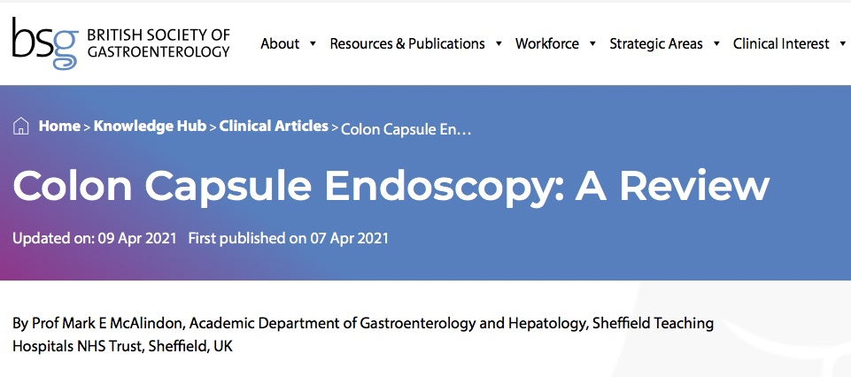
How does it compare to Colonoscopy in Diagnostic Ability?
Meta-analysis = Compared to colonoscopy, colon capsule endoscopy (CCE) has 87% sensitivity and 95% specificity for detection of polyps of ≥10 mm.2
This was achieved despite variable completion rates of between 57% and 100%.
Systematic reviews demonstrated detection of cancer in 44 cases; cancers missed were due to eight incomplete examinations, one lesion being incorrectly measured as ≤5mm (it was a malignant 10mm polyp) and a cancer of which an image was saved but not commented on by the reporter. 2,3
CCE IBD pick=up rate = Sensitivity of 97% in patients with ulcerative colitis.4
How does it compare to CT Colonography?
Large polyps >9mm = Relative sensitivity of 1.91 (95% confidence interval 1.18‒3.09)
Smaller polyps (≥5‒≤9 mm) = 2.67, 95% confidence interval 1.76‒4.04).5
CCE Vs CT with flat and depressed lesions = 87% versus 67%, P=0.01.6

Slide 13
What are the indications for Colon Capsule Endoscopy?
CCE is feasible, safe, and accurate in individuals at average risk of colorectal cancer
Could be considered in those who have incomplete examination by or have declined colonoscopy.8,12,13
ScotCap project study - Use of CCE as a primary diagnostic tool avoided 70% of colonoscopy (some may need a completion FS if the CCE recording was incomplete).
The NHS England pilot of CCE in 2WW patients referred with +ive FITT (10‒100 µg haemoglobin/g.15
During COVID - Alternative investigation of those with 20% risk of organic disease (inflammatory bowel disease, cancer, or advanced adenomas)
It seems likely that in the future, CCE would be best suited for use in the 80% low-risk patients (FIT <10 µg/g).16

Slide 14
UEGW Submitted Abstracts
Acceptability of PanEnteric Capsule Endoscopy as a means of assessing the treatment outcome of Biological agents in patients with inflammatory bowel disease: A proof of concept study
The use of PanEnteric Crohn’s Capsules to assess treatment outcome of Vedolizumab in IBD patients: A 1 year proof of concept study

Slide 15
Why do these studies
Patients with IBD suffer flares
Their condition may require strong Biological therapy
Prior to funding / starting it is important to assess Severity and Extent
These invasive endoscopies are often performed in patients at a time point when they are at their most vulnerable and most uncomfortable.
This study set out to assess whether PanEnteric Crohn’s Capsule (PECC) assessments could be used as an acceptable alternative.
Vedolizumab has been shown to be an effective biological agent in the treatment of both ulcerative colitis (GEMINI 1)¹ and Crohn’s disease (GEMINI 2+3)².
These studies largely concentrated their endoscopic analysis on the improvements seen within the colonic mucosa.
Little is known about the effects of Vedolizumab on the small bowel presentation of Crohn’s disease.
We set out to evaluate the symptomatic, clinical and endoscopic improvements seen in a group of IBD patients over a 1 year treatment course of Vedolizumab, using the new PanEnteric Crohn’s Capsule.

Slide 16
Proof of Concept Study
1 year study with 10 patients
IBD patients were started on Vedolizumab
9 had sb+lb Crohn’s disease + 1 had pan-colonic UC (ulcerative colitis)
Treatment evaluations at 0, 6 and 12 months.
They all had ;-
ESR
Calprotectin
Symptomatic scores (HBI or mUCDAI)
Medtronic’s (Given) PanEnteric Crohn’s Capsules (PECCs)
Eliakim Scores (built in, validated, assessment of extent and severity)
All outcomes were collected
Exception - 4 Capsules were not completed at 6m due to COVID restrictions

Slide 17
Capsule Endoscopy - Scoring
ESGE suggests the use of activity scores to allow for longitudinal assessment of the course of small-bowel Crohn’s disease and its response to medical therapy (using mucosal healing as an end point) (weak recommendation, low quality evidence).
Mucosal healing is increasingly recognised as an important end point for assessment of therapeutic efficacy in patients with IBD .
Recent clinical trials have begun to evaluate the potential role of VCE for assessment of mucosal healing in the small bowel [193 – 195], using ;-
Lewis score [190] or
CECDAI [189] - Capsule Endoscopy CDAI Score
The results of these scoring systems must be interpreted in the appropriate clinical context

Slide 18
Capsule Endoscopy
Eliakim Score
 | 0 | 1 | 2 | 3
MCL Most Common Lesion | None | Mild | Moderate | Severe
MSL Most Severe Lesion | None | Mild | Moderate | Severe
Extent | None | 10-30 | 30-60 | 60-100
Strictured | None | 1x traversed | >1x traversed | Retention

Slide 19
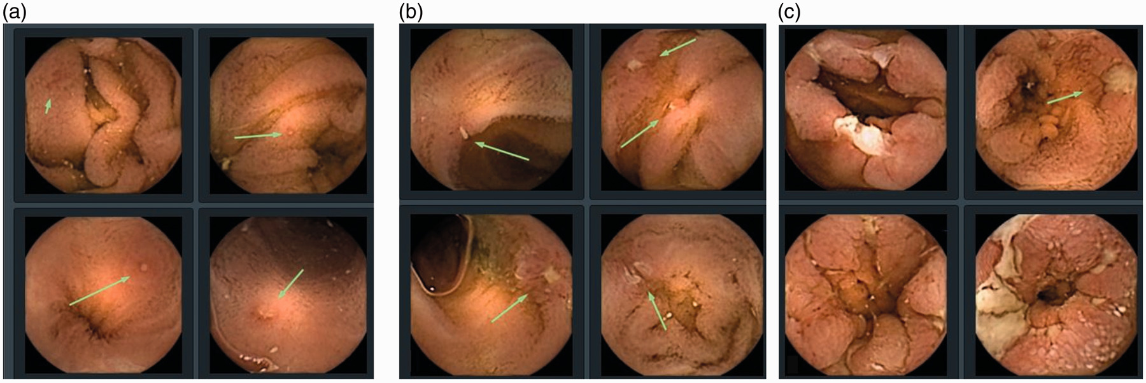
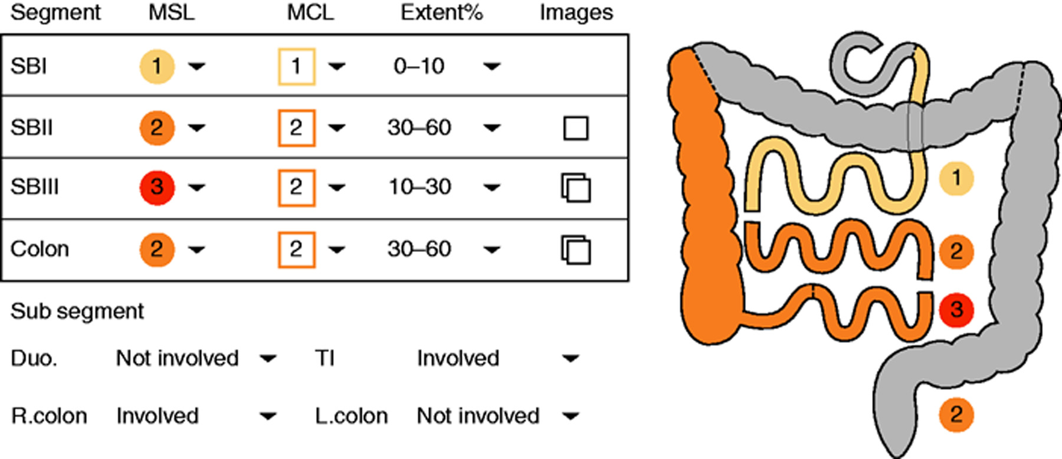
Eliakim Score
A novel PillCam Crohn’s capsule score (Eliakim score) for quantification of mucosal inflammation in Crohn’s disease
United European Gastroenterol. j., Volume: 8, Issue: 5, Pages: 544-551, First published: 01 June 2020

Slide 20
Capsule Endoscopy
Eliakim Score
Segmental Score = [(MCL + MSL) x Extent] + Stricture
Segmental Score = SB1 / SB2 / SB3 / Right Colon / Left Colon
Small Bowel PECC Score = SB1 + SB2 + SB3
PanEnteric PECC Score = SB1 + SB2 + SB3 + Right Colon + Left Colon

Slide 21
ESR
Average | 30 | 17.3 | 12.1
Range | 7 - 81 | 5 - 45 | 2 - 31

Slide 22
Calprotectin
Average | 1263.6 | 852.3 | 440.1
Range | 187->1800 | 73->1800 | 30-1460

Slide 23
Symptomatic scores
HBS | 7.5 | 2.1 | 3.4
mUCDAI | 5 | 0 | 0

Slide 24
Colonic Eliakim Score
Av C-ES | 9.7 | 1.7 | 2.5

Slide 25
Segmental SB Eliakim Score
Average | 5 | 3.8 | 2.8
Range | 0 - 10 | 0 - 14 | 0 - 11
Missing 4
6 Patients = 0
by the 12m

Slide 26
Total Eliakim Score
Average | 13.6 | 6.6 | 5.2
Range | 6-30 | 0-18 | 0-22

Slide 27
Acceptability of PanEnteric Capsule Endoscopy as a means of assessing the treatment outcome of Biological agents in patients with inflammatory bowel disease:
A proof of concept study
The PanEnteric Crohn’s Capsules (PECCs) provide an excellent evaluation of the pan-intestinal extent and severity of IBD, allowing the effects of different treatment regimes to be reviewed with ease. As an alternative to invasive endoscopy it was deemed much more acceptable and preferred.
Other patient benefits included; “less painful”,”didn’t have to take time off from work”, “no after-effects from sedation”,”didn’t have to stay in hospital” and “didn’t have to be accompanied by a family member”.
We feel that PECCs should be considered as a less invasive 1st line assessment tool in the evaluation of Biological therapy in IBD patients.
Further work is needed to optimise the acceptability of our PECC bowel prep regime, whilst still maintaining good views.

Slide 28
The use of PanEnteric Crohn’s Capsules to assess treatment outcome of Vedolizumab in IBD patients:
A 1 year proof of concept study
Medtronic’s PanEnteric Crohn’s Capsules (PECCs) provides an excellent evaluation of the pan-intestinal extent and severity of IBD, and the effects of different treatment regimes.
We feel PECCs should be considered as a less invasive 1st line assessment tool when evaluating the effectiveness of Biological therapy in IBD patients, especially those with small bowel Crohn’s disease.
Whilst Vedolizumab has already been shown to be beneficial in the treatment of colonic inflammation, this proof of concept study also demonstrated its beneficial effect in reducing intestinal inflammation, across all 3 segments of the small bowel.

Slide 29
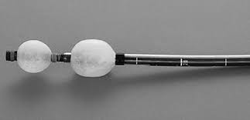
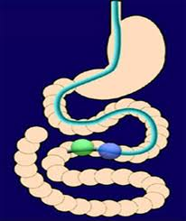
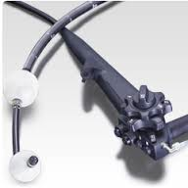
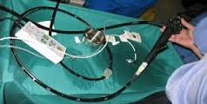
Double Balloon Enteroscopy

Slide 30
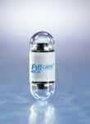
The Future of Capsule Endoscopy
Colon Capsule
Steering
Drug Delivery
Biopsy

Slide 31
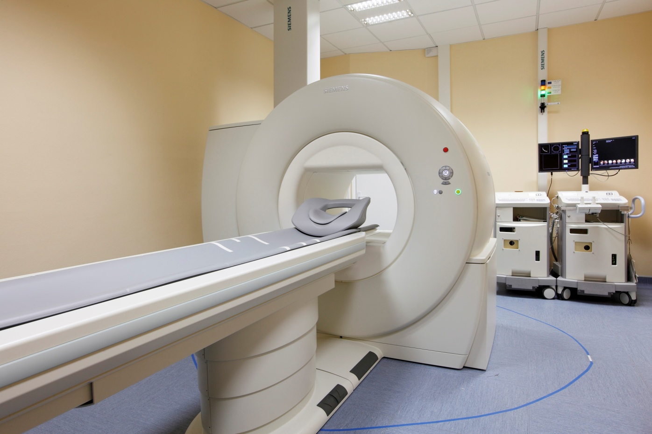
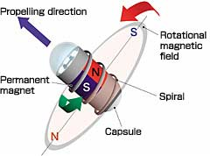
Magnetically Guided Capsule Endoscopy

Slide 32
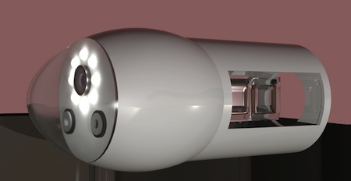
Swimming Capsules

Slide 33
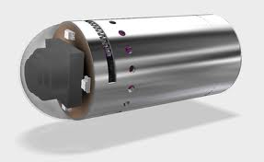
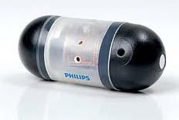
Drug Delivery Capsules

Slide 34
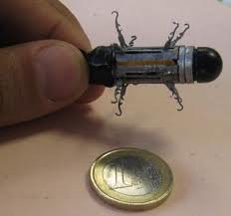
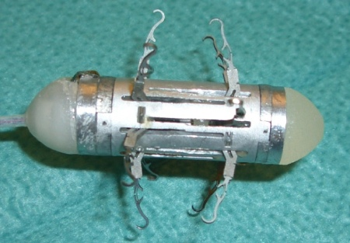
Capsule Robot

Slide 35
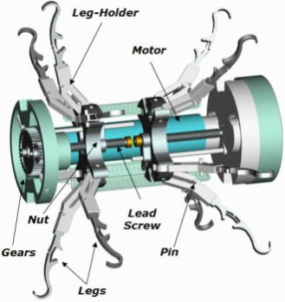
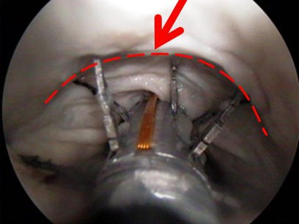
Robotic Capsules

