Slide 1
Microscopic Colitis
Prevalence, Causes, Diagnosis, Treatment, and Surveillance
Dr. Matt W. Johnson | L&D | 2025

Slide 2

European Guidelines - UEG

Slide 3


Symptoms
Chronic >6m
Watery (non-bloody) diarrhoea
OB average 6-7 x / d
Nocturnal defaection 25%
Urgency 55%
Incontinence 26%

Slide 4
Introduction
Guidelines: 2013 (Updated ECCO Guidelines 2021)
Definition:
Chronic inflammatory bowel disease with “watery” (non-bloody) diarrhoea.
Normal macroscopic colonoscopy, but abnormal microscopic histology.
Where other exogenous factors (eg. infection) have been ruled out
Subtypes:
- Lymphocytic colitis LC
- Collagenous colitis CC
- Incomplete microscopic colitis MCi

Slide 5
Epidemiology / Prevalence
Incidence: ~ 0.01%, or 10 per 100,000/year
Prevalence: ~0.12%, or 120 per 100,000 (62 with LC > 50 with CC)
More common in women (>80%)
Peak incidence: 50–70 years, Median age is 60y
Often under-diagnosed

Slide 6
Risk Factors / Causes
Autoimmune conditions (DM, Coeliac, Thyroid disease, Rheumatoid arthritis)
Medications: NSAIDs, SSRIs, PPIs, H2RB, Statins, ACE, ATRB, Parkinson Rx
Smoking (especially collagenous colitis)
Genetic predisposition
Gut microbiome alterations

Slide 7
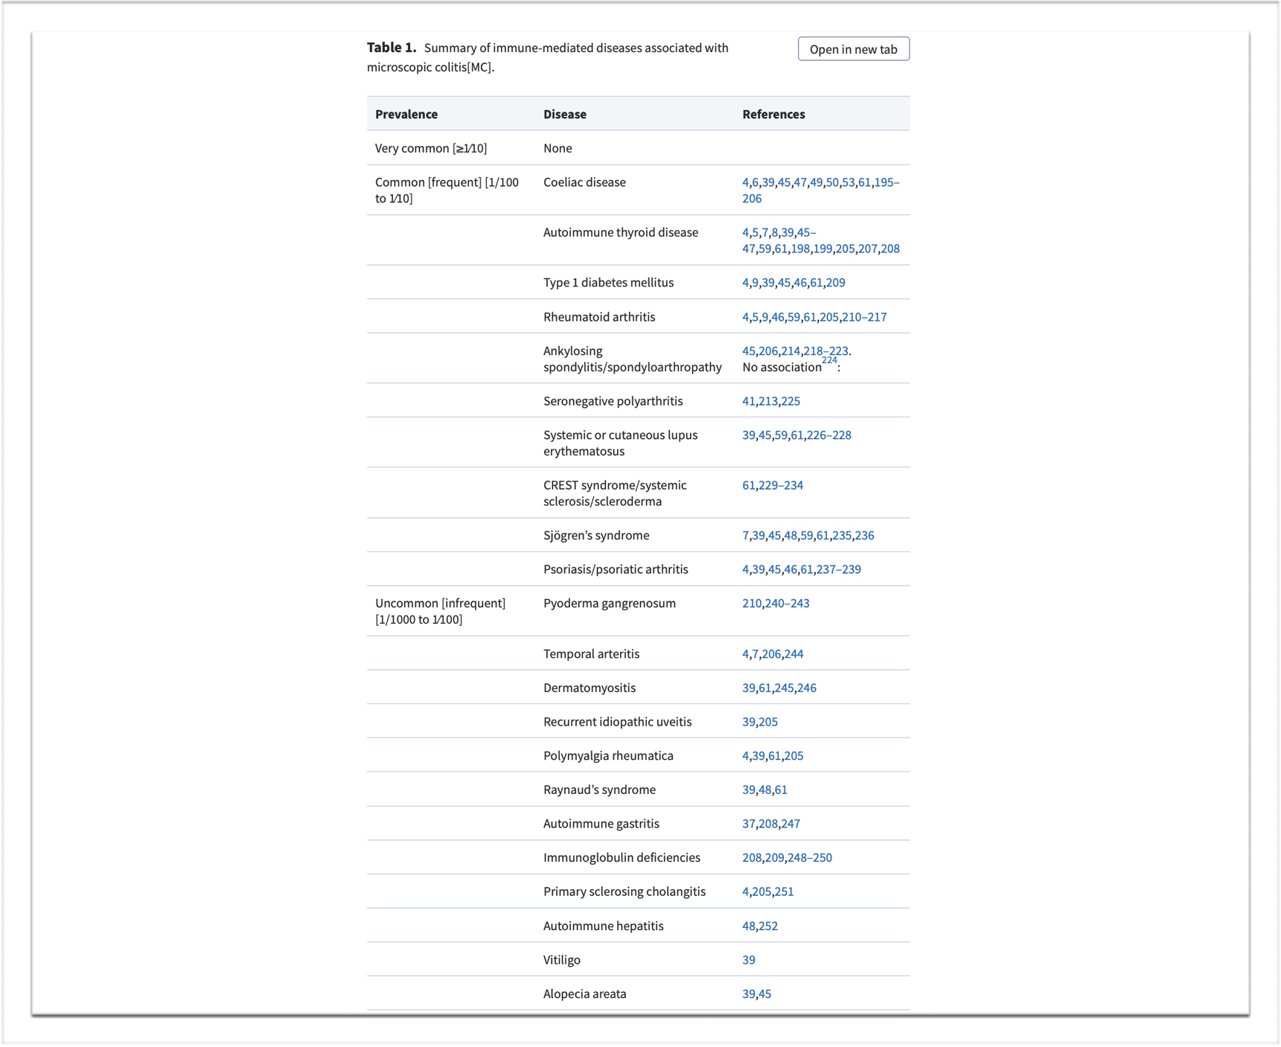
AI Associations
Pathogenesis of Microscopic Colitis: A Systematic Review
Journal of Crohn's and Colitis, Volume 16, Issue 1, January 2022, Pages 143–161

Slide 8
Clinical Aspects
MC accounts for 12.8% of all unexplained chronic diarrhoea
Smoking is a direct risk factor (15-40%, CC > LC),
But stopping doesn’t help
Association with Drugs >6m eg PPIs, NSAIDS and SSRIs,
Withdrawal is recommended (But data is lacking of direct benefit)
Moderate association with IBS symptoms (55%), poor QOL, Fatigue, Ax & Dx

Slide 9
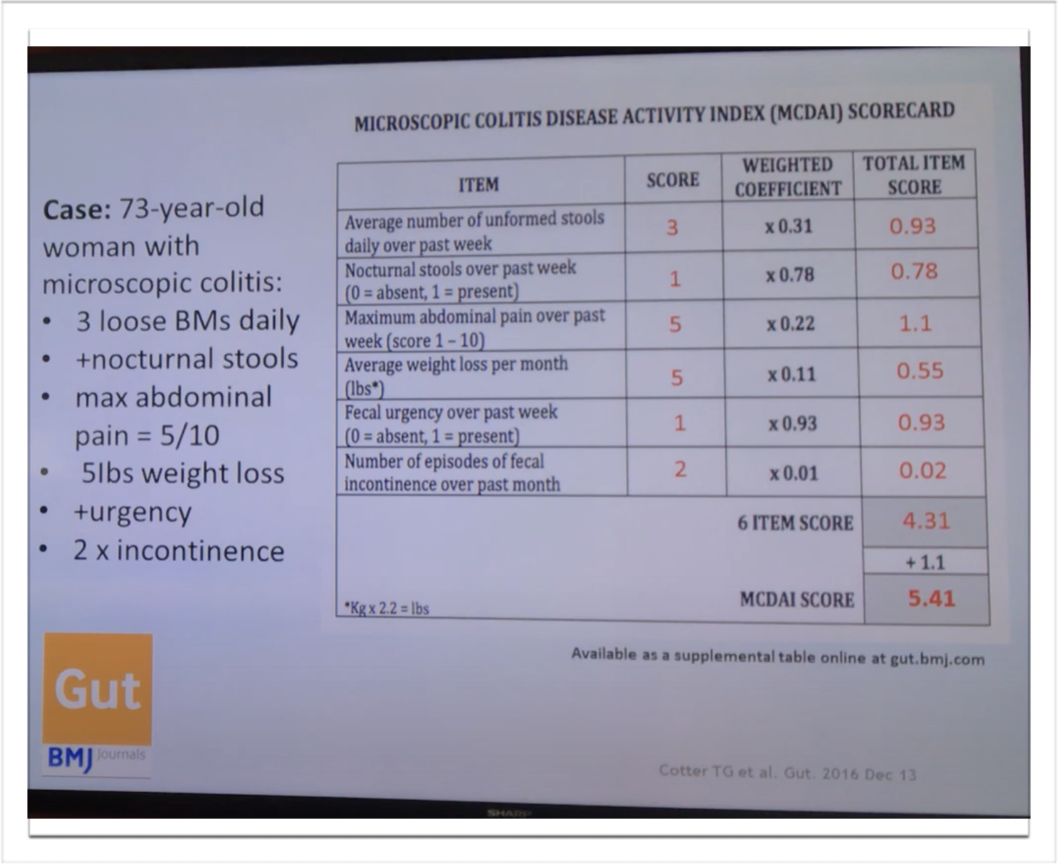
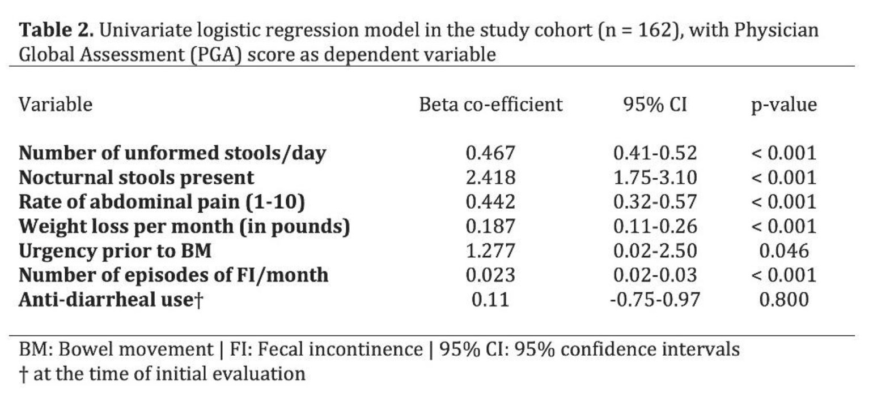
MC Disease Activity Index

Slide 10
Diagnosis
Colonoscopy:
Typically normal mucosa
Histology:
- Lymphocytic colitis: ↑ intraepithelial lymphocytes
- Collagenous colitis: thickened collagen band
Exclude infections, IBD, celiac disease

Slide 11
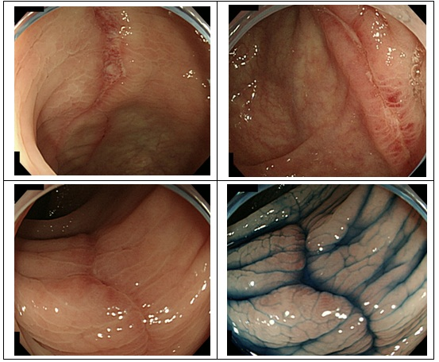
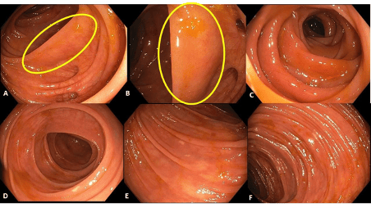
Endoscopic Changes - 38.8%
linear ulcerations
pseudomembranes
irregular vascular patterns
mucosal lacerations
erythema, oedema
nodularity
altered texture
CC
LC

Slide 12
Microscopic Diagnosis
Lymphocytic Colitis
IEL >20 per 100 surface epithelial cells
Increased inflammatory infiltrate in the lamina propria
Collagenous Colitis
Thickened collagenous band >10mm (thicker distally)
Incomplete Microscopic Colitis
Increased inflammatory infiltrate in laminated propria
LCi - IEL 10-20 + an i
CCI - Subepithelial collagen band 5-10mm

Slide 13
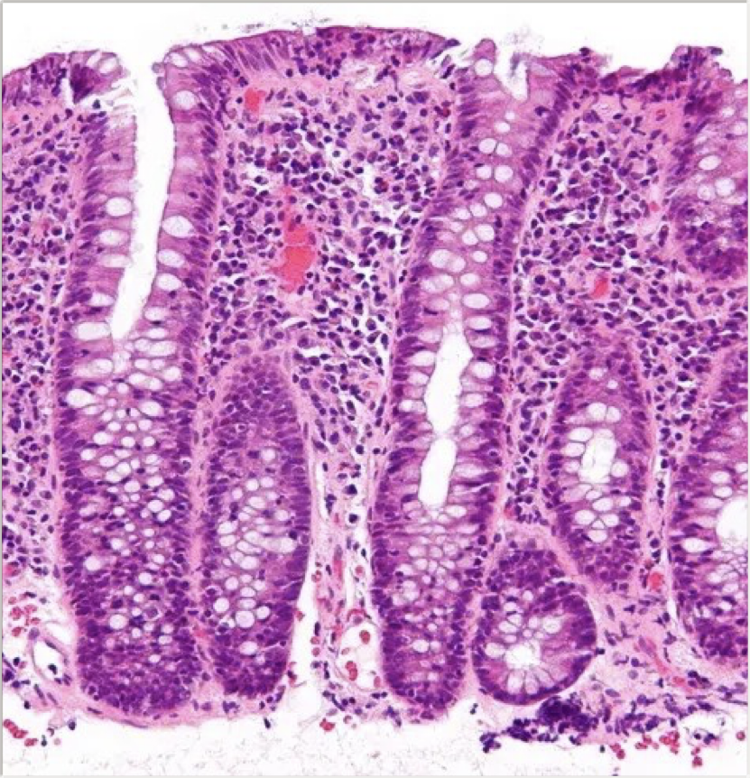
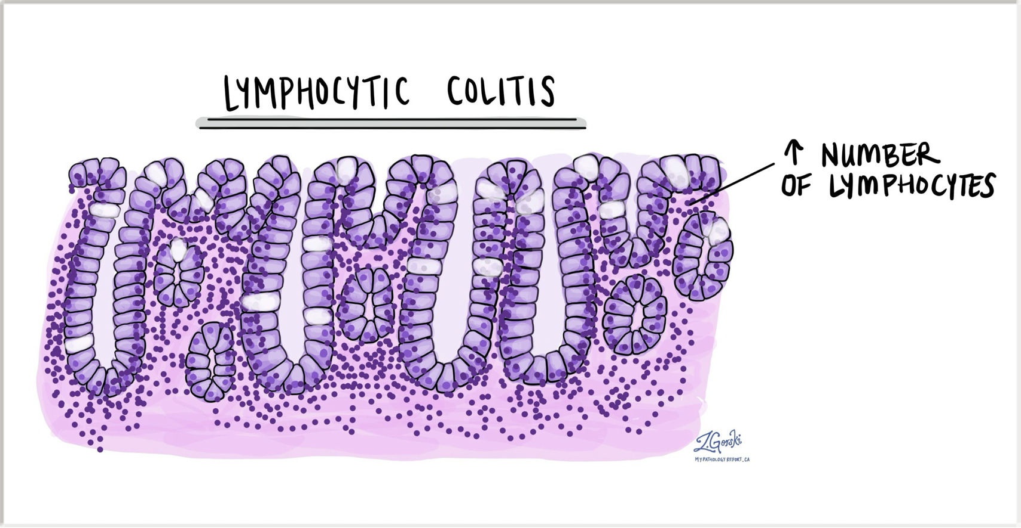
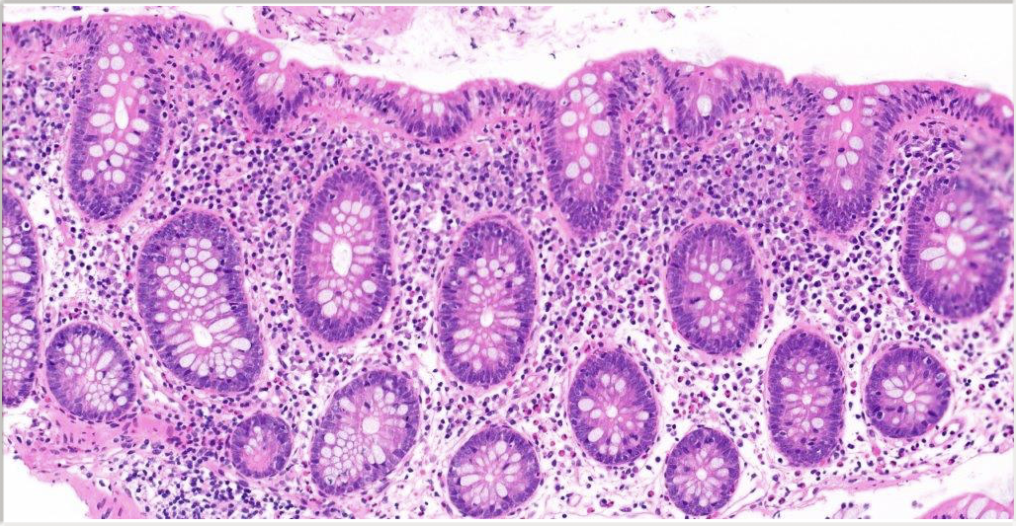

Slide 14
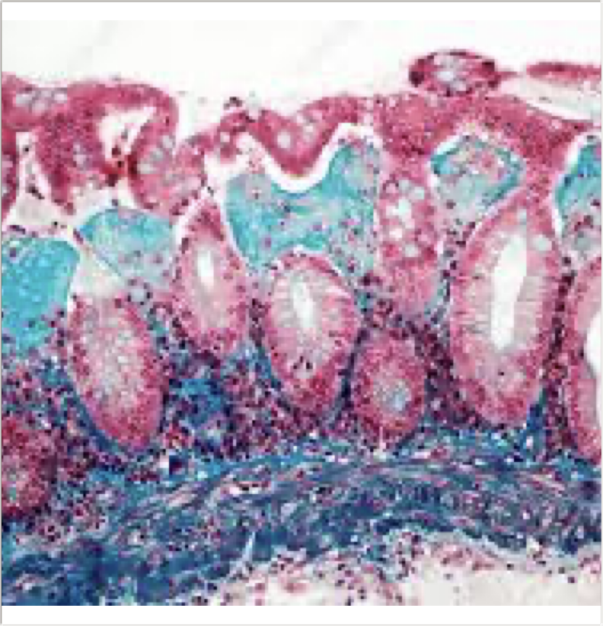
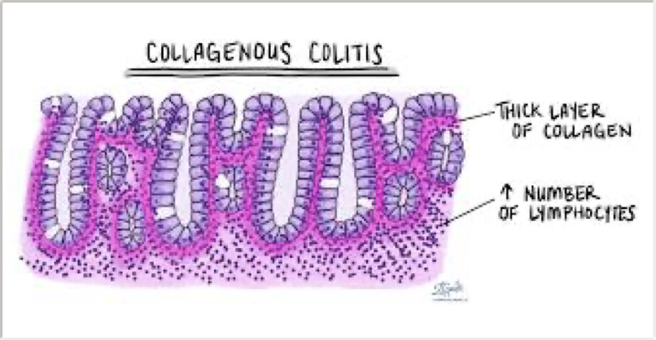
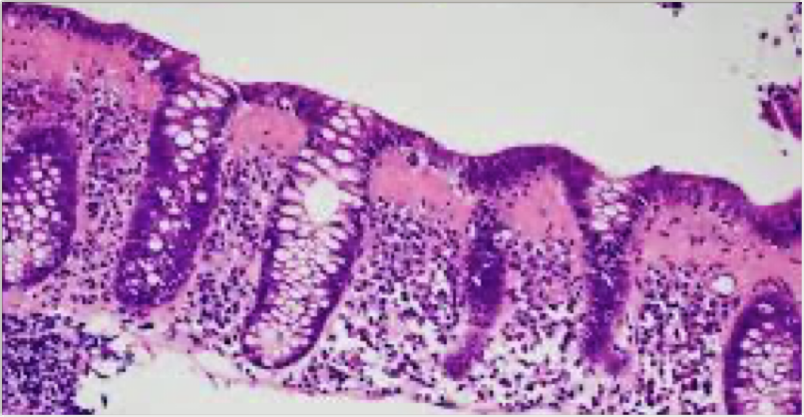

Slide 15
Follow Up
Incidence of Coeliac disease in MC is 2-4% (0.4% in Normal controls)
No direct association with BAM, but bile acids can cause similar microscopic appearances
Calprotectin predictive value is too low, although slightly higher than Normal / IBS
Target should be symptomatic resolution
Histological features persisted at 1 year in 77% CC, 64% LC & 45% MCi
……of whom 6%, 9% and 18% will convert to a different subtype, respectively.

Slide 16



THE OUTCOME OF LOWER GASTROINTESTINAL INVESTIGATIONS IN COELIAC DISEASE: A 12 YEAR RETROSPECTIVE REVIEW FROM A DISTRICT GENERAL HOSPITAL PERSPECTIVE
Jay Patel¹ , Meha Bhuva¹ , Giruba D. Sakthivel² , Kamran Rostami³ ,
Michael N. Marsh¹ , Matt W. Johnson¹
1Gastroenterology, 2Coding Department, Luton & Dunstable University Hospital, Luton, U.K.
3Gastroenterology, Milton Keynes Hospital, Milton Keynes, U.K
Introduction
Lower gastrointestinal (GI) endoscopy is frequently requested in patients with coeliac disease (CD) who present with a change in their bowel habit (CIBH). Constipation is the most common complaint. However, diarrhoea or “looser stools”, regardless of age, and often in the absence of other red-flag features such as weight-loss, is often referred in for colonoscopies review. This is primarily driven by concerns about possible underlying microscopic colitis (MSC). There is, however, little evidence in the current literature to determine direct causation between CD and MSC, whilst the strength of the association is still not fully known.
Aims
We set out to review the number of CD patients
referred locally for lower gastrointestinal (GI) procedures, the primary referral reason and the outcomes.
Method
The Luton & Dunstable University Hospital has a database of 1317 patients with coeliac disease
[Male n= 467, Female n= 850
Age range: 1-102 years old; mean age 58].
Using the database for reference, the hospital coding system was used to analyse the total number of lower
GI endoscopy procedures performed for these
patients during 2005-2016.
Indications for the procedures were identified, along with their further histopathological analysis.
Results 1
Over the 12 year period, the 1317 patients underwent a total of 527 lower GI procedures:
Lower GI procedures were performed for the following primary indications (above)
Results 2
MSC was found in just 4 patients presenting with CIBH (4/252, 1.6%).
Other findings:
Conclusions
48% of the lower GI procedures performed in CD patients were due to CIBH, and MSC was only found in 4/527 (<1%) of these patients, suggesting a weak association.
Melanosis coli was histologically identified in 38.5% of procedures performed for CIBH. We know constipation is a common symptom in CD and melanosis coli is often attributed to use of laxatives; however a direct pathological link between CD and melanosis coli cannot be excluded.
Consultations relating to CIBH in CD patients should focus on constipation and use of laxatives, however, the role of calprotectin +/- endoscopy remains crucial, given the number of new cases of colorectal cancer (20, 4%) and IBD (26, 5%) identified in our CD cohort.
Diagnosis | N=
New lower GI malignancy | 20 (1 for CIBH)
New case of IBD | 26 (16 for CIBH)
Melanosis Coli | 101 (97 for CIBH, 3 for rectal bleeding and 1 for anaemia)
PTU-136

Slide 17
Treatment (Stepwise)
1. STOP offending drugs eg. Metformin
2. Antidiarrheals (loperamide + cholestyramine)
3. Budesonide (first-line, highly effective), 60-80% relapse at 3m, consider longer tailored dosing
4. Alternatives: mesalamine (42-75% effective), bismuth
5. Diet modification (gluten/lactose trial if needed)
6. In Resistant cases - AZA, MTX, anti-TNF’s, Vedolizumab
…………Remission < 3x a day, and <1 watery stool (Hjortswang criteria)

Slide 18
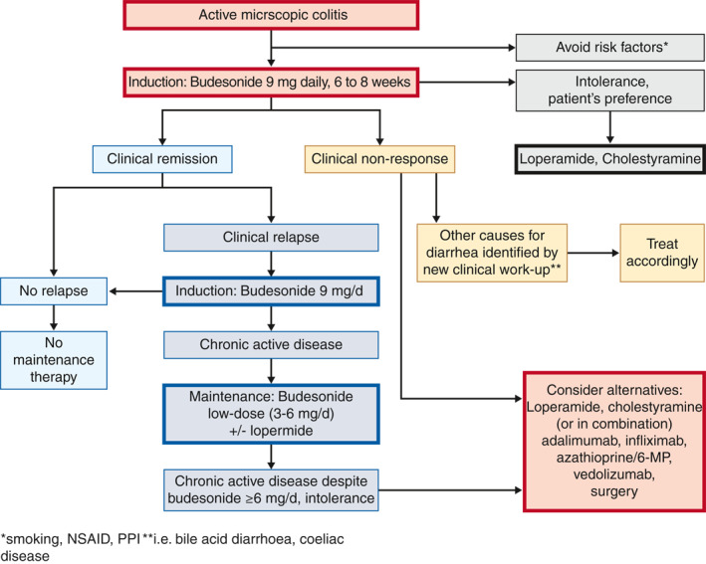

Slide 19
Prognosis & Surveillance
Chronic relapsing-remitting course
No routine colonoscopies surveillance - No increased risk of CRC
It actually has a negative association for Adenoma + CRC
Follow-up focused on symptoms and QOL

Slide 20
References
ACG Clinical Guideline: Management of Microscopic Colitis (2016)
Miehlke S. et al. 'Microscopic Colitis: Current Perspectives' (2021)
ECCO Guidelines on Microscopic Colitis (2020)
European guidelines on microscopic colitis: United European Gastroenterology and European Microscopic Colitis Group statements and recommendations
United European Gastroenterol J. 2021 Feb 22;9(1):13-37

Slide 21
Oddities
10% of IBS-D
Calprotectin use > 100 (acute flare often >150)
Patchy, Transitional, Rectal sparing in 30%.
Random Colonic biopsies, Right sided biopsies more definitive,
Microscopic, but 30% have subtle macroscopic Endoscopic findings
Are LC + CC two distinctly different entities ? 6-18% transform at 1y,
1-3% develop full IBD
Is it more common in Coeliac ? - 2-4% is Debatable
Budesonide tapering dose + 9/6/3mg (6mg assoc with 2% BMD loss over 2y, 0% with 3mg)

Slide 22
Radiation Proctitis
Appearance & Management
Dr. Matt W. Johnson | L&D | 2025

Slide 23
Radiation Proctitis Symptoms
Urgency
Diarrhoea
PR Bleeding
Mucus
Tenesmus

Slide 24

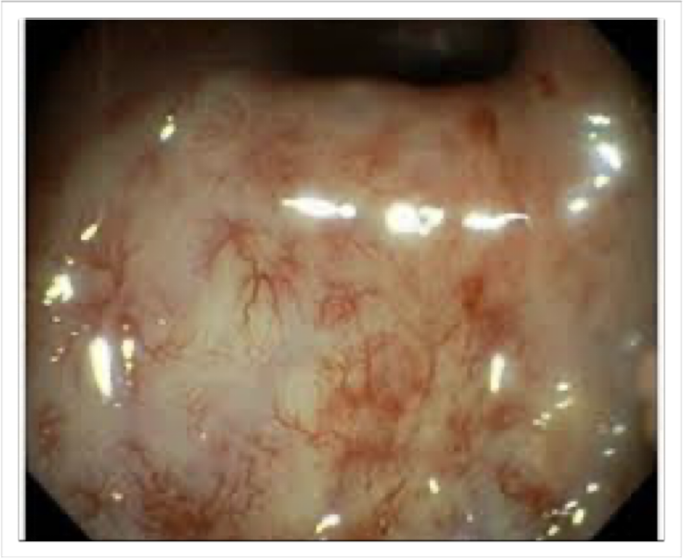
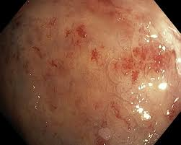
Endoscopic Appearance
Don’t Biopsy - It’s ischaemic & doesn’t heal well !!

Slide 25
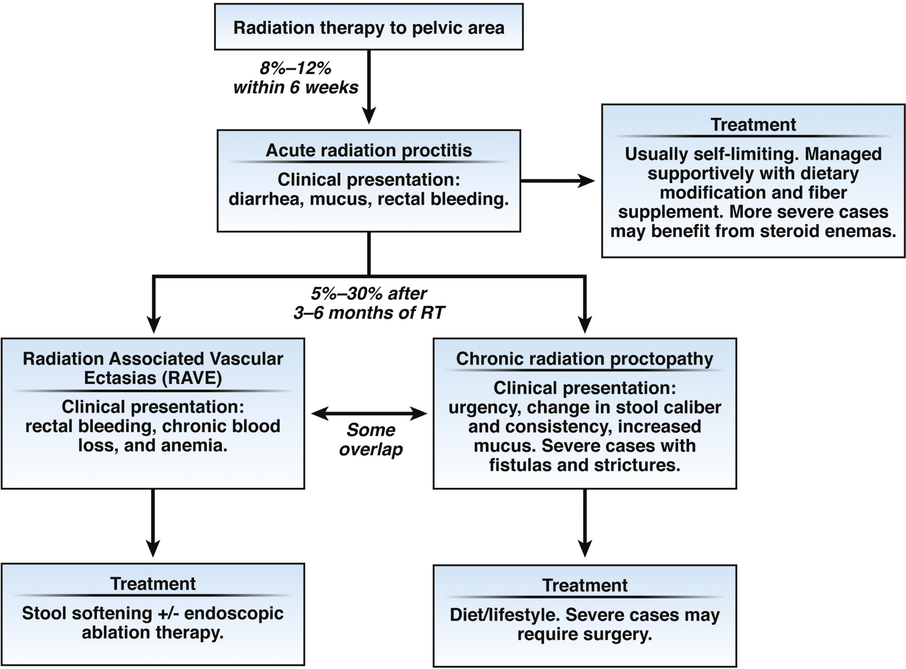
Treatment Options
Sucralfate Enemas Purostat 5ml e3m
RFA not APC 4%

Slide 26
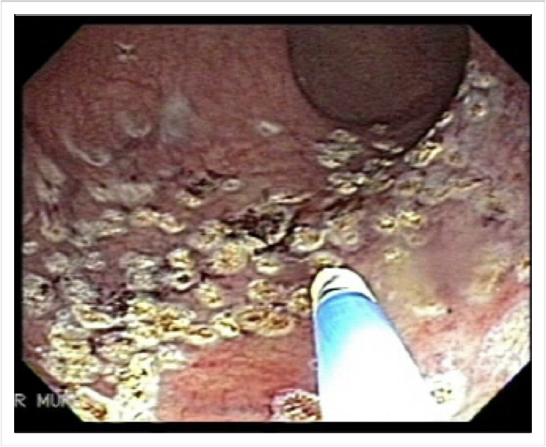
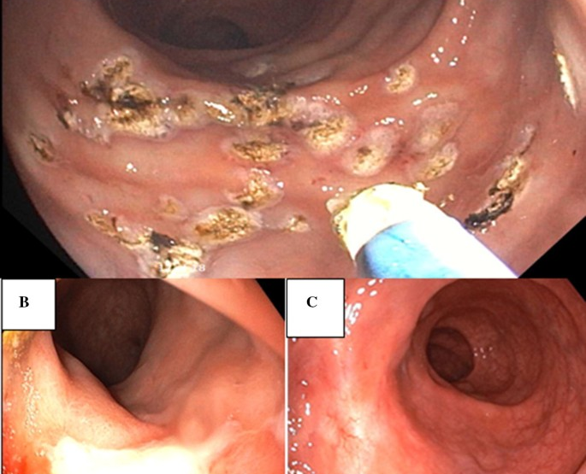
RAVE = Targeted RFA
👌🏻
😳

Slide 27
Chronic Radiation Proctopathy
1) Sucralfate Suspension 1g per 5ml (ie. 2g in 10ml)
2) Mix with 10mls warm water, in a 60ml Syringe
3) Attach 14-French rubber urethral catheter
4) Then use Lubricating Jelly (42g tube)
5) Lie on a towel on left side
6) Pump + Hold
Based on Patient Information from The Royal United Hospital Bath

