Slide 1




IBD Sx & Cancer Risk
Dr. Matt W. Johnson

Slide 2
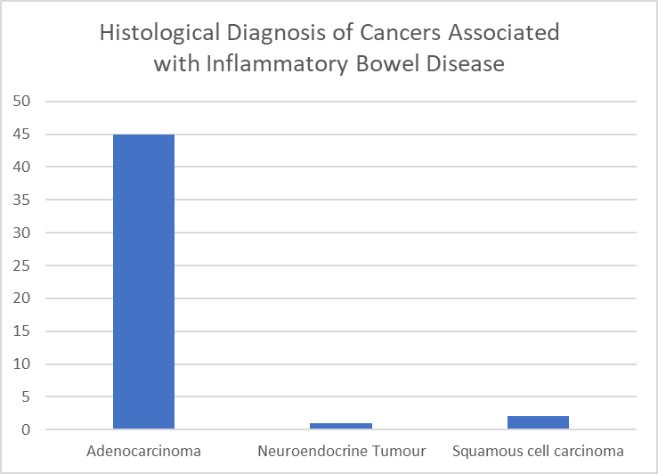
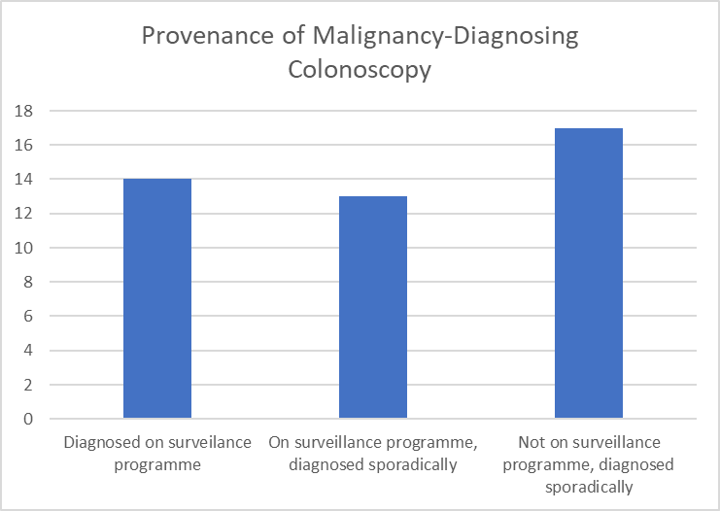


THE OUTCOME OF COLONOSCOPIC SURVEILLANCE AND SURGERY IN A COHORT OF INFLAMMATORY BOWEL DISEASE PATIENTS WHO DEVELOPED COLORECTAL CANCER OVER A 12 YEAR REVIEW PERIOD AT A DISTRICT GENERAL HOSPITAL
MW Johnson¹, LB Johnson², J. Wye¹, K. Kabiru¹
Gastroenterology Unit, Luton & Dunstable FT University Hospital, Luton, United Kingdom
Manchester University, Medical School, Manchester, United Kingdom
Introduction
The annual mortality from colorectal cancer (CRC) in patients with inflammatory bowel disease (IBD) is quoted at 2% per year, and accounts for 10-15% of all the deaths seen in IBD patients. The 5 year survival rate is 50%[1]. Given these risks the British Society of Gastroenterology (BSG) recommends surveillance colonoscopy every 1, 3 or 5 years, starting 8-10 years from the onset of symptoms, depending on the extent and severity of the underlying IBD.
We set out to review the effectiveness of this colonoscopic surveillance programme in our IBD cohort.
Methods
A 12 year retrospective review was made of a district general cohort of IBD patients, cross correlating their outcomes with the documentation and datasets of our local histopathology department, endoscopy unit reporting system and decision making process through the multi-disciplinary cancer team network.
We then assessed;-
whether the BSGs surveillance guidelines were being adhered to and
whether it made an impact to the patients outcome.
Results 1
The data of 2142 local patients listed on the National IBD Registry database (0.65% of the local population) were analysed. 45 patients went on to develop CRC (4%), on average 12.8 years after the onset of their IBD (0-55y, median =9.5y).
Of those 45 IBD patients, 23 had ulcerative colitis (UC) and 22 had Crohn’s disease (CrD).
There were 2x squamous cell cancers, 1x neuroendocrine cancer and 45 adenocarcinomas.
Results 2
3 of the UC patients went on to develop 2 cancers each. 26 (54%) were distal, 6(13%) were left, 15(31%) were right and 1(2%) was small bowel. 9 patients had left sided or distal strictures (1UC +8CrD). 44 of the 45 were diagnosed at colonoscopy. Only 14 of these were diagnosed during their surveillance assessments, 9 of which were compliant with the BSG guidelines and 5 were non-compliant. 30 cases were picked up sporadically (due to symptom assessments), despite 13 of these being actively involved with a regular colonoscopic surveillance programme.
Conclusion
Over the 12 year review period 45 (4%) of our IBD patients developed CRC. In total 27 (60%) of these patients were on a colonoscopic surveillance programme, with the intention that these procedures could potentially identified cancers at an earlier stage, and therefore offer better longterm surgical out-comes and survival rates.
14 of the 45 CRCs (31%) were picked up in the surveillance group, leading to an early diagnosis in 9 of these, when the surveillance was compliant with the BSG guidelines. 50% of the surveillance colonoscopic timings were non-compliant with the the BSG’s recommendations, and had not been performed at the recommended time intervals, potentially delaying these asymptomatic pick ups.
A majority of the CRC cases (30, 68%) were picked up sporadically, including 13 of the 27 who were already under-going routine colonoscopic surveillance, but had presented for earlier review due to symptoms.
These results question the effectiveness of our present surveillance programme and highlight the need for organised, dedicated IBD surveillance lists, run by experienced endoscopists, with appropriate time set aside for effective surveillance, to optimise an early pick rate.
References
[1] Colorectal cancer in inflammatory bowel disease: review of the evidence. Tech Coloproctol. 2019 Jan;23(1):3-13. Keller DS, Windsor A, Cohen R, Chand M
The authors declare no conflict of interests
Copyright © 2020 John Wye john.wye1@nhs.net Abstract No. P0315

Slide 3
Acceptability of PanEnteric Capsule Endoscopy as a means of assessing the treatment outcome of Biological agents in patients with inflammatory bowel disease:
A proof of concept study
The PanEnteric Crohn’s Capsules (PECCs) provide an excellent evaluation of the pan-intestinal extent and severity of IBD, allowing the effects of different treatment regimes to be reviewed with ease. As an alternative to invasive endoscopy it was deemed much more acceptable and preferred.
Other patient benefits included; “less painful”,”didn’t have to take time off from work”, “no after-effects from sedation”,”didn’t have to stay in hospital” and “didn’t have to be accompanied by a family member”.
We feel that PECCs should be considered as a less invasive 1st line assessment tool in the evaluation of Biological therapy in IBD patients.
Further work is needed to optimise the acceptability of our PECC bowel prep regime, whilst still maintaining good views.

Slide 4
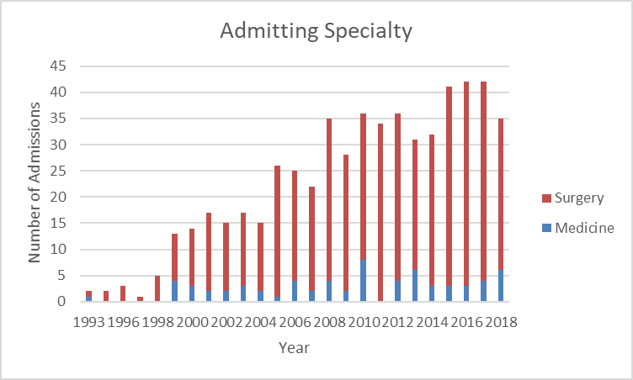
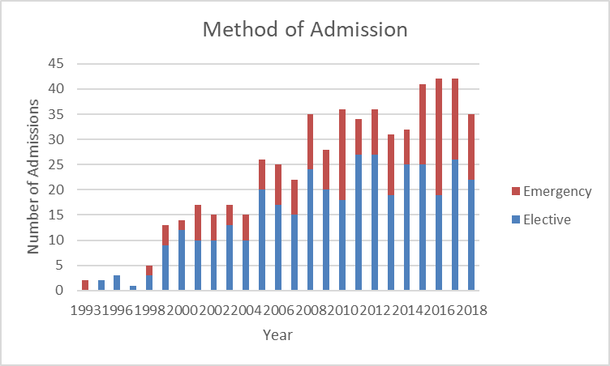
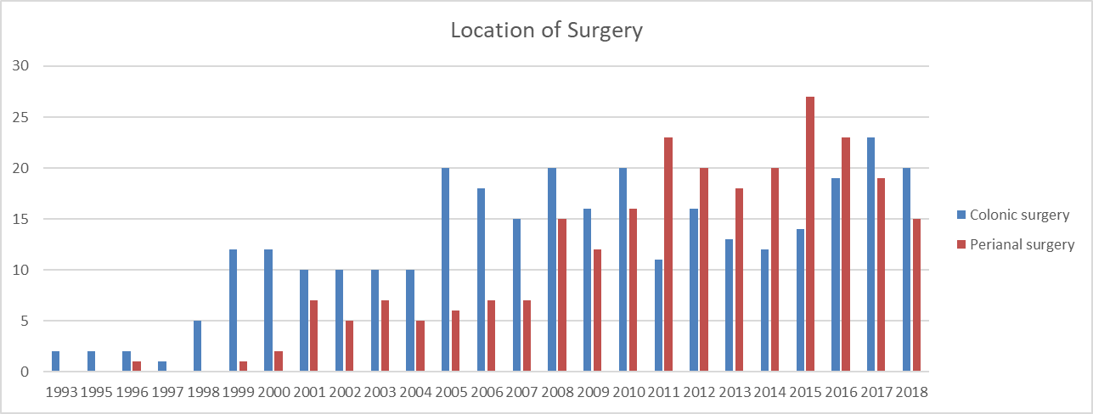
The changing trends seen with surgery in patients with inflammatory bowel disease over a 25 year review period
J. Wye, K. Kabiru, MW Johnson
Gastroenterology Unit, Luton & Dunstable FT University Hospital, Luton, United Kingdom
Introduction
In days gone by surgery was seen as the main stay of treatment for IBD patients whose condition failed to settle on traditional systemic steroids. Since then we have had clinical practice engage with mesalazine, immuno-modulators and more recently biological and disease modifying drugs. The role of the surgeon still remains critical within the team, especially in the emergency situations and when these alternative therapies fail. We were keen to explore the impact that this may have had on surgical demand.
Methods
In this 25 year retrospective cohort analysis we analysed the 3687 IBD patients on our local IBD database who had previously been coded by the Trust to have undergone colo-rectal or peri-anal surgery. All patients listed to have had endoscopic surgery or haemorrhoids banding were excluded. We performed multivariate analysis on the number of procedures being performed year on year over that 25 year period to see if the introduction of immunomodulators and biologics had any impact on the surgical rates at our local DGH.
Results
Immunomodulators were infrequently used until 2009, but by 2014 greater than 600 patients were prescribed a range of azathioprine, 6-mercaptopurine, and methotrexate. Likewise, biologics were introduced in 2011 for local IBD patients, and their use has steadily increased to 100 in 2015, 320 by 2018 and 417 by March 2021. Annual colorectal surgical rates steadily climbed from 2 per year in 1991, to 20 in 2005, before hitting a plateau of 20 by 2018. Annual peri-anal surgical rates also climbed from 1 in 1996 to a peak of 27 in 2015, before steadily dropping down to 15 in 2018.
Conclusion
The demand on surgery amongst our local cohort of IBD patients seems to be falling in the last 2-4 years. The introduction of immunomodulators in 2009 seems to have had a temporal effect on plateauing the increasing need for colorectal surgery, whilst the introduction of biological therapy in 2011 seems to have had more of a temporal effect on reducing the rates of peri-anal surgery from 2015.
The authors declare no conflict of interests
Copyright © 2021 John Wye
john.wye1@nhs.net
Abstract No. P0515

Slide 5
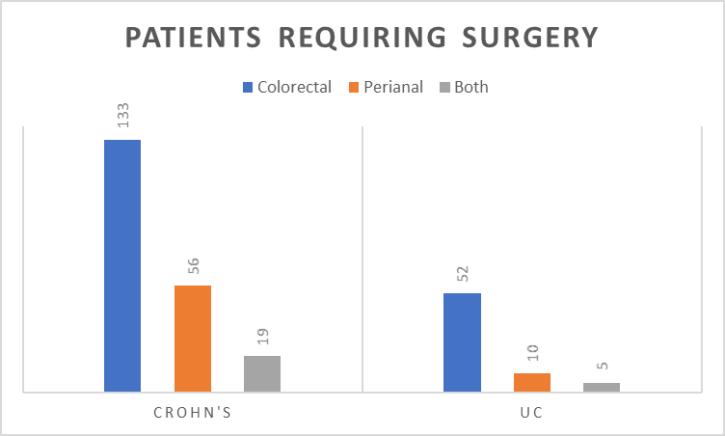
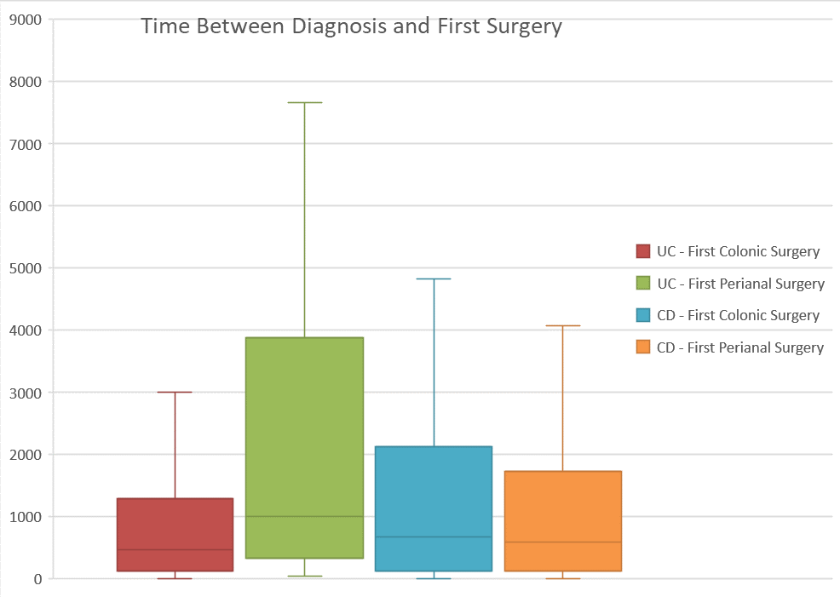
Prevalence of first time surgery amongst inflammatory bowel disease patients at a district general hospital:
A 25 year retrospective review
J. Wye, K. Kabiru, MW Johnson
Gastroenterology Unit, Luton & Dunstable FT University Hospital, Luton, United Kingdom
Introduction
In UK the prevalence of inflammatory bowel disease (IBD) has been quoted at 0.7% of the population [1]. Some of these patients will go on to need surgery, depending on a range of risk factors, such as age and disease type. The risk of needing surgery after 10 years with Crohn's disease (CrD) is said to be as high as 46.6%, which is considerably higher than the the 15.6% seen in patients after 10 years of ulcerative colitis [2]. We performed a 25 year retrospective study in our local IBD cohort to assess the number presenting for the first time requiring surgery within this group of patients.
Methods
3687 IBD patients are listed on our local IBD database, that provides a service for a catchment of 330,000. This indicates a local prevalence of 1.1%. A 25 year retrospective analysis was performed, analysing all the Trust’s coding records on our IBD cohort, to determine the number that subsequently went on to re-quire either colo-rectal or peri-anal surgery. All patients listed to have had endoscopic surgery or haemorrhoids banding were excluded. We performed multivariate analysis on recorded variables to ascertain risk factors for recurrent surgery. Variables analysed included age at diagnosis, gender, location of first surgery, and presence of perianal disease.
Results 1
During the 25 year study period 337 (9.1%) of our 3687 IBD patients underwent surgery for the first time. 232 (68%) of these needed colonic surgery alone and 78 (23%) peri-anal surgery alone; 27 (3%) of patients required surgery at both locations.
Of the 67 UC patients who needed surgery, 52 (78%) underwent colorectal surgery and 10 (15%) needed peri-anal surgery, with 5 patients (7%) needing both.
Of the 208 CrD patients who needed surgery, 133 (64%) needed colonic surgery alone and 56 (27%) needed peri-anal surgery alone, with 19 (9%) requiring both.
Results 2
62 of the patients requiring surgery were listed as having indeterminate colitis. The time to first surgery for a UC patient on average was 1329 days, with the average time to colorectal surgery being 1110 days, and the average time to peri-anal surgery being 2580 days. The time to first surgery for a CrD patient on average was 1560 days, with the average time to colorectal surgery being 1697 days, and the average time to peri-anal surgery being 1782 days.
A range of risk factors were assessed but only perianal disease was found to be an independent variable risk factor in Crohn’s patients.
Conclusion
Over a 25 year period the prevalence of surgery in our local IBD cohort was lower than expected at 9.1%. 62% had Crohn’s disease, 20% had UC, and 18% were listed as indeterminate colitis. It is possible that over time, as our clinical management has improved with an array of new therapeutic options now available (such as the Biological therapies) that we are finally starting to change the disease course and outcome of these conditions, especially if used earlier in the disease pathway.
More specifically the prevalence of surgery in our UC cohort was 5.4%, with the average time from diagnosis to 1st surgery being 1329 days (approximately 3.6 years). The majority of these needed colo-rectal surgery (85%) as compared to per-anal surgery (22%).
Within the larger Crohn’s disease cohort the prevalence of surgery was higher at 15.8%, with a larger proportion of peri-anal surgery. The average duration of disease prior to 1st surgery was 1560 days (approximately 4.3 years). Perianal disease was the only independent variable found that predicted surgery in Crohn’s patients.
References
[1] BMJ Open. 2020 Jul 19;10(7): e036584
[2] Gastroenterology. Vol 145, Issues 5, P996-1006, Nov 01, 2013
The authors declare no conflict of interests
Copyright © 2021 John Wye john.wye1@nhs.net Abstract No. P0512
Notes:
P0512
Hello my name is John Wye and today I’m going to be talking through our poster on first-time surgery among patients with inflammatory bowel disease, or IBD.
In this poster we sought to answer the question: what proportion of our patients with inflammatory bowel disease go on to require surgery? Previous studies have estimated the cumulative risk of surgery in Crohn’s as as much as 46% after ten years, whereas ulcerative colitis has a cumulative risk of surgery of 15% after ten year of follow-up in the literature.
We performed a retrospective analysis on our local IBD database; this database has 3687 patients listed over the past 25 years. From our hospital database we extracted the coding records indicating a surgery had been performed on the colon or perianal area for these patients. We excluded minor procedures from our study; these included endoscopic procedures and haemorrhoidectomies.
As you can see, we had a sample of 337 patients who underwent an initial surgical operation under our care. 68% of them required operations on the colon; 23% of them were operations on the perianal area; and 8% of them required operations in both areas.
When looking at our patients with ulcerative colitis, 78% of them underwent colorectal surgery alone compared to 15% who underwent perianal surgery and 7% who required surgery in both areas.
Looking at patients with Crohn’s disease, 64% of them required colorectal surgery alone; 27% of them had perianal surgery alone; and 9% of them required surgery in both areas.
When comparing the Crohn’s and ulcerative colitis groups, it is clear that a greater proportion of Crohn’s patients required perianal surgery compared with colorectal surgery when compared with the Ulcerative Colitis cohort. Our database has similar numbers of patients with Crohn’s and patients with Ulcerative Colitis; when comparing the number requiring surgery it is clear that many more patients with Crohn’s require surgery than those with Ulcerative Colitis.
When comparing time to surgery we find a picture of similarity between those diagnosed with Crohn’s and those diagnosed with Ulcerative Colitis. The average patient with Ulcerative colitis waits over three and a half years after diagnosis before requiring surgery; for Crohn’s this period is four point three years. These intervals are similar when these patients are subgrouped into those requiring perianal surgery and those requiring colonic surgery; there is, however, a marked prolongation of the period for patients with an initial diagnosis of ulcerative colitis who had perianal surgery. This is interesting and nicely represents the diagnostic dilemma often faced by gastroenterologists when faced with a patient with colitis fitting the phenotype of both Crohn’s colitis and Ulcerative colitis; as our study used phenotype at time of diagnosis this is nicely captured by our 25-year follow-up.
When comparing with previously published statistics on requirements for surgery in inflammatory bowel disease, our statistics are rather smaller; for Ulcerative Colitis the cumulative risk of requiring surgery was 5.4% and the risk of requiring surgery in Crohn’s disease was 15.8%; this is based on an average follow-up time of 13 years. Perianal disease was more common in Crohn’s patients; and a perianal phenotype predicted need for surgery.
I hope that this presentation has been helpful for you in showing some basic figures on the requirement for surgery in our cohort of over 3600 patients over the past 25 years. If you have any questions, please feel free to email me on the address below.

Slide 6
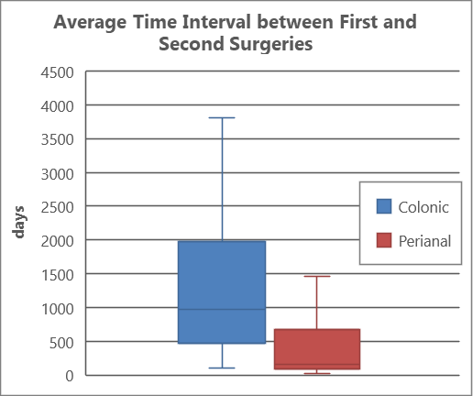
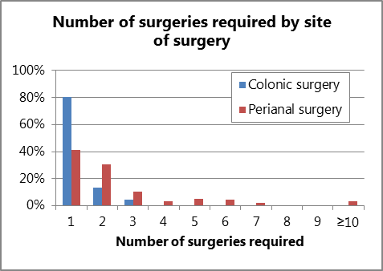
Redo Surgery in IBD Patients: What is the Time Interval and Is This Affected by Specific Risk Factors?
J. Wye, K. Kabiru, MW Johnson
Gastroenterology Unit, Luton & Dunstable FT University Hospital, Luton, United Kingdom
Introduction
Within our local catchment we have a higher than average prevalence of IBD of 1.1% (3687/330,000).
Previous studies have suggested that for those with Crohn’s disease the risks of surgery at 1, 5, and 10 years (after diagnosis) are 16.3%, 33.3% and 46.6%, respectively.
For Ulcerative colitis these risks at 1, 5, and 10 years (after diagnosis) are 4.9%, 11.6%, and 15.6%, respectively [1].
Less is known about the risks of redo-surgery after the first episode.
Methods
A 25 year retrospective analysis was performed on a local cohort of 3687 IBD patients, who had been coded as having undergone colo-rectal or peri-anal surgery. All patients listed to have had endoscopic surgery or haemorrhoids banding were excluded.
We performed multivariate analysis on recorded variables to ascertain risk factors for recurrent surgery. Variables analysed included age at diagnosis, gender, location of first surgery, and presence of perianal disease.
Results 1
337 (9.1%) of our 3687 IBD patients underwent 464 surgical procedures over the 25 year study period. 103 of these patients required 230 repeat surgical procedures during the study period. In total 259 (7.0%) had colonic surgery, of which 43 (17%) went on to have a further 52 colo-rectal surgical procedures. In total 105 (2.8%) had peri-anal surgery, of which 52 (49.5%) went on to have a further 151 procedures. 27 patients had surgical procedures in both locations and are included in both the above statistics.
Results 2
For those undergoing the colonic surgery 83% required just 1 operation, 14% required 2, 3% required 3 procedures and 0% required 4 or more. For those undergoing perianal surgery, 50% required 1 procedure, 25% required 2, 10% required 3, with 15% requiring more than three procedures, including 3% who required more than 10 procedures.
The average time interval between 1st and 2nd colo-rectal and peri-anal surgeries were 1204 days (3.3 years) and 591 days (1.6 years), respectively.
Conclusion
Over a 25 year period the prevalence of surgery in our local IBD cohort was lower than expected at 9.1%. However, once a patient has surgery, the need for repeat (redo) surgery was 30.5%, of which 29% were colonic and 71% were peri-anal procedures.
Over a 25 year period the prevalence of surgery in our UC cohort was 3.4%, whilst in our Crohn’s disease cohort this prevalence was found to be slightly higher at 5.6%.
After colo-rectal surgery the chances of needing further colo-rectal surgery was 17%. The average duration between the 1st and the need for a 2nd colo-rectal surgical procedure was 3.3 years.
After having per-anal surgery the chances of needing repeated peri-anal surgery was 49.5%. The average duration between the 1st and the need for a 2nd peri-anal surgical procedure was 1.6 years.
Perianal disease was the strongest predictor for repeat surgical intervention.
References
[1] BMJ Open. 2020 Jul 19;10(7): e036584
[2] Gastroenterology. Vol 145, Issues 5, P996-1006, Nov 01, 2013
The authors declare no conflict of interests
Copyright © 2021 John Wye john.wye1@nhs.net Abstract No. P0513
Notes:
Hi my name is John Wye and today I’m going to be talking through our poster on redo surgery in IBD patients.
This is a retrospective study on the need for repeat surgery in patients attending our Gastroenterology clinic with IBD.
The motivation for this study is clear: the decision for surgery in IBD is often a difficult one and the potential need for repeat surgery will have a significant bearing on this decision. Up till now, there have been few studies focused on re-resection after the initial surgical resection; the pair of studies we found had sample sizes of less than a hundred patients.
To locate the data for this study, we collated a list of patients from our local IBD registry, where we keep a log of every patient with IBD diagnosed within our catchment area.
To create the statistics presented, we pulled the diagnosis codes of these patients from our hospital system looking for specific surgeries on the colon or the perianal area. We had to exclude some minor operations that were unlikely to be related to IBD, such as haemorrhoidectomy. We then collated our data to look at the journey of each patient.
As you can see, we had a sample of 337 patients who underwent an initial surgical operation under our care. 103 of them required a repeat operation or approximately 1 in 3, which is similar to previously published studies on the subject. However, when we separated out the patients who had undergone perianal surgery from those who had undergone colonic surgery, a big difference was seen. Patients who had undergone surgery on the colon had a re-resection rate of 17%, or just under one in six. Comparatively the patients who had undergone surgery on the perianal area had a re-do rate of 49.5%, or one in just two. These rates were statistically significant to the 5% level.
We did include patients who had had surgery at both locations in each statistic, assuming that the risk of surgery of the colon was independent of that of the perianal area. However, even excluding these patients the relative risk was still significant; the rates were similar if not more divergent.
These results are summarised in the second table below. Surgery of the colon is coloured blue and are the columns on the left; perianal surgery is coloured red and are the columns on the right. The need for colonic surgery sharply drops off after the first one, with no-one requiring more than three procedures on the colon. For perianal surgery the results are very different. Almost as many people required two or more operations as had only one operation; some patients even required ten or more separate operations.
When analysing the time interval between the first surgery and a repeat operation, perianal surgeries came out ahead again. As you can see from the box plot, patients with colonic surgeries, represented by the blue box on the left, waited longer before a repeat surgery than did those with perianal surgery, represented by the red box plot on the right. The mean average time interval between 1st and 2nd colorectal surgeries was 3.3 years, compared with 1.6 years between first and second perianal surgeries, approximately twice the amount of time.
This study clearly shows how different the disease phenotypes are between IBD affecting the colon and that affecting the perianal area. I hope that it will be useful to inform clinical discussion as well as giving representative information to our patients when deciding on the right course of treatment for them.
143. Polle SW, Slors JF, Weverling GJ, Gouma DJ, Hommes DW, Bemelman WA. Recurrence after segmental resection for colonic Crohn's disease. Br J Surg. 2005;92(9):1143-9.
144. Martel P, Betton PO, Gallot D, Malafosse M. Crohn's colitis: experience with segmental resections; results in a series of 84 patients. J Am Coll Surg. 2002;194(4):448-53.

Slide 7
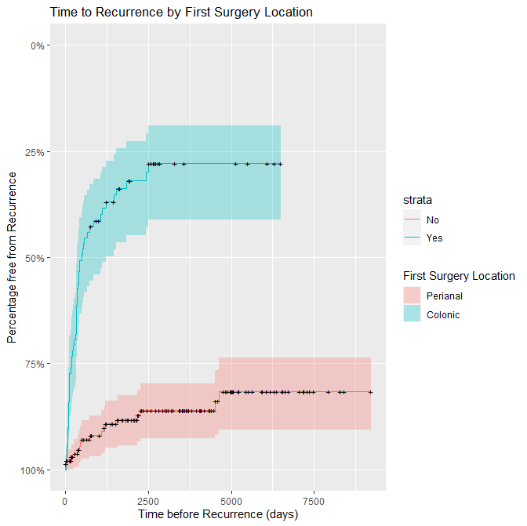
Does the type of surgery or disease location predict the need for subsequent surgeries in IBD patients?
J. Wye, K. Kabiru, MW Johnson
Gastroenterology Unit, Luton & Dunstable FT University Hospital, Luton, United Kingdom
Introduction
The prevalence of IBD in UK is said to be approximately 0.7% [1]. There is a high 1.1% (3687/330,000) prevalence of IBD within the local population. A proportion of these patients will require surgery. The estimated risk depends on a range of factors such as age and disease type. The risks of surgery at 1, 5, and 10 years after diagnosis with Crohn's disease have been shown to be 16.3%, 33.3% and 46.6%, respectively. The risks of surgery at 1, 5, and 10 years after a diagnosis of ulcerative colitis (UC) are 4.9%, 11.6%, and 15.6%, respectively [2].
Objective - We performed a 25 year retrospective review of all the lower GI surgery performed in our local IBD patients, to see if the type of surgery or disease location influenced the risks for subsequent surgeries.
Methods
In this 25 year retrospective cohort analysis we analysed the 3687 IBD patients on our local IBD database who had previously been coded by the Trust to have undergone colorectal or perianal surgery. All patients listed to have had endoscopic surgery or haemorrhoids banding were excluded. We performed multivariate analysis on recorded variables to ascertain risk factors for recurrent surgery. Variables analysed included age at diagnosis, gender, location of first surgery, and presence of perianal disease.
Results 1
During the 25 year study period 337 (9.1%) of our 3687 IBD patients underwent surgery. 259 (7%) had colonic surgery and 105 (2.8%) had peri-anal surgery, with 27 requiring both. 103 (2.8%) needed repeat surgery (>2 procedures). The overall risk of needing repeat surgery was 30.6% (103/337), however if their first surgery had been colonic, then the risk of requiring colonic surgery again over the 25 year review period was 16.6% (43/259). If the first surgery had been peri-anal the risks of further peri-anal surgery were 49.5% (52/105).
Results 2
In essence, 58% of patients who underwent perianal surgery for the first time, went on to have additional peri-anal surgeries over the 25 year review period. For those undergoing perianal surgery first, 41% required 1 procedure, 31% required 2, 11% required 3, with 18% requiring more than three procedures, including 3% who required more than 10 procedures.
In those whose first procedure was a colorectal procedure, just 19% of patients went on to require further colorectal procedures (p<0.05). 81% required just 1 operation, 14% required 2, 4.5% required 3 procedures and none required 4 or more. The presence of perianal disease had no effect on the need for additional colorectal surgery.
Conclusion
Perianal disease was the only variable demonstrated to influence the need for “redo” additional surgery. Its presence strongly predicted the requirement for repeat peri-anal surgical intervention in 49.5% of inflammatory bowel disease patients. The presence of peri-anal disease did not appear to increase the need for colonic surgery in this cohort.
References
[1] BMJ Open. 2020 Jul 19;10(7): e036584
[2] Gastroenterology. Vol 145, Issues 5, P996-1006, Nov 01, 2013
The authors declare no conflict of interests
First surgery location
 | Perianal
 | Colonic
Variable | HR | 95% CI | p-value
Sex: Male (vs Female) | 1.1685 | 0.7162-1.906 | 0.533
Age at Diagnosis: Over 50 (vs Under 50) | 0.9415 | 0.3980-2.227 | 0.891
Age at first surgery: Over 65 (vs Under 65) | 1.8426 | 0.4648-7.304 | 0.384
Year of Diagnosis: After 2010 (vs Before 2010) | 0.9287 | 0.5352-1.611 | 0.793
Presence of Perianal Disease | 5.2805 | 3.1308-8.906 | <0.000001
The Cox’s proportional hazards model showed that of the variables analysed, only the presence of perianal disease predicted the need for a second surgery (p<0.01).
Copyright © 2021 John Wye john.wye1@nhs.net Abstract No. P0514
Notes:
Hello. My name is John Wye and today I’m going to be talking through our poster on the risk factors for recurrent surgery in inflammatory bowel disease.
Inflammatory bowel disease is often complex to manage as it requires a combination of medical, endoscopic and surgical therapy. In this poster we sought to determine the factors affecting whether a surgical operation would need to be repeated in a patient with IBD.
To locate the data for this study, we collated a list of patients from our local IBD registry, where we keep a log of every patient with IBD diagnosed within our catchment area.
To create the statistics presented, we pulled the diagnosis codes of these patients from our hospital system looking for specific surgeries on the colon or the perianal area. We had to exclude some minor operations that were unlikely to be related to IBD, such as haemorrhoidectomy. We then collated our data and mixed in each patient’s phenotype and demographics to extract possible risk factors for analysis. These included sex, age at diagnosis, age at first surgery, decade of diagnosis, and presence of perianal disease. To determine the significance of these interrelated factors we performed a multivariate analysis using the Cox proportional hazards model.
As you can see in the table, of the factors analysed only presence of perianal disease predicted requirement for repeated surgery, with a hazard ratio of five point three (confidence interval between three point one and eight point nine). This is represented in graphical form to the right of this table, with a modified Kaplan-Meier curve showing the time to second surgery for patients receiving perianal surgery and colonic surgery respectively; the clock starts the moment the patient has their first surgery. The blue curve represents the cohort of patients receiving perianal surgery as a first operation. It has a rapid rate of repeat surgery displayed by the solid blue line, with the 95% confidence intervals in faded blue. The salmon-pink curve represents the cohort of patients receiving colorectal surgery as a first operation. It has a slow rate of repeat surgery as displayed by the pink line, with the 95% confidence interval in faded pink.
These confidence intervals can be seen to diverge after less than one year, or approximately a quarter of a small box. This implies that there is a very significant difference in rates of surgery from the outset depending on whether you initially require surgery to the perianal region.
In summary, for those patients whose first surgery was in the colorectal area, the chance of needing a repeat surgery was 19%, or one in five. For those patients whose first surgery was in the perianal area, the chance of needing repeat surgery was 58%, or three in five. In addition to this, 28% of patients receiving perianal surgery went on to have more than two surgeries compared with 4.5% of patients receiving colonic surgery first.
I hope that this poster has demonstrated perianal disease as a strong signal towards need for repeated surgical interventions. Further research is required into how to treat this more complex cohort of patients.

Slide 8
The use of PanEnteric Crohn’s Capsules to assess treatment outcome of Vedolizumab in IBD patients:
A 1 year proof of concept study
Medtronic’s PanEnteric Crohn’s Capsules (PECCs) provides an excellent evaluation of the pan-intestinal extent and severity of IBD, and the effects of different treatment regimes.
We feel PECCs should be considered as a less invasive 1st line assessment tool when evaluating the effectiveness of Biological therapy in IBD patients, especially those with small bowel Crohn’s disease.
Whilst Vedolizumab has already been shown to be beneficial in the treatment of colonic inflammation, this proof of concept study also demonstrated its beneficial effect in reducing intestinal inflammation, across all 3 segments of the small bowel.

Slide 9

The Future of Capsule Endoscopy
Colon Capsule
Steering
Drug Delivery
Biopsy

Slide 10


Magnetically Guided Capsule Endoscopy

