Slide 1




IBS/DD/EDS/NBS
GI Word Salad
Dr. Matt W. Johnson

Slide 2
I don’t believe in IBS

Slide 3
I don’t believe in IBS
Well, at least not in the way this term is being used

Slide 4
Once someone is labelled with IBS
Its like a dustbin diagnosis
The brain stops
Alternatives aren’t considered
Symptoms continue
Perpetuating the diagnosis (as incurable)

Slide 5
D-IBS- Diarrhoea > 3x/d
  62 Colonoscopy -ive patients
  Then underwent a multitude of investigations
    Coeliac + sb Crohn’s
    Lactose + Fructose intolerance
    Small bowel bacterial overgrowth
    Bile acid malabsorption
    Pancreatic insufficiency
  82% were found to have an explanation
  18% had functional IBS-D (? Psychiatric / PI-IBS)
Fernandez-Banares F.
AmJGastro. 2007: 102; 2520

Slide 6
Chronic diarrhoea
25% of coeliac patients were originally diagnosed with IBS
5% of Britons >40y are lactose intolerant
30% of IBS thought to due to bile acid malabsorption
6% of diarrhoea-dominant IBS = pancreatic exocrine insufficiency
80% of IBS could have SIBO

Slide 7
The vast majority of the IBS that I see is related to Constipation
(including a lot of the diarrhoea)

Slide 8
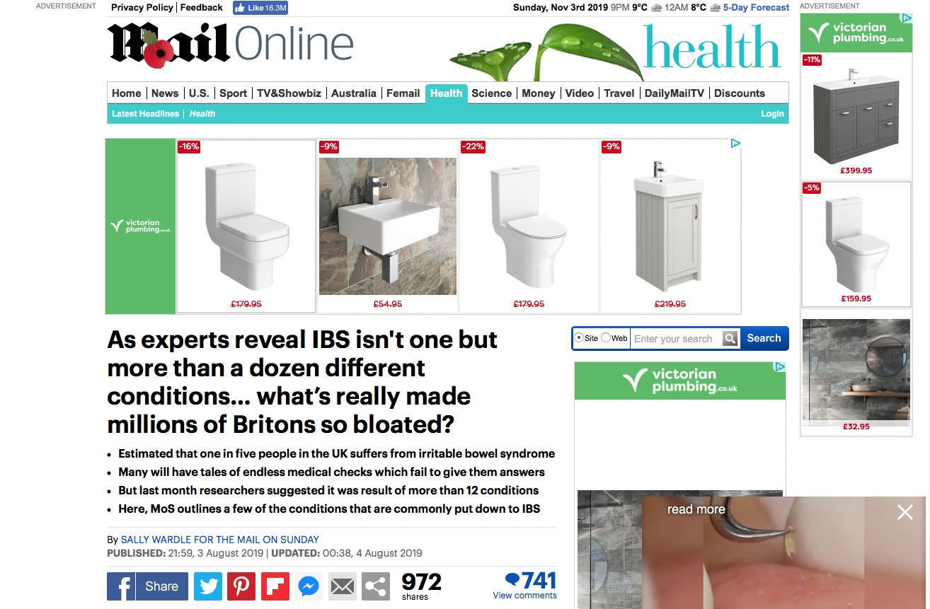

Slide 9
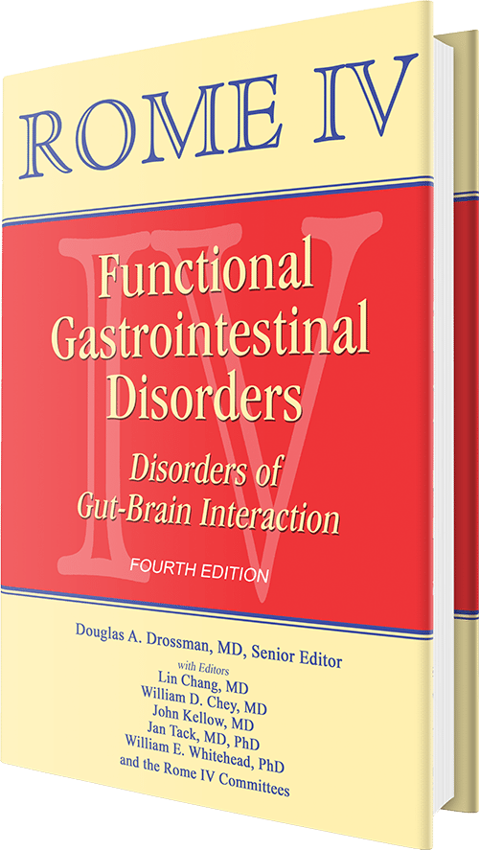
Rome IV
Criteria
3m of abdominal pain at least 1 day a week with;-
a) Related to defaection
b) Altered bowel habits
Now includes - Oesophageal issues, NUD, SBBO, SOD, BAM, Pancreatic insufficiency
Essentially everything but cancer and colitis

Slide 10
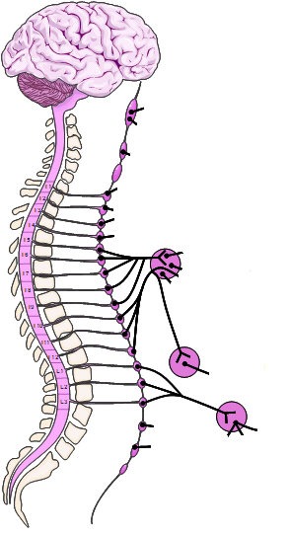

Regulation of colonic function
Brain gut axis
Two-way interaction between ENS and CNS via sympathetic and parasympathetic nervous system
So, a number of factors can influence colonic function:
  Conscious: Behavioural factors¹
    e.g. toilet avoidance
  Unconscious: Emotional distress²
  Hormonal: Increased expression of progesterone receptors³
Sympathetic nervous system
Parasympathetic nervous system
1. Kamm MA. Gastroenterology 2006;131:233-239; 2. Chan AOO et al. World J Gastroenterol. 2005;11(34):5362-5366
3. Cong P et al. Gastroenterology 2007;133:445-453; Image developed for programme

Slide 11
QoL of secondary care chronic constipation patients Lower than that of many common diseases
QoL for diseases in community and hospital (secondary care) setting using SF-36¹
Mean Physical Component
Healthy Individuals = 55.4
Score
Ulc Colitis –Stable
Allergies
Consti-pation
Dermatitis
Ulc Colitis –
Unstable
Back Pain / Sciatica
Depression
Anaemia
Crohn’s –
Stable
Funct. Dyspepsia
Consti-pation (2ndry)
Crohn’s –
Unstable
Diabetes
Coronary Heart Dis.
Rheum. Arthritis
Osteo-arthritis
Haemo-dialysis
Systemic Lupus
Mean Mental Component
Healthy Individuals = 52.9
Score
Allergies
Diabetes
Ulc Colitis –Stable
Consti-pation
Osteo-arthritis
Coronary Heart Dis.
Dermatitis
Back Pain
/ Sciatica
Rheum. Arthritis
Crohn’s
– Stable
Funct. Dyspepsia
Systemic Lupus
Haemo-dialysis
Anaemia
Ulc Colitis –
Unstable
Consti-pation (2ndry)
Crohn’s –
Unstable
Depression
Community
Hospital
(Secondary Care)
Constipation
1Belsey et al. Aliment Pharmacol Ther. 2010;31:939-949
Study uses Short Form 36 (SF-36) QoL Tool. Scores normalised to a consistent scale ( total population mean= 50 and standard deviation =10)

Slide 12
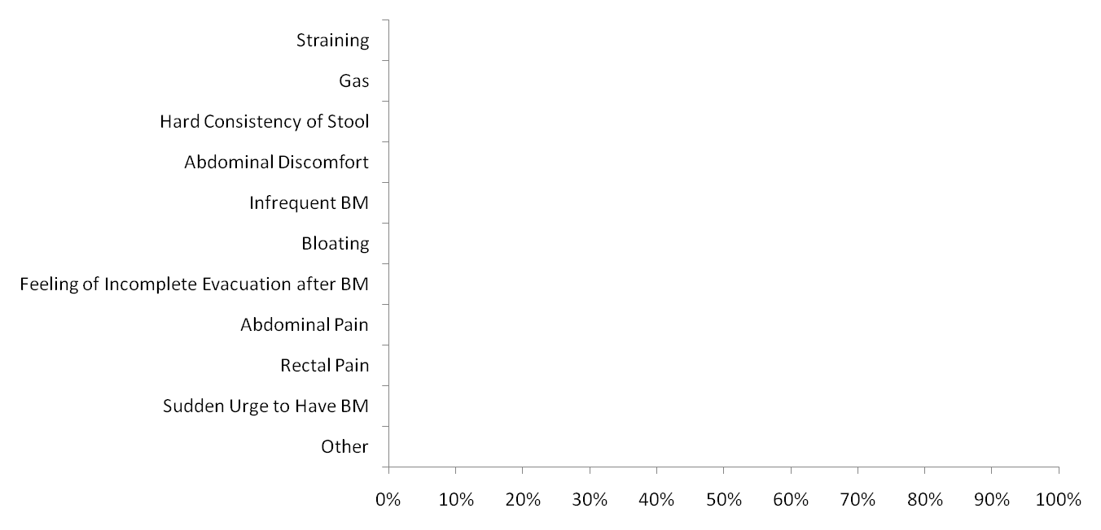
Multiple symptoms
Patients report a variety of symptoms
Percent of CC respondents* reporting each symptom
79%
74%
71%
62%
57%
57%
54%
48%
41%
35%
8%
*Respondents classified as having CC according to Rome II criteria; Methodology = 45-question web-based survey; 557 eligible participants: 243 men and 314 women, ≥18 years old; Johanson & Kralstein. Aliment Pharmacol Ther 2007;25:599.

Slide 13
A categorisation of chronic constipation
Primary¹
Secondary^{2,3}
Normal diameter colon
  Functional constipation
  IBS-C
  Pelvic floor disorders
Intrinsic
  e.g., colorectal cancer, diverticular disease
Metabolic / endocrine
  e.g., hypercalcaemia, coeliac, hypothyroidism, hypokalaemia
Dilated colon¹
  Hirschsprung’s Disease
  Idiopathic megacolon / megarectum
  Chronic intestinal pseudo-obstruction
Dilated colon
  Hirschsprung’s disease
  Idiopathic megacolon / megarectum
  Chronic intestinal pseudo-obstruction
Neurological
  e.g., spinal cord injury, multiple sclerosis, Parkinson’s disease
Psychological
  e.g., depression, anorexia nervosa, bulimia, affective disorders, abuse
Today’s focus
Medications
  e.g., opiates, ferrous supplements, tricyclics, diuretics, antipsychotics
1. Gattuso JM & Kamm MA. Aliment Pharmacol Ther. 1993;7(5):487-500; 2. Blaker P & Wilkinson M. Prescriber 2010;21(9):30–45;
3. Chatoor D & Emmanuel A. Best Prac Res Clin Gastroenterol. 2009;23:517-530.

Slide 14
Treatment options for chronic constipation¹
GUT WALL
Salts, Sugars and Soluble Fibre
Water
binding
in stool
a) Osmotic agents
Osmotic agents
Stool
softening &
lowers surface
tension of stool
b) Laxatives
Docusate and Stool softeners
c) Stimulants
Peristalsis
Senna and Stimulant agents
d) Symptomatic agents
Mebeverine, colperamin
1Tack & Müller-Lissner. Clin Gastroenterol Hepatol 2009;7:502

Slide 15
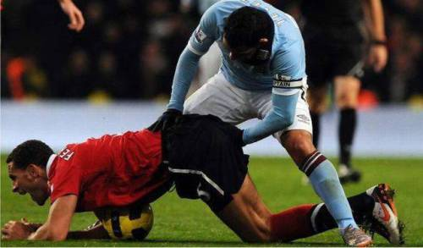
Movicol makes things easier !
14

Slide 16
Osmotic agents: polyethylene glycol
Higher stool frequency with PEG vs lactulose after 1 month¹
Less straining with PEG vs lactulose after 1 month¹
P<0.005
P<0.0001
Attar et al. Gut. 1999.44.226-30
Andorsky & Goldner. Am J Gastroenterol. 1990;85(3):261-5
Corazziari et al. Dig Dis Sci. 1996;41(8):1636-42
Di Palma et al. Am J Gastroenterol. 2007;102(9):1964-71

Slide 17
Are current treatment options effective?
16–40% of those with constipation use laxatives
Symptoms persist despite laxative use
Patients with ongoing constipation symptoms (%)
100
80
60
40
20
0
Use laxative
Do not use laxative
US
UK
FR
GE
IT
BR
SK
Approximately 2000 adults each from: United States, US; United Kingdom, UK;
France, FR; Germany, GE; Italy, IT; Brazil, BR; South Korea, SK
Country
Wald et al. Aliment Pharmacol Ther 2008;28:917
Notes:
This figure illustrates that, in most countries, the proportion of patients experiencing symptoms is at least as high among those taking laxatives as among those not taking laxatives.

Slide 18

Constipation of the Normal Diameter Colon
Three overlapping types of disorders
+
IBS-C
Pelvic Floor Disorder(s)
Abdominal Pain
Normal
Transit (Time)
Slow
Transit (Time)
NO or YES
–
Disordered Motility
1. Eoff & Lembo. J Manag Care Pharm 2008;14(9):S1-S17; 2. Mertz et al. Am J Gastroenterol 1999;94:609-615.

Slide 19
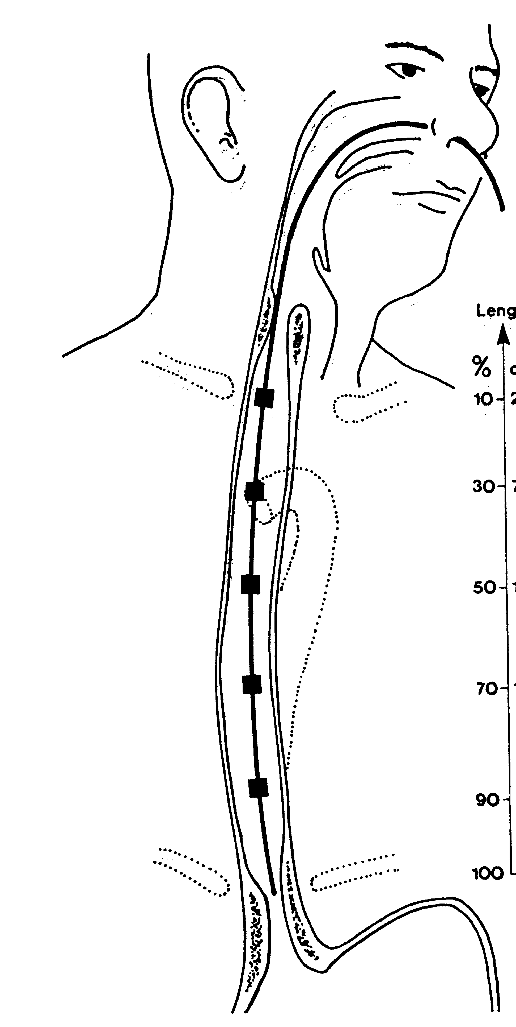
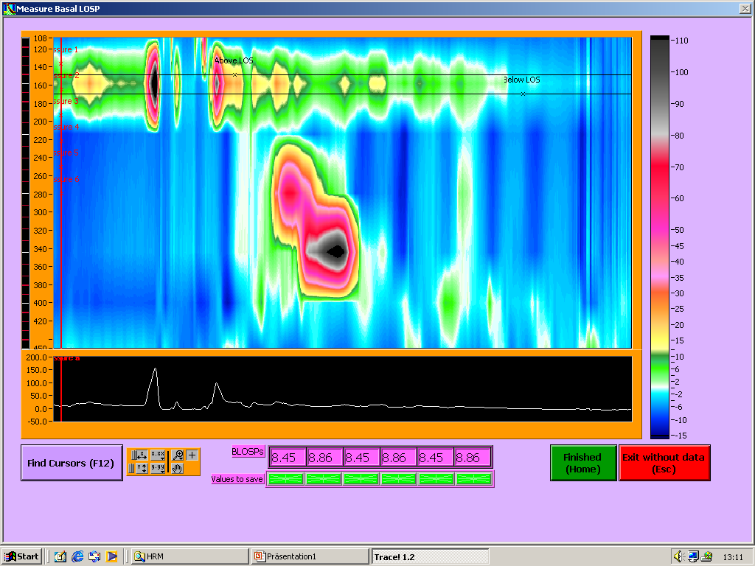
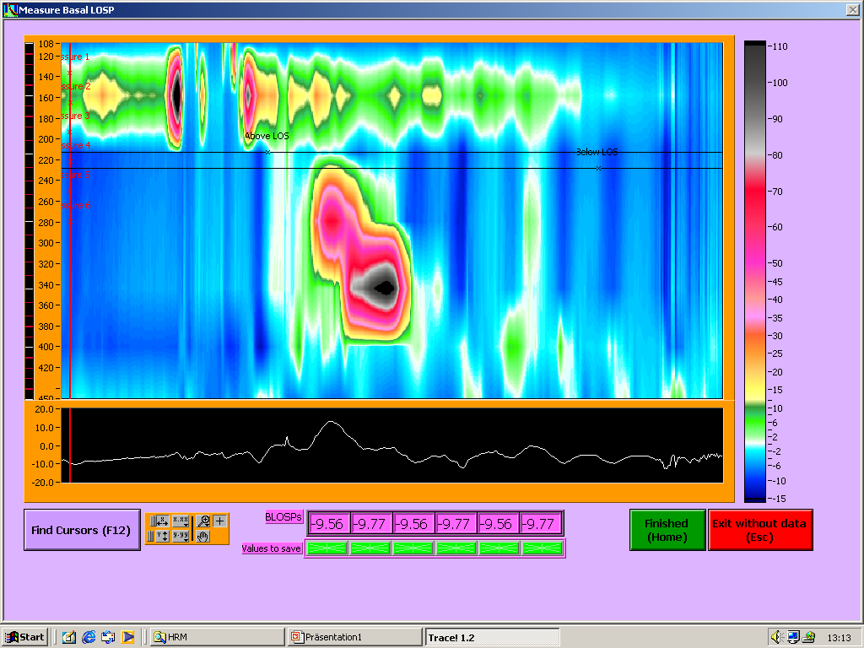
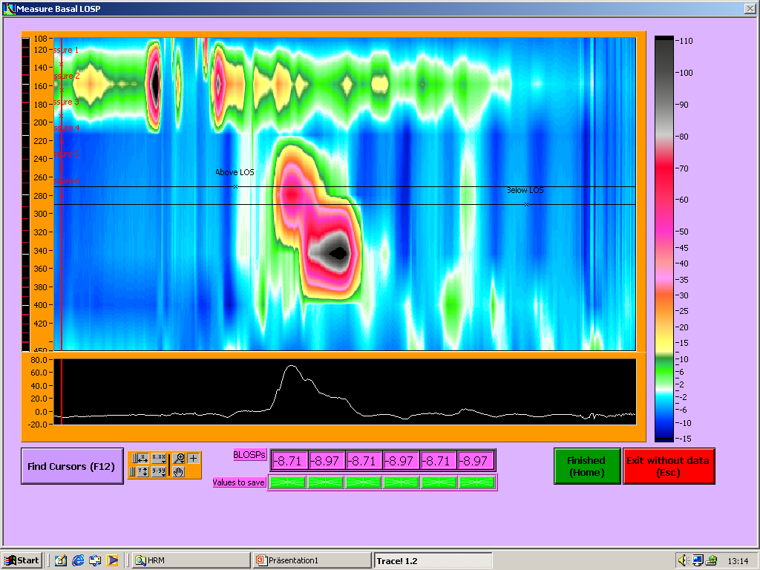

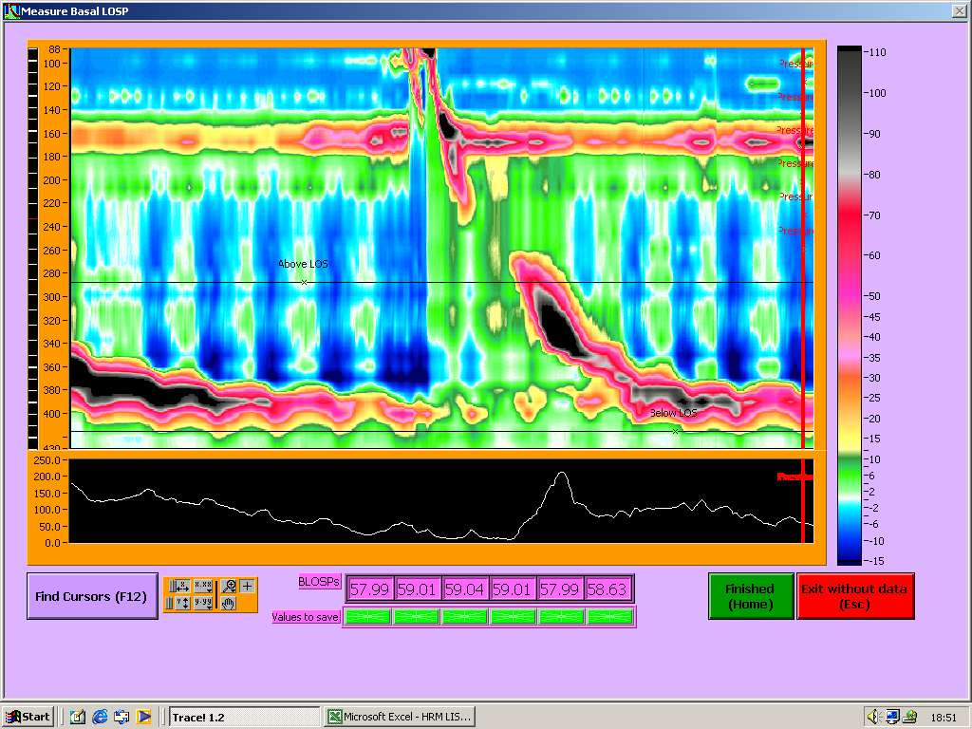
‘Conventional’ Manometry
Line Pressure Plots
Swallow
Pharynx
(Deglutination)
UOS
LOS Sleeve Sensor
LOS
Relax
Gastric
(Reference)
Gastric Reference

Slide 20
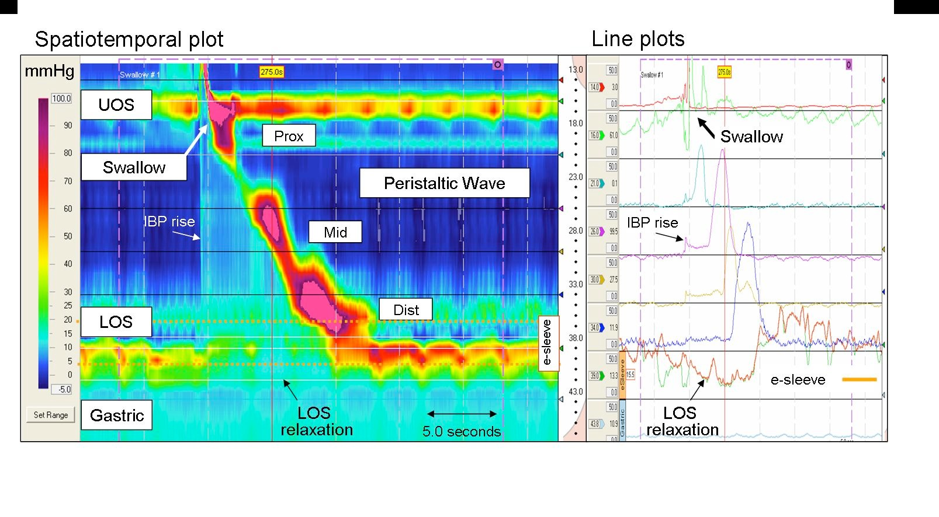
HRM
Recordings can be analysed and presented either as:
  Line plots (similar to conventional manometry)
  Spatiotemporal plots
HRM demonstrates segmental character of oesophageal motor function

Slide 21
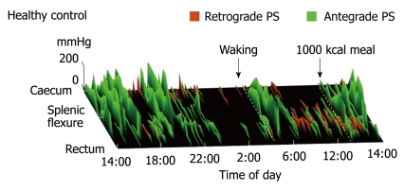
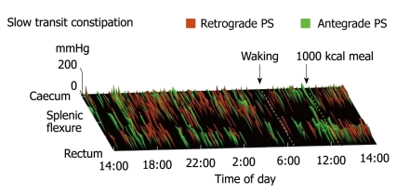
Motility
Healthy vs. constipated motor activity¹
1. Dinning et al. World J. Gastroenterol 2010;16(41):5162-5172.
Copyright permission pending

Slide 22
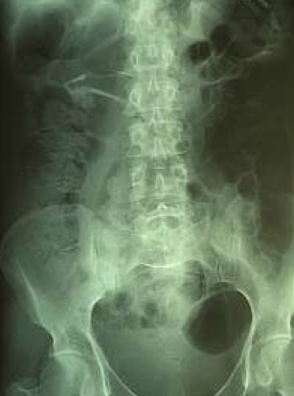
Right sided faecal loading
19

Slide 23
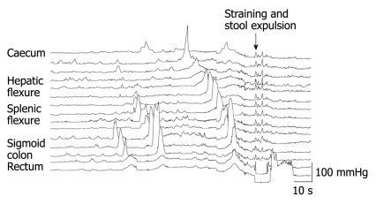
Motility
Symptoms: fewer HAPCs means infrequent urge
Association of High Amplitude Propagating Contractions (HAPCs) with defaecation in healthy controls¹
Study of HAPCs in constipated vs. healthy control group²
Transit | HAPC/day
Control (n=18) | 6 ± 1
IBS-C / Normal Transit (n=10) | 3.7 ± 2*
Slow transit (n=35) | 1.5 ± 0.4*, †
*p<0.05 vs. control (healthy subjects)
†p<0.05 vs. IBS-C
1. Dinning et al. World J. Gastroenterol 2010; 16(41):5162-5172; 2. Bassotti et al. Digestion 2003;68(4):178-183.
Copyright permission pending

Slide 24
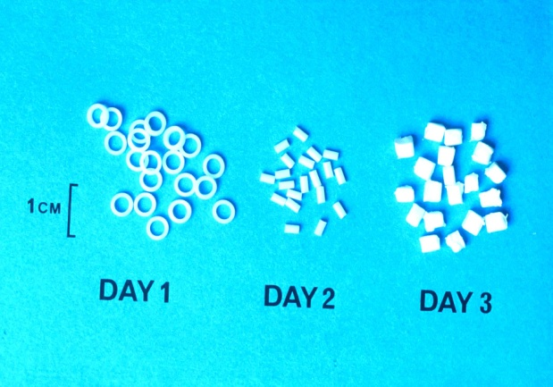
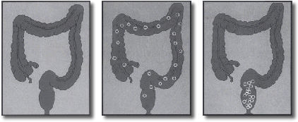
Measuring transit in clinical practice
Typical radiopaque markers¹
Slow transit constipation is characterized by prolonged delay in the transit of stool through the colon²
20
18
16
14
12
10
Number of markers remaining
Possible transit time study outcomes
8
6
4
2
0
0
24
48
72
96
120
144
168
Time after ingestion of markers (h)
Normal transit
Slow transit
Normal Transit Time
Majority of markers passed by Day 5
Slow transit Time
Markers scattered throughout colon
Pelvic floor disorder
Most markers in rectum or rectosigmoid*
Mean
Remaining cubes
±2 standard deviations
Remaining cylinders
Remaining rings
*Note: this represents a possible scenario, but pelvic floor disorders are not always visible via transit study
Chatoor & Emmanuel. Best Pract Res Clin Gastroenterol. 2009;23(4):517-30; 2. Evans et al. Int J Colorect Dis. 1992;7:15-17; Image developed for programme

Slide 25
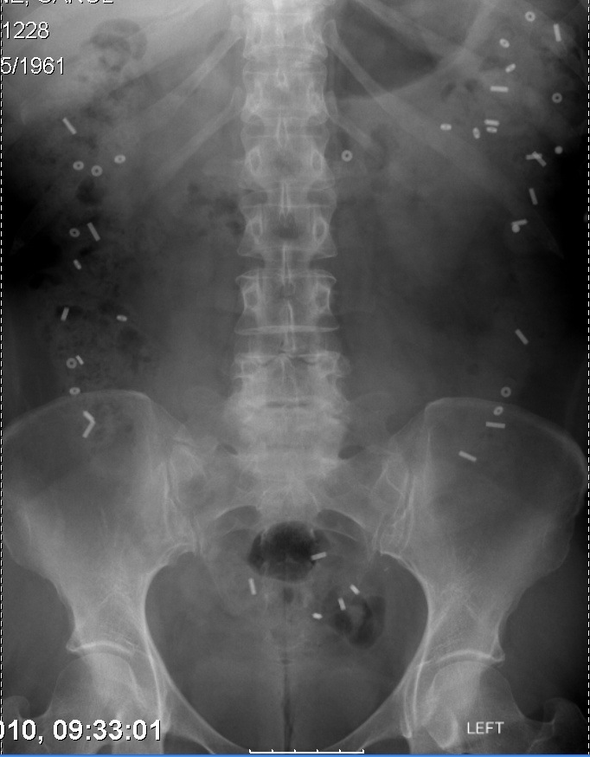

Case 1: Idiopathic Slow Transit Constipation
Courtesy of Anton Emmanuel

Slide 26
Stimulants
More frequent bowel movements with bisacodyl vs placebo in patients with chronic constipation³
More frequent bowel movements with sennoside plus bulk laxative vs lactulose in elderly patients (n=30)⁴
*
P<0.05
*P<0.0001 vs placebo
CSBM, complete spontaneous bowel movement
Pare et al. Can J Gastroenterol. 2007;21(Suppl B):3B-22B
Emmanuel. Ther Adv Gastroenterol. 2011;4(1)37-48
Kamm et al. Clin Gastroenterol Hepatol. 2011 [Epub ahead of print]
Kinnunen et al. Pharmacology. 1993;47 Suppl 1253-5

Slide 27
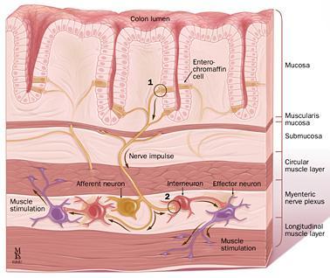
Prucalopride: a prokinetic
Treatment
Selective high affinity 5-HT₄ receptor agonists¹
Binds to 5-HT₄ receptors involved in bowel motility^{2,3}
Indications
Approved for symptomatic treatment of chronic constipation in women in whom laxatives* fail to provide adequate relief^{†4}
Prucalopride
*For full prescribing information please refer to the Summary of Product Characteristics. Not approved in all countries.
†Two laxatives in UK; number of laxatives not stipulated in Europe
Briejer et al. Eur J Pharmacol. 2001; 423:71-83
Breijer et al. Neurogastroenterol Motil. 2001; 13: 465-72
Bouras et al. Gut 1999;44:682-6
Prucalopride. Summary of product characteristics. 2011

Slide 28
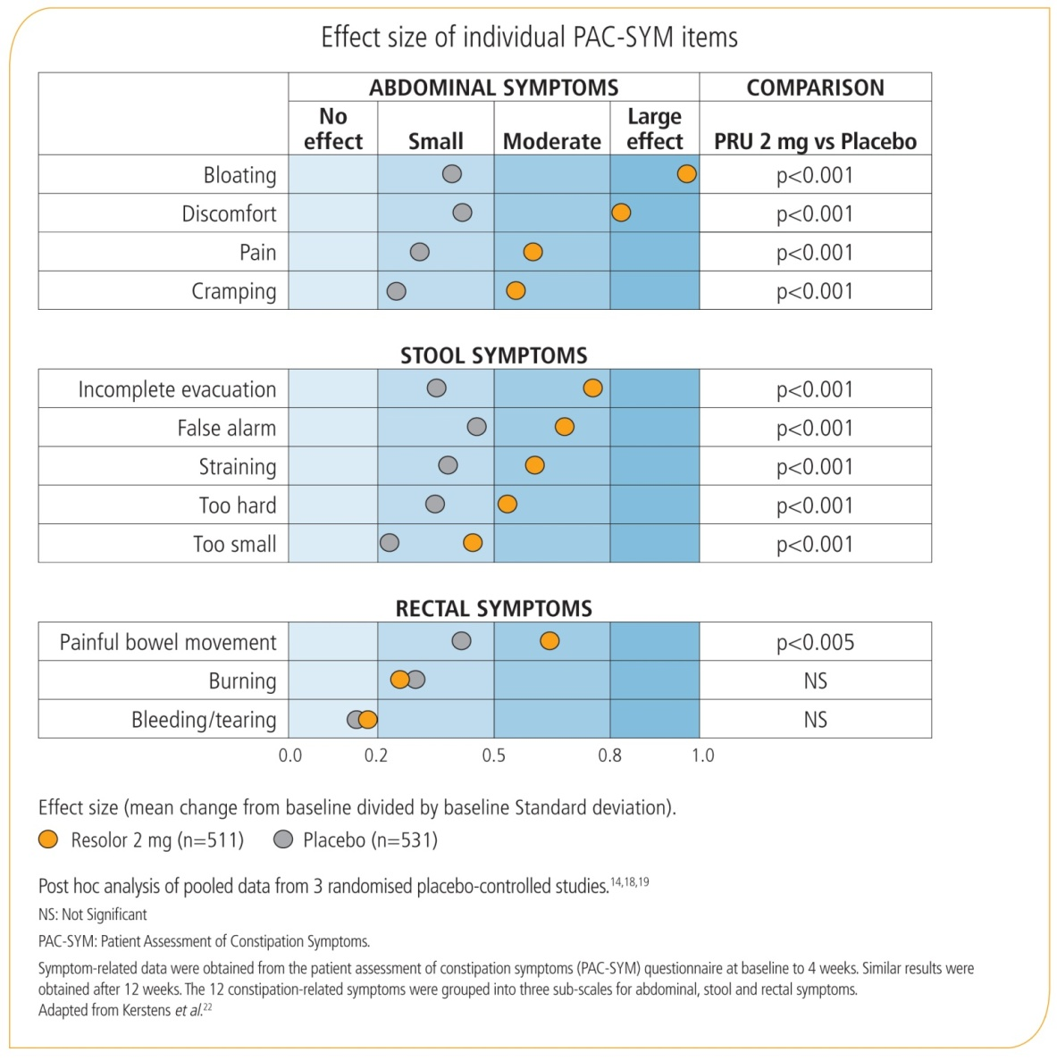
Prucalopride: a prokinetic
Effect on symptoms associated with chronic constipation¹

Slide 29
Emerging treatments: Pharmacotherapy overview
Compounds | Outcome effects
Renzapride and mosapride | Prokinetic, enhances gut motility
Alvimopan and methylnaltrexone | Block effects that opioids have on the gut without impacting their effect on pain control
Lubiprostone and linaclotide | Increases intestinal fluid secretion into the lumen, enhances gut motility

Slide 30
Case 2: 32y male 6m post car crash
How do you interpret this transit study?
Courtesy of Anton Emmanuel

Slide 31
Case 2: 32y male 6m post car crash
Narcotic Bowel Syndrome
Courtesy of Anton Emmanuel

Slide 32

Opioid-induced constipation in a secondary care gastroenterology service
Background
Opioids are the most commonly prescribed drugs to treat chronic pain.¹
Opioid-induced bowel dysfunction compromises a broad-spectrum of disorders that result from the actions of opioids on the central nervous system and gastrointestinal tract.²
Opioid-induced constipation (OIC) is the most common bowel dysfunction induced by these drugs.³
Can cause a pain in their own right (in the absence of constipation) = NBS
A change from baseline bowel habits and defecation patterns when initiating opioid therapy.
Characterised by:⁴
Reduced bowel frequency
Development or worsening of straining
Sense of incomplete evacuation
Patient perception of being distressed due to their bowel habit
Activation of μ-opioid receptors in the GI tract (mainly stomach and proximal colon) leads to OIC and other side effects
UKIRE/MOV/0067 Date of preparation: October 2017
Manchikanti L et al. Pain Physician 2012; 15(3 Suppl): ES9-38.
Brock C et al. Drugs 2012; 72(14): 1847-65.
Camilleri M et al. Neurogastroenterol Motil 2014; 26(10): 1386—1395.
Gaertner J et al. J Clin Gastroenterol 2015; 49(1): 9-16

Slide 33

Pathophysiology of OIC
OIC may lead to secondary gastrointestinal complications such as:^{1,2}
Increased
gastroesophageal
reflux
Abdominal distension
Delayed gastric emptying
Pseudo-obstruction
of the bowel
Holzer P, Eur. Rev. Med. Pharmacol. Sci. 2008;12:119-127
Holzer P, Am. J. Gastroenterol. Suppl. 2014;2:9-16
Penning-van Beest FJA, Journal of Medical Economics 2010; 13(1): 129-135
CNS=central nervous system
MOV/UK/0131 Date of preparation: March 2018

Slide 34
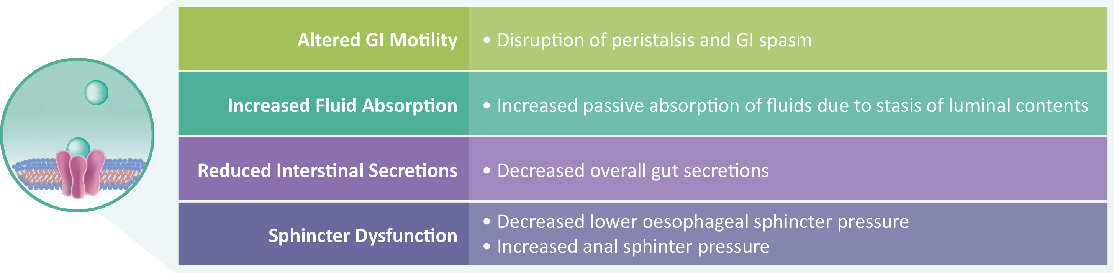
Pathophysiology of OIC
Activation of μ-receptors in the GI tract leads to downstream effects.¹
These effects may manifest as bowel dysfunction, including constipation:
Opioid
Brock C et al. Drugs 2012;72:1847-1865.
UKIRE/MOV/0060 Date of preparation: October 2017

Slide 35
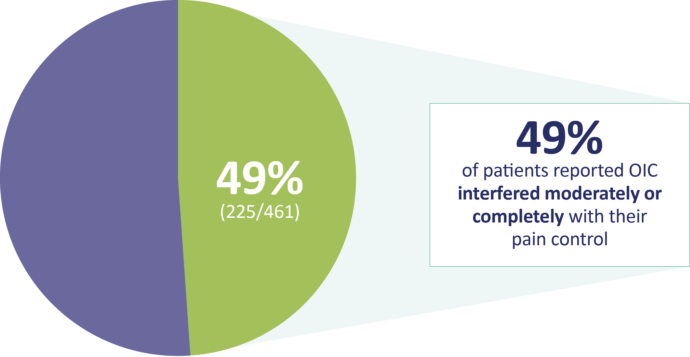
Pathophysiology of OIC
OIC may interfere with pain management.¹
In a prospective observational study of 493 patients with confirmed OIC and non-cancer pain:
(n=225 of 461 patients who answered the question)
Note: Among patients in the study with sufficient laxative use (n=198), 94% had an inadequate response to at least one laxative agent within the past 2 weeks. Laxative Inadequate Response (LIR)
was defined as <3 SBMs with ≥1 constipation symptom of at least moderate severity while taking at least one laxative agent ≥4 times in the past 2 weeks.1
Coyne KS et al. Clinicoecon Outcomes Res 2014; 6: 269-281.
UKIRE/MOV/0060 Date of preparation: October 2017

Slide 36
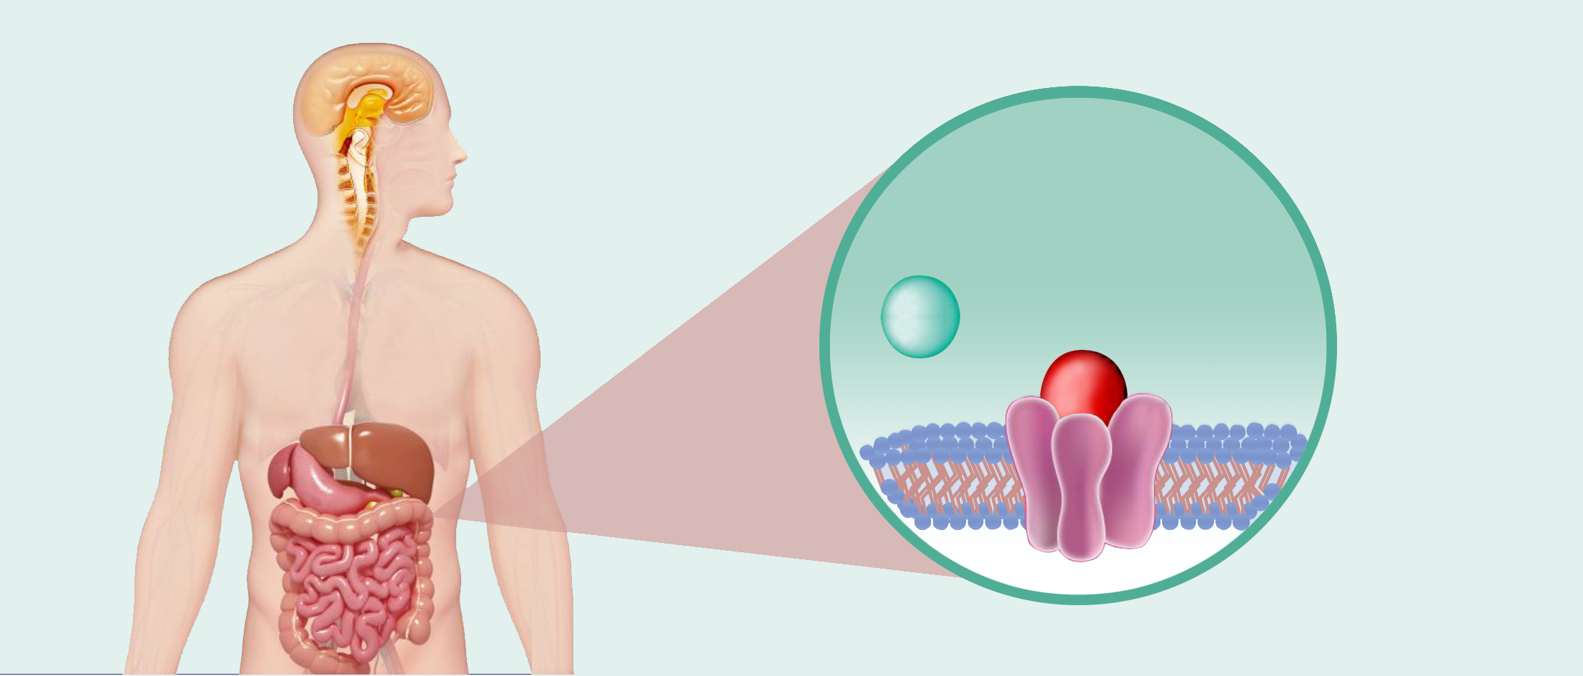
Naloxegol: Clinical data in OIC
Naloxegol addresses OIC by blocking opioids from binding to μ-receptors in the GI tract¹
Naloxegol
Naloxegol
Opioid
μ-Receptor
Moventig Summary of Product Characteristics
MOV/UK/0131 Date of preparation: March 2018

Slide 37
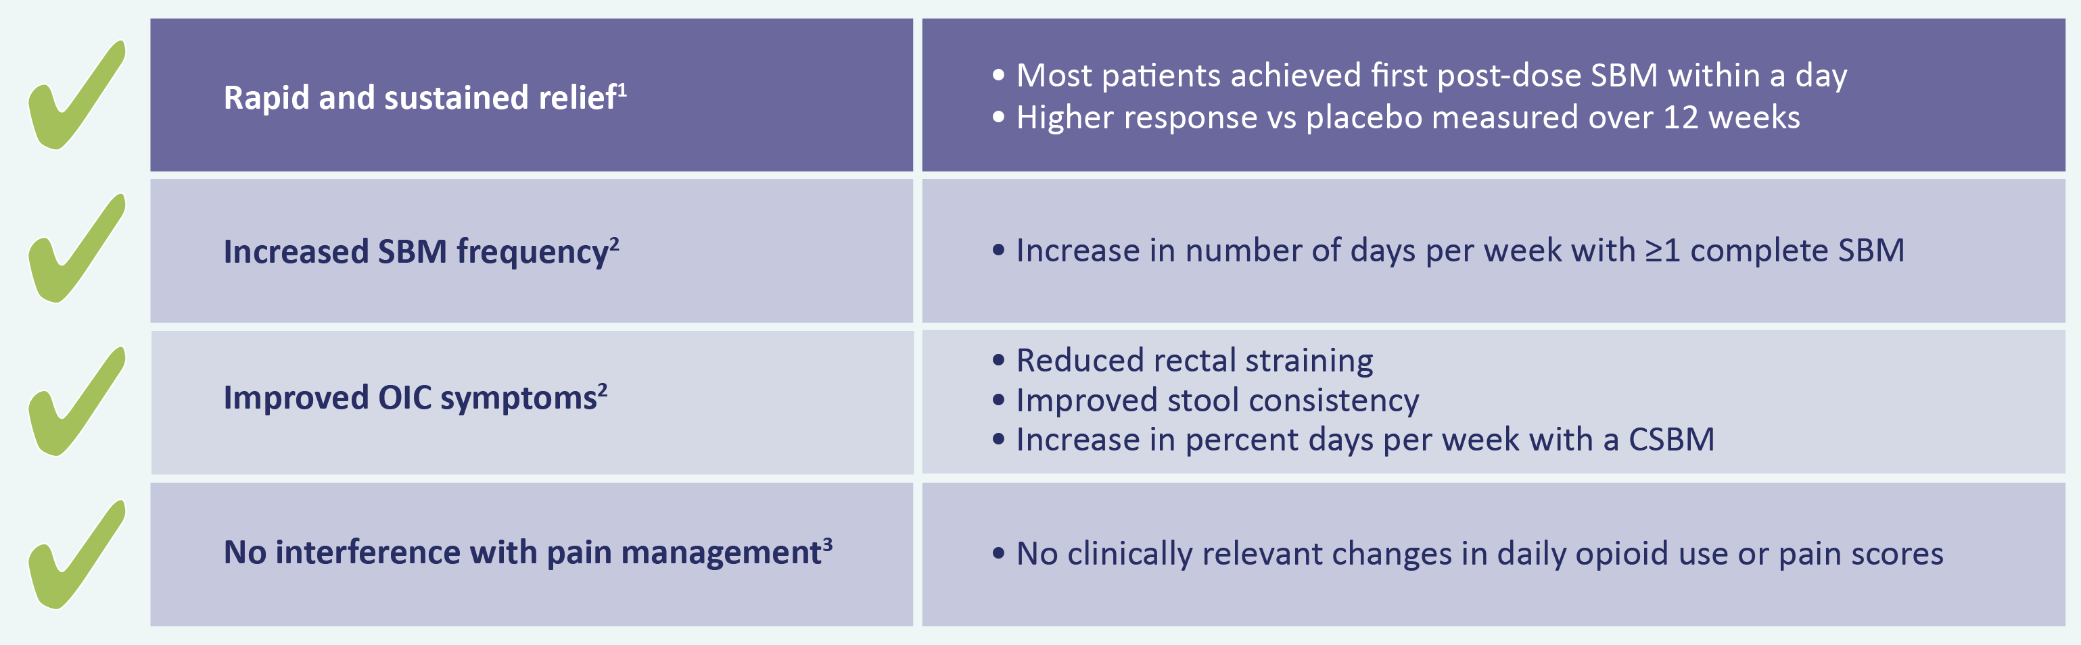
Naloxegol: Clinical data in OIC
KODIAC Conclusions
Naloxegol 25 mg has demonstrated the following in adult patients with OIC and an inadequate response to laxative(s):
Sustained relief¹ | Most patients achieved first post-dose SBM within a day Higher response vs placebo measured over 12 weeks
Increased SBM frequency² | Increase in number of days per week with ≥ 1 complete SBM
Improved OIC symptoms² | Reduced rectal straining Improved stool consistency Increase in percent days per week with CSBM
No interference with pain management³ | No clinically relevant changes in daily opioid use or pain scores
The safety profile of naloxegol was evaluated up to 52 weeks in clinical trials^{2,4}
Majority of GI AEs were graded as mild to moderate and occurred during early treatment
AstraZeneca UK Ltd Data on File MOV-011-AUG15
Moventig Summary of Product Characteristics
Chey WD, et al. N. Engl. J. Med. 2014;370:2387-2396
Webster L, et al. Aliment. Pharmacol. Ther. 2014;40:771-779
MOV/UK/0131 Date of preparation: March 2018

Slide 38
NICE: Single Technology Appraisal of naloxegol
NICE Technology Appraisal issued: July 2015:¹
“Naloxegol is recommended, within its marketing authorisation, as an option for treating opioid-induced constipation in adults whose constipation has not responded adequately to laxatives.”
An inadequate response is defined as opioid-induced constipation symptoms of at least moderate severity in at least 1 of the 4 stool symptom domains
(that is, incomplete bowel movement, hard stools, straining or false alarms) while taking at least 1 laxative class for at least 4 days during the prior 2 weeks.
NICE TA345. July 2015.
UKIRE/MOV/0110 Date of preparation: October 2017

Slide 39
Rome IV - Narcotic Bowel Syndrome
Diagnostic criteria:
1) Chronic or frequently recurring abdominal pain that is treated with acute high-dose or chronic narcotics
2) The nature and intensity of the pain is not explained by a current or previous GI diagnosis
3) Two or more of the following:
  The pain worsens or incompletely resolves with continued or escalating dosages of narcotics
  There is marked worsening of pain when the narcotic dose wanes and improvement when narcotics are re-instituted (soar and crash)
  There is a progression of the frequency, duration, and intensity of pain episodes
(a) Criteria fulfilled for the last 3 months with symptom onset at least 6 months before diagnosis.
(b) Pain must occur most days.
(c) A patient may have a structural diagnosis (eg, inflammatory bowel disease, chronic pancreatitis), but the character or activity of the disease process is not sufficient to explain the pain.
The key to diagnosis is the recognition that long-term or increasing dosages of narcotics lead to continued or worsening symptoms rather than benefit.

Slide 40
Narcotic Bowel Syndrome Protocol
5-6% of all users
Under-recognised despite escalating opioid epidemic.
Other symptoms include nausea, vomiting, bloating, constipation abdominal distention and possibly weight loss.
Pathophysiology is complex and incompletely understood;
  Opioid-induced hyperalgesia (key issue)
  Related to bimodal opioid regulatory systems / counter-regulatory mechanisms, neuroinflammation, opioid facilitation, and interactions of the N-methyl D-aspartate receptor with opioids at the level of the spinal cord.

Slide 41
Case 3: 32y Female ex-ballet dancer
How do you interpret this transit study?
Courtesy of Anton Emmanuel

Slide 42
Case 3: 32y Female ex-ballet dancer
Ehlers Danlos Syndrome - Hypermobility Syndrome
Courtesy of Anton Emmanuel

Slide 43

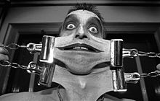

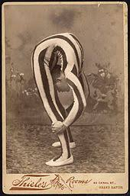

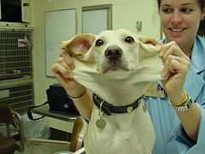
Ehlers Danlos Syndrome
Hypermobility Syndrome

Slide 44
Ehlers Danlos Syndrome
Hypermobility Syndrome
13 Types
    T1 Classical / T2 Hypermobile / T4 Vascular
19 different genes
Defects in the structure/processing of collagen
1 in 5,000 worldwide
1st described by Hippocrates 400BC
No treatment - Manage by analgesia and Reduce joint + ligament impact

Slide 45
Hypermobility Syndrome
Beignton Score
Placing flat hands on the floor with straight legs
Left knee bending backward
Right knee bending backward
Left elbow bending backward
Right elbow bending backward
Left thumb touching the forearm
Right thumb touching the forearm
Left little finger bending backward past 90 degrees
Right little finger bending backward past 90 degrees
1 point each
A Score of >4/9 is Positive

Slide 46
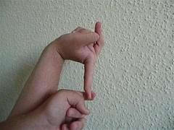
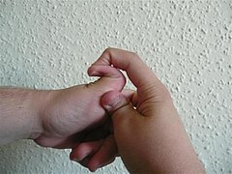
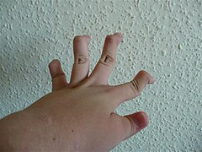
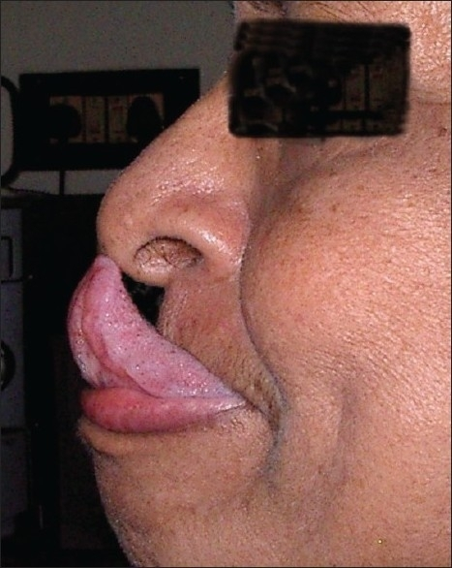
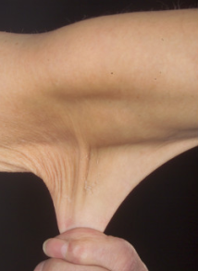
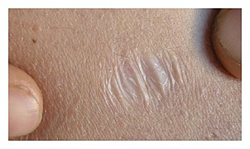
Ehlers Danlos Syndrome
Hypermobility Syndrome
Gorlin’s sign

Slide 47
Ehlers Danlos Syndrome
Hypermobility Syndrome
Hypochondiasis
Depression
Chronic fatigue syndrome / ME
Thoracic outlet syndrome / Valvular disease / Ascending AA / VV / Raynaud’s
HH / Reflux / Poor GI motility / Constipation / Gastroparesis / Anal prolapse / Coeliac disease
Arnold Chiari malformations
Cataracts / retinal detachment / Sjogrens
Dysautonomia / POTS

Slide 48
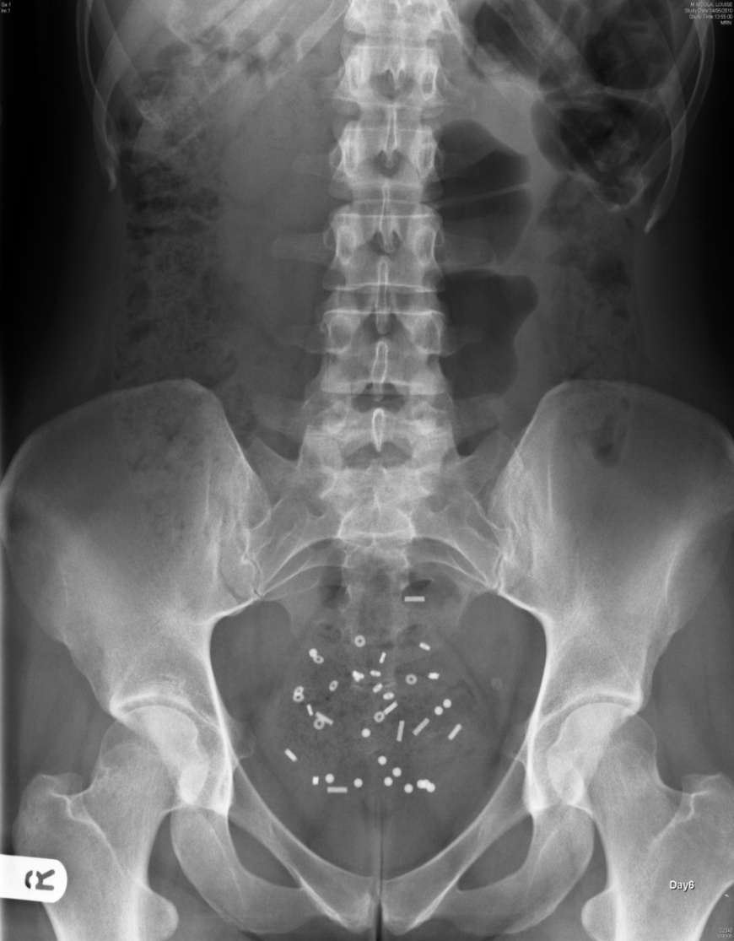
Case 4: Miss SH, age 24 years
How do you interpret this transit study?
Image courtesy of Shaheen Hamdy

Slide 49
Case 4: Pelvic Floor Dysfunction
Dysnergic Defaecation or Megarectum (?Hirschprungs)
Image courtesy of Shaheen Hamdy

Slide 50
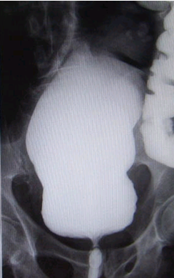
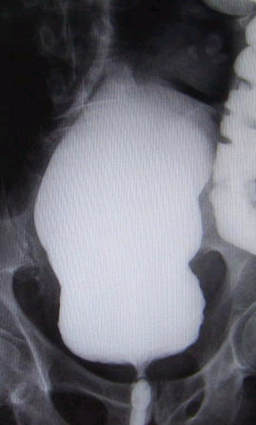
Constipation of the dilated colon
Megacolon / megarectum
Ant.
Megarectum
Post.
Left
L
Courtesy of Ayesha Akbar,

Slide 51
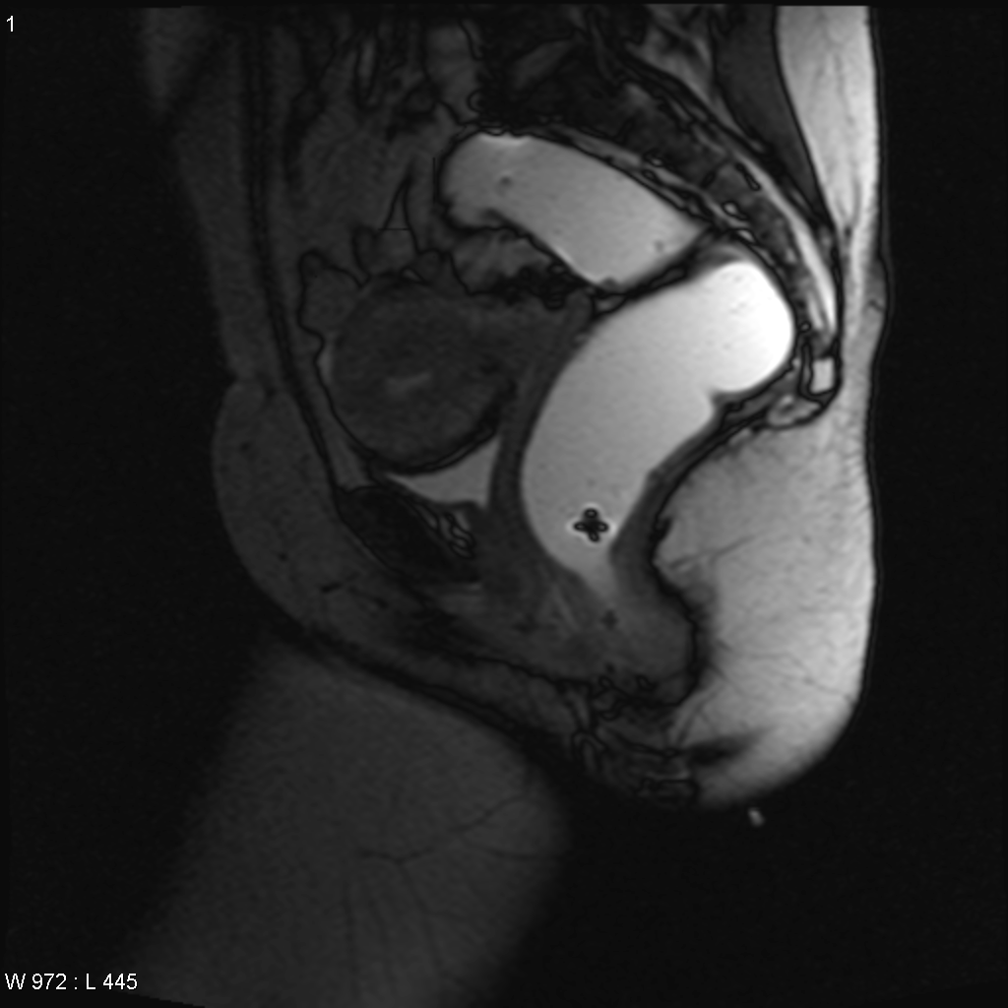
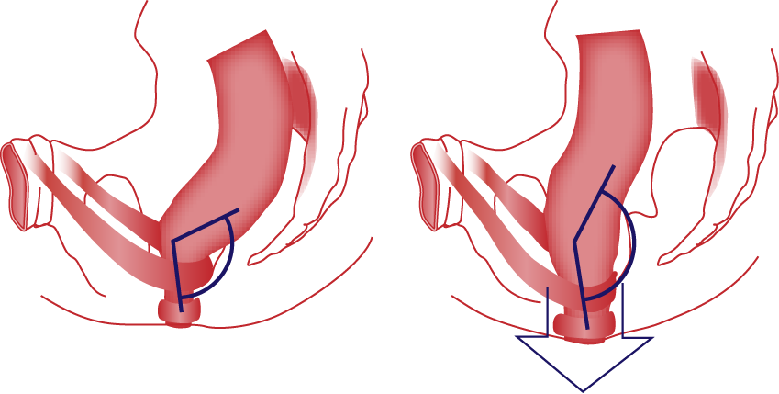
Dyssynergic defaecation
Normal pattern for defaecation
At rest
During straining
Pubis
Puborectalis
Coccyx
Anorectal
angle
Anorectal
angle
External anal
sphincter
Internal anal
sphincter
Descent of the pelvic floor
Ant.
Post.
Courtesy of Dave Chatoor

Slide 52
Treatment Options
Stool softening agents
Overdrive the motility
Biofeedback (Dysnergic) - St. Mark’s or UCH
Lecicarbon A
Rectal stimulants
Rectal enemas
Rectal lavage

Slide 53
Case 5: Miss SH, age 42 years
How do you interpret this transit study?
Image courtesy of Shaheen Hamdy

Slide 54
Case 5: Miss SH, age 42 years
Pelvic Floor Dysfunction - ? Rectocele
Image courtesy of Shaheen Hamdy

Slide 55
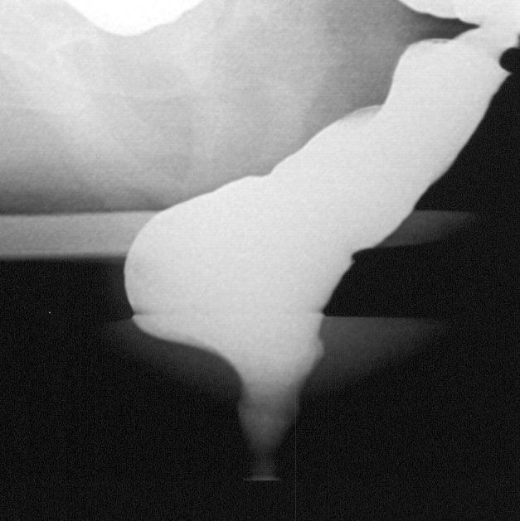
Case 1: Mrs BS, age 57 years
Barium proctogram results
Rectocoele size (cm)
Chatoor et al. Gut. 2007;56(Suppl. 2):A46–A47.
Image courtesy of Dave Chatoor

Slide 56
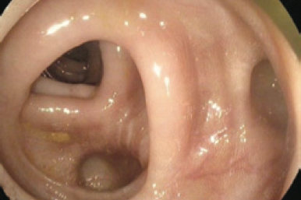
Diverticulosis

Slide 57
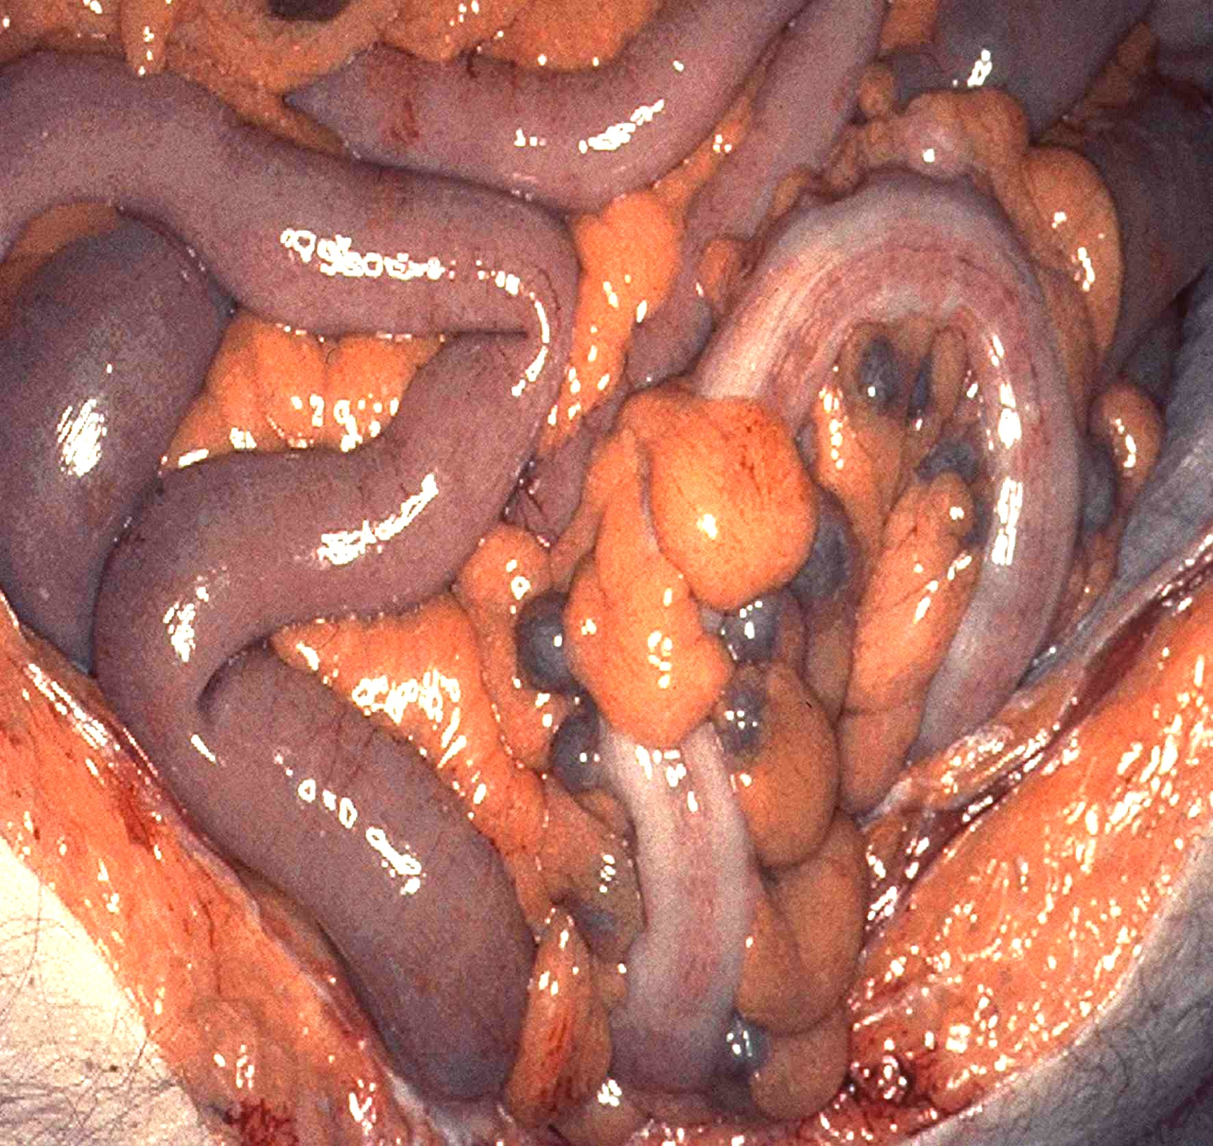
Operative Picture

Slide 58
Colonoscopy at the L&D 2012
  40% Normal
20% Diverticulosis
25% Polyps
3% Cancer
  12% Colitis (surveillance)

Slide 59
Diverticular Disease
Prevalence = 40% in those >50y
70% of those >80y
Diverticular ? disease - ? Normal “Wear and Tear”
68,000 Hospital admissions / year in UK
2,000 deaths / year in UK
Spiller RC. Mechanistic RCT of Mesalazine in Symptomatic Diverticular Disease. Clinical Trial number NCT00663247. 2010
Diverticular disease and diverticulitis, Clinical Knowledge Summaries (March 2008)

Slide 60
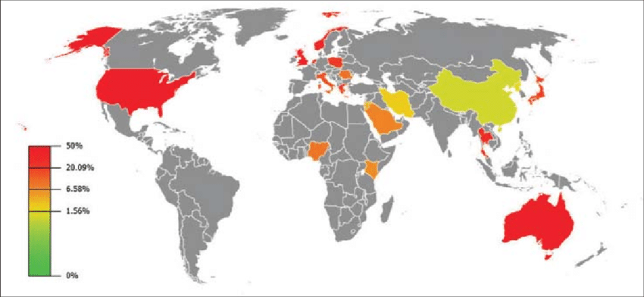
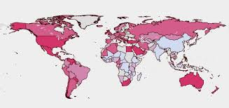
Diverticular Disease
Wheat Consumption

Slide 61
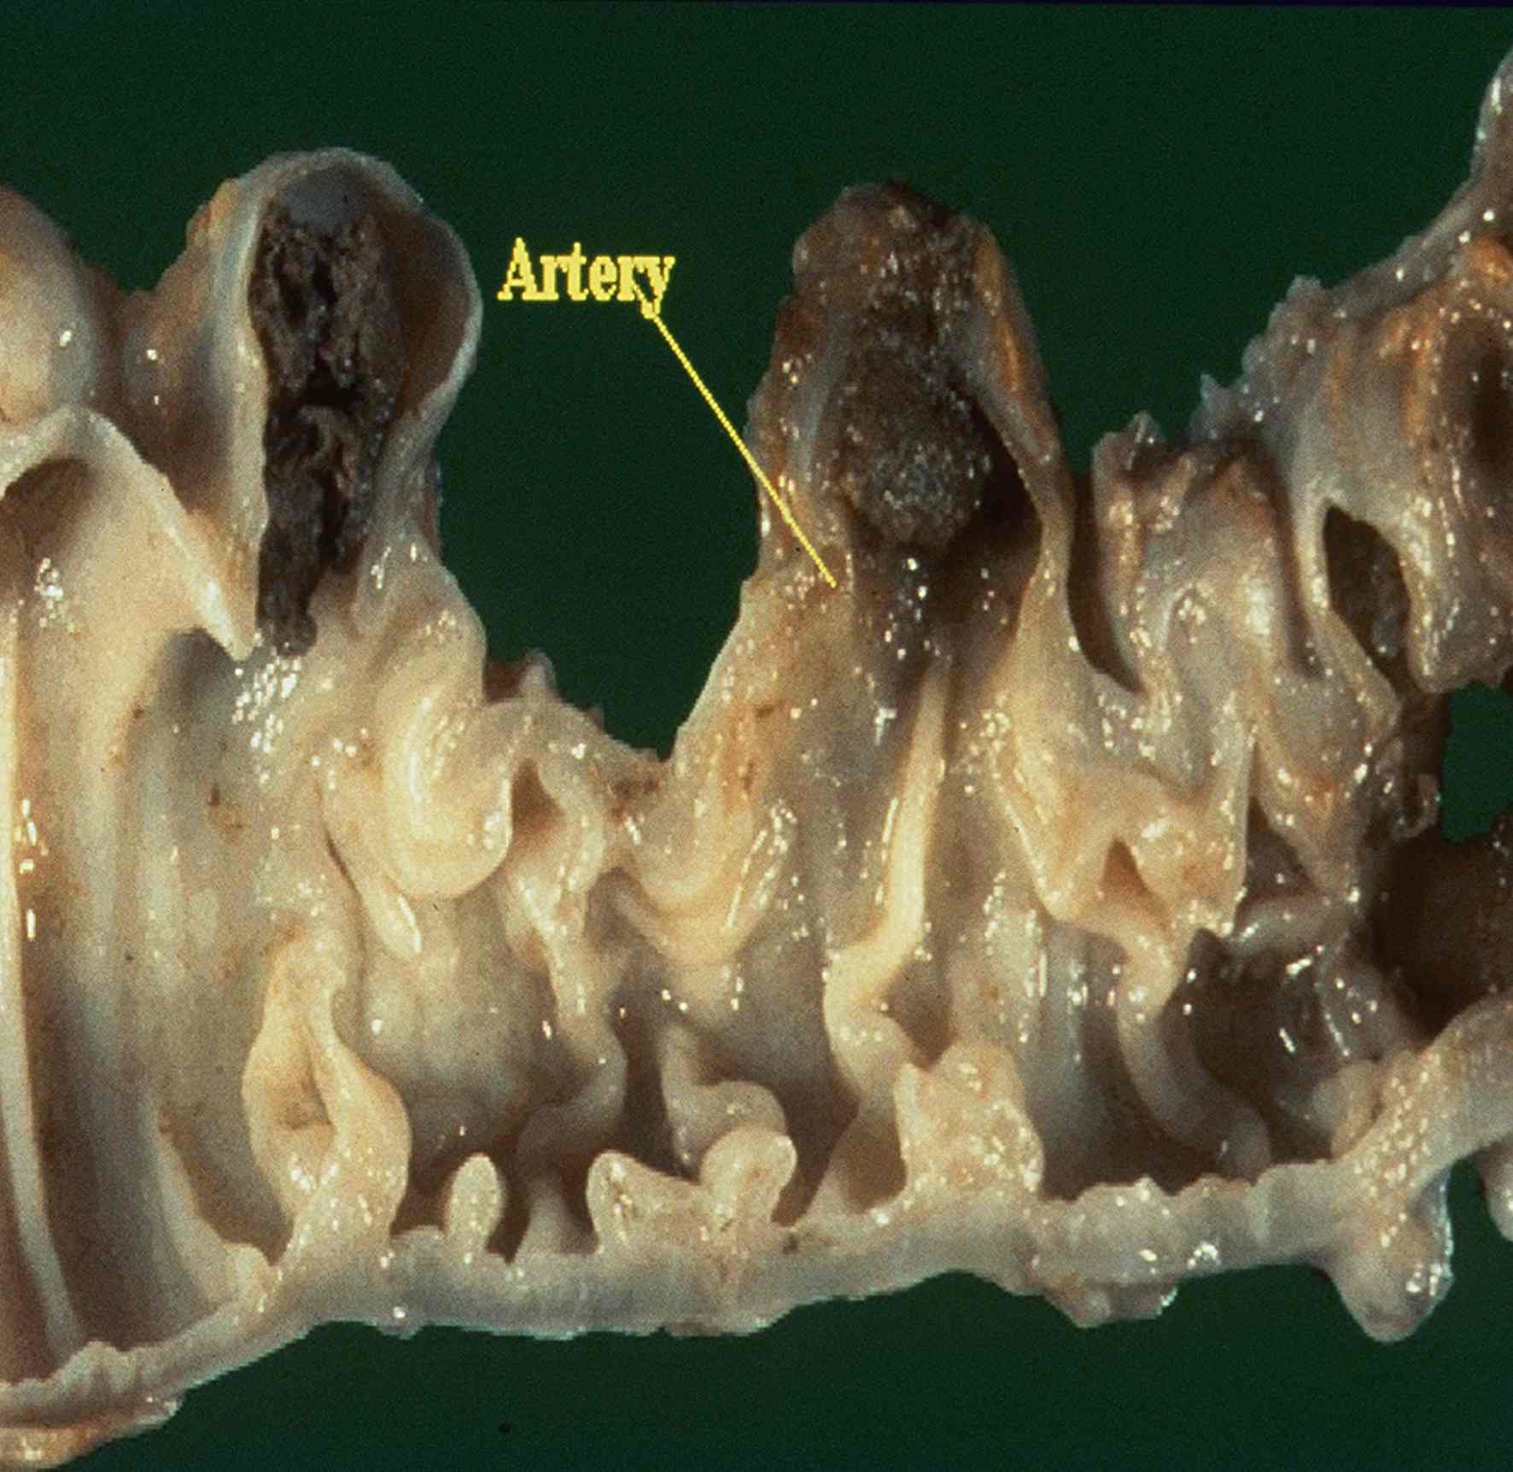
Complications of Diverticulitis
Bleeding¹ (15-25%)
Perforation (25%)
Obstruction
Fistulae
Abscess
May co-exist with IBD
Specimen showing blood in diverticulae
1 Travis S. Colonic Diverticular Disease 2005;312

Slide 62
Bleeding in Diverticular Disease
  3-5% of all diverticulosis
  15-25% of all the diverticulitis ¹
  Accounts for 40% of all LGI bleeding ¹
  75-90% stop spontaneously ²
  10-40% risk of re-bleed ²
  Morbidity + Mortality rate = 10-20% ³
1 Gostout CJ. JClinGastro. 1992;14(3):260
2 McGuire HH Jr. Ann Surg. 1994;220(5):653
3 Uden P. Dis Colon Rectum. 1986;29(9):561

Slide 63
Re-Bleeding Rates
Re-bleeding rate
Year | Percentage
1 | 9
2 | 10
3 | 19
4 | 25
1 Longstreth Am J Gastro 1997

Slide 64
Diverticular colitis
Presentations
  Asymptomatic
  Bloody diarrhoea
  Abdo pain
Affects sigmoid like UC but doesn’t effect rectum
Rx = Mesalazines ^{1,2,3,4}
1 Spiller RC. NCI00663247
2 Mario F. JClinGastro. 2006;40Suppl3:S1. 55-9
3 G. Did Dis Sci. 2007;52:2934-41
4 A. Dig Dis Sci. 2007. 2007;52:671-4

Slide 65
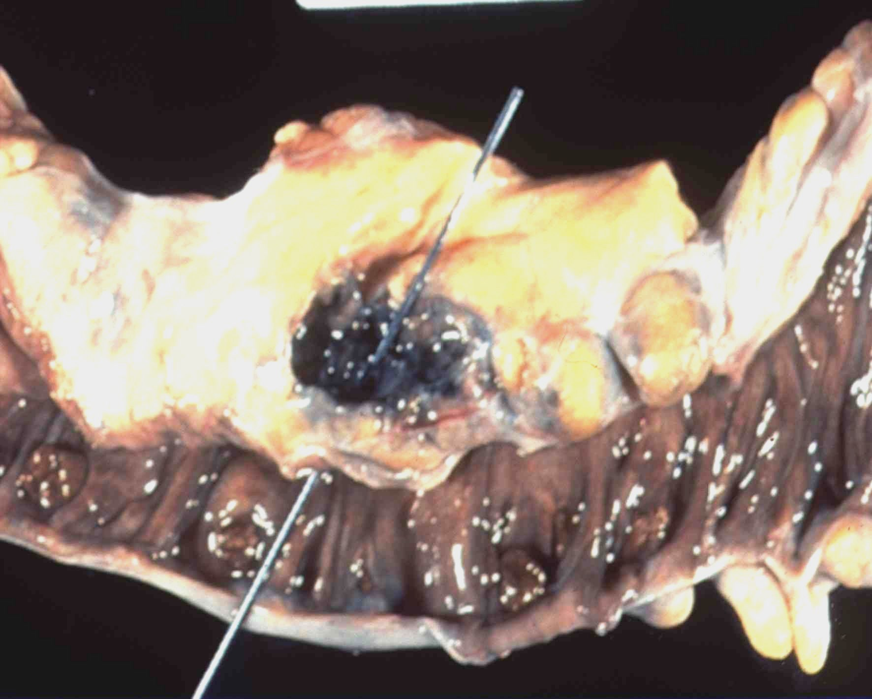
Perforation (35% Mortality)

Slide 66
