Slide 1




Weight Loss
& The Balloon Party
Dr. Matt W. Johnson

Slide 2
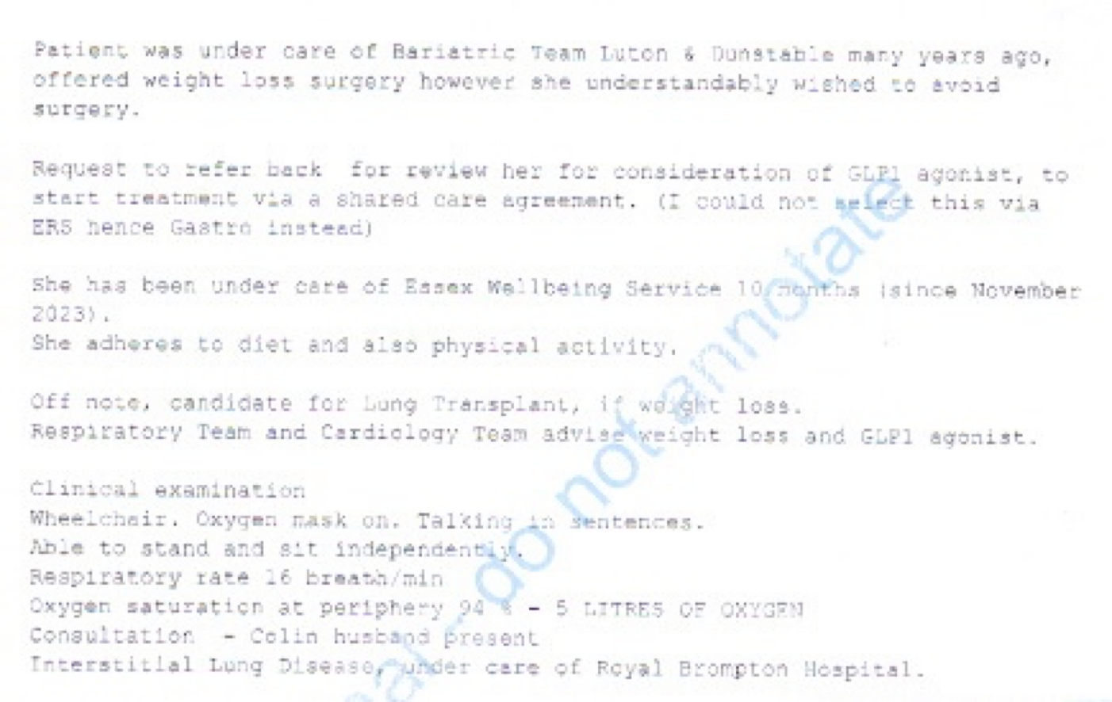
Obesity Referral for Medical Treatment

Slide 3
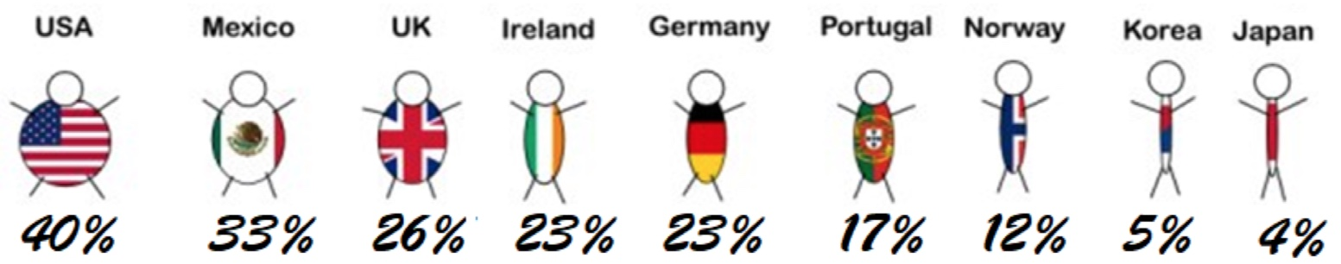
Obesity in UK - Worldwide Comparison

Slide 4
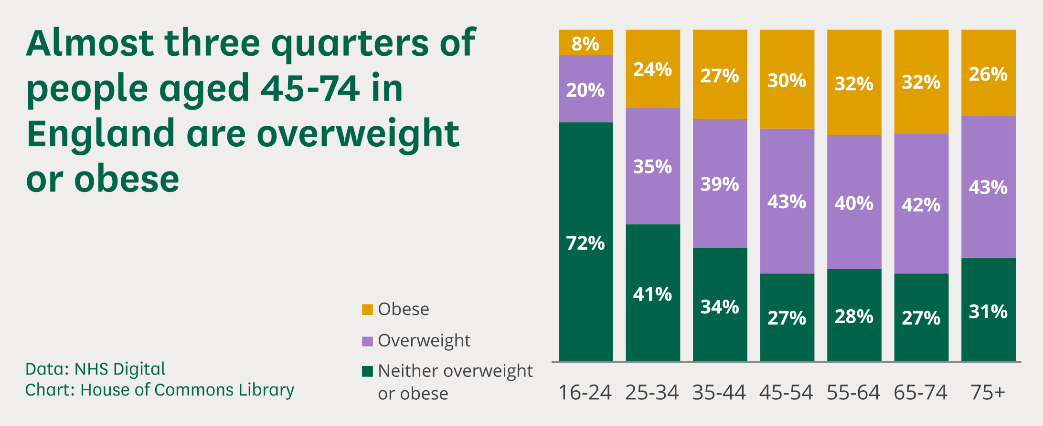
UK Parliament Website:

Slide 5
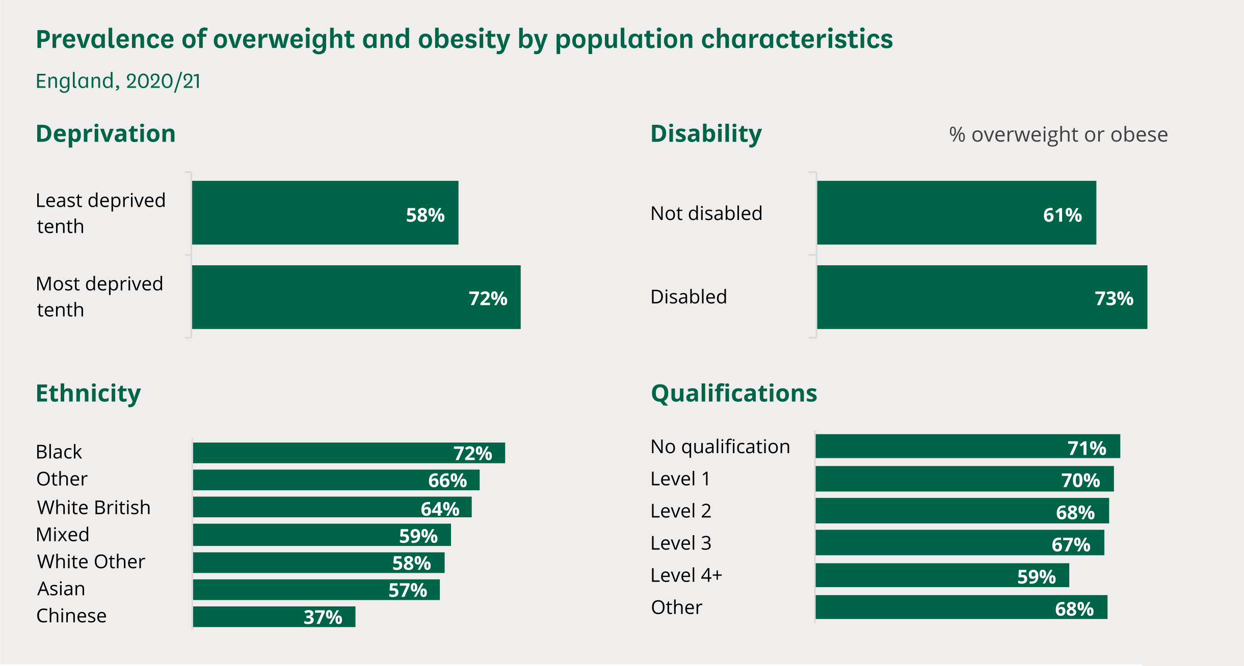
UK Parliament Website:

Slide 6
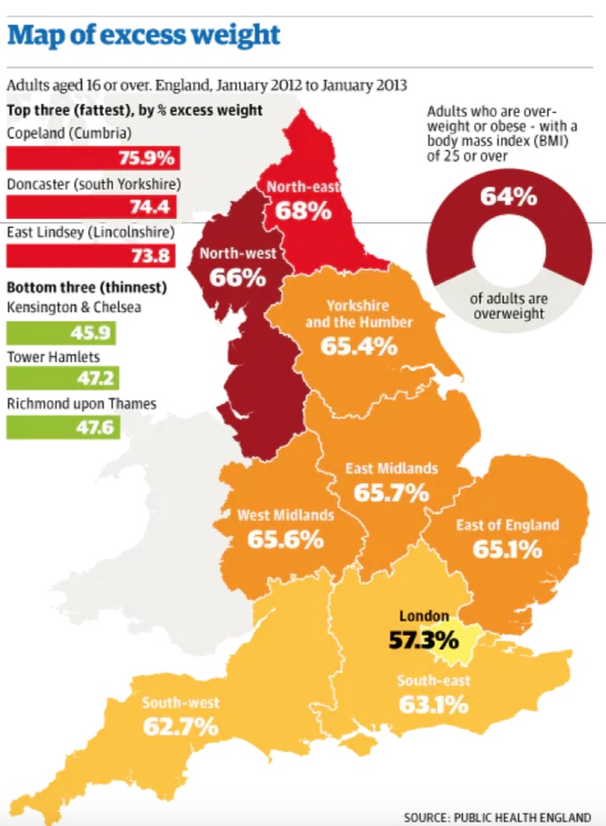
Public Health UK:

Slide 7
Audience Participation
Know your BMI
https://www.nhs.uk/health-assessment-tools/calculate-your-body-mass-index
Google - NHS BMI calculator
BMI - 25-30 = Overweight
BMI > 30 = Obese

Slide 8
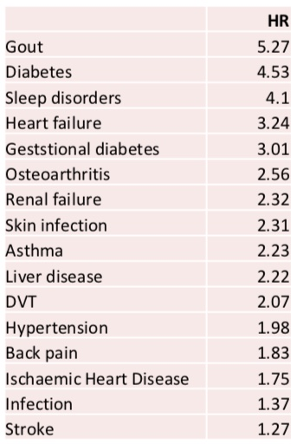
BMI & Risk of Obesity-related complex Co-Morbidity:
an Observational Multicohort Study
Lancet 2022;10:253-63

Slide 9
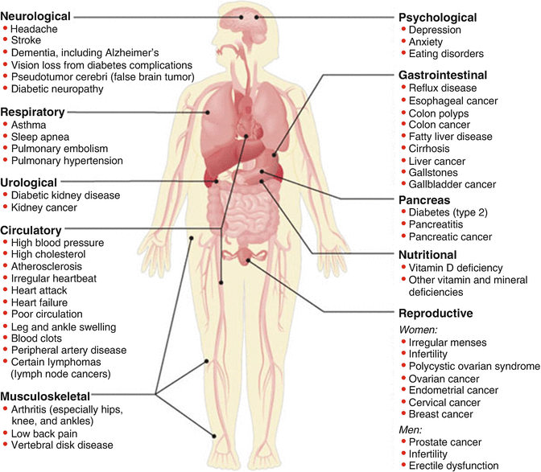
Weight & Medical Issues:

Slide 10
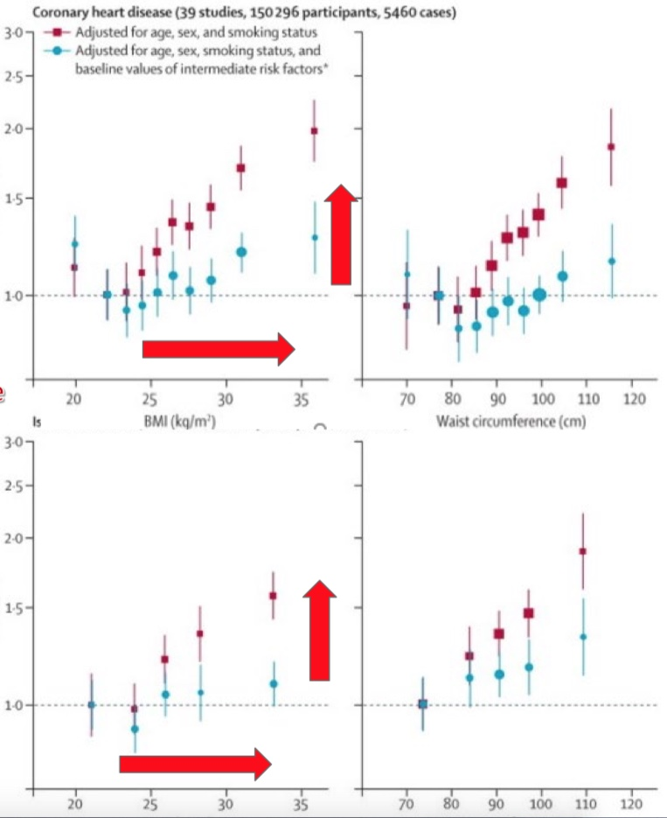
Obesity CVS Vs Stroke Risk: Hazard Odds Ratios
CVS Risk
Lancet 2011; 377 (9784):
1085-1095
Stroke Risk

Slide 11
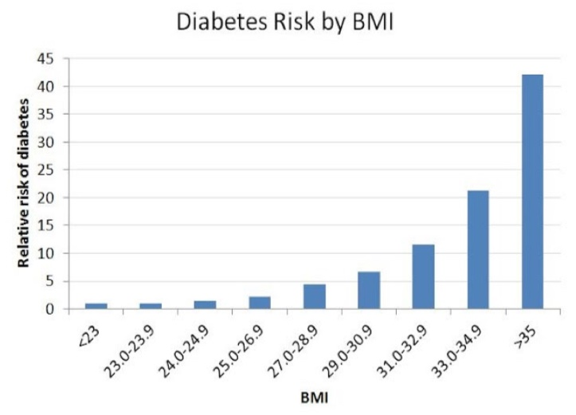
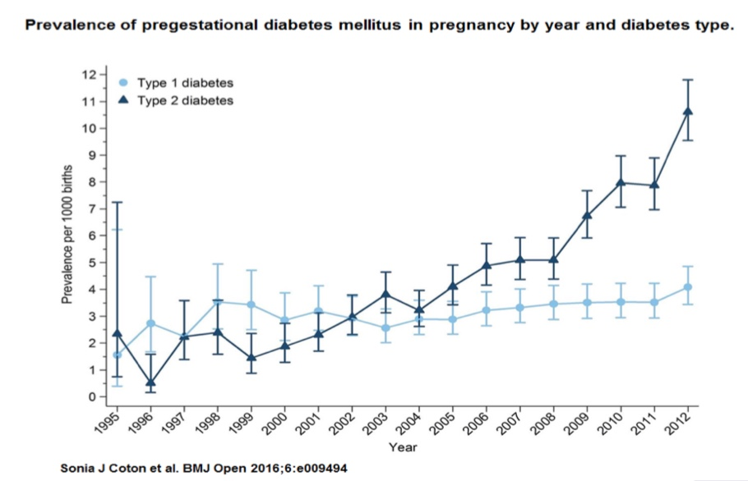
Obesity and DM Risk:

Slide 12
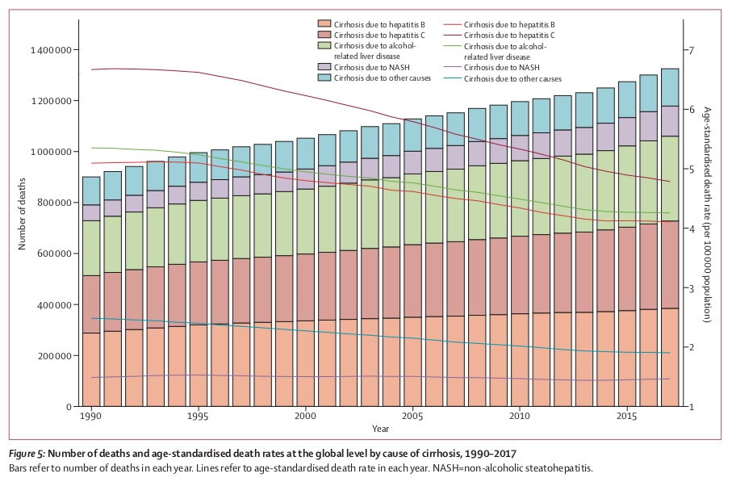
NASH & Cirrhosis:
The Lancet. GastroHep. March 2020. Vol 5; Issue 3, 245-266

Slide 13
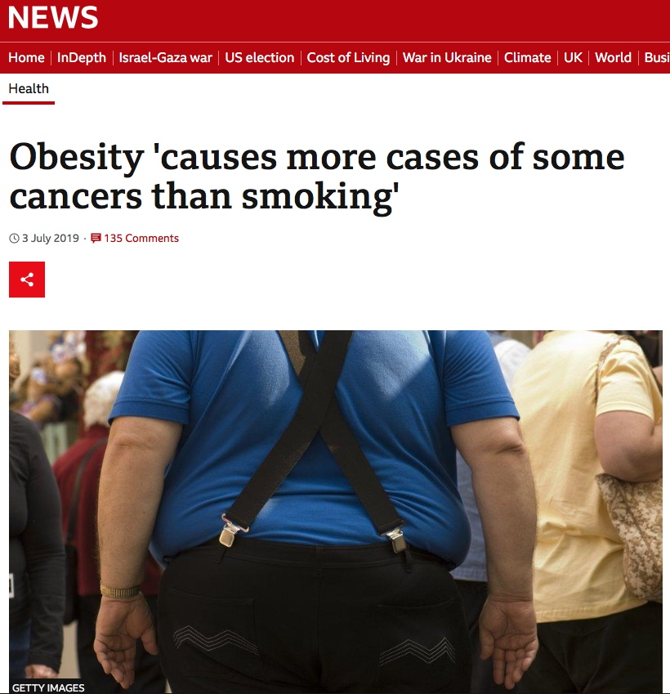
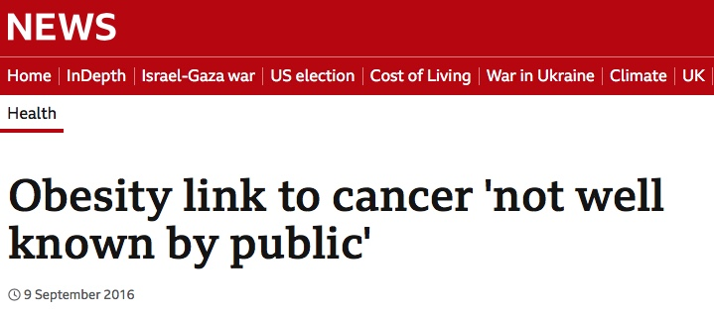
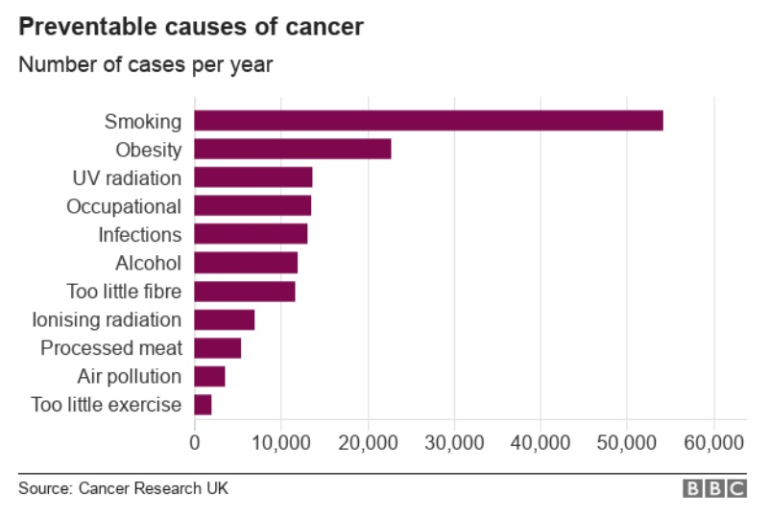
BBC Headlines on Obesity & Cancer:

Slide 14
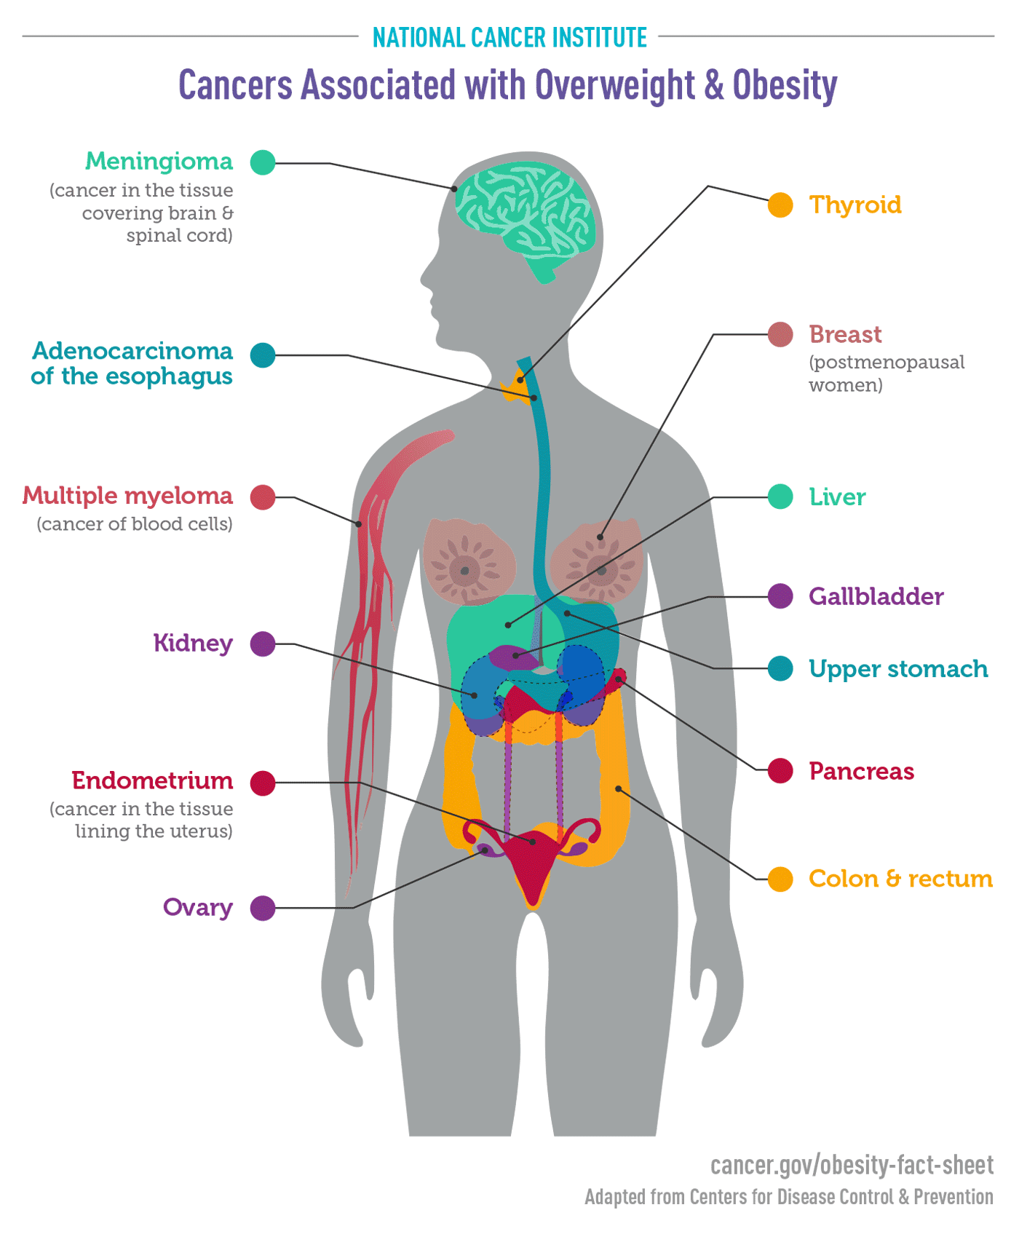
Obesity & Cancer:

Slide 15
Obesity & Cancer:
Cancer | Relative Risk
Endometrial | 7x in Severely Obese 2-4x in Obese + Overweight
Oesophageal | 4.8x in Severely Obese 2.5x in Obese 1.5x in Overweight
Stomach | 2x in Obese + Overweight
Liver | 2x in Obese + Overweight
Kidney | 2x in Obese + Overweight
Pancreatic | 1.5x in Obese + Overweight
Gallbladder | 1.6x in Obese 1.2x in Overweight
Meningioma | 1.5x in Obese 1.2x in Overweight
Breast - Post-Menopausal | 1.4x in Obese + Overweight with 1.2x as likely for every 5unit increase in BMI
Breast Pre-Menopausal | 0.8x in Obese + Overweight
Colo-Rectal Cancer | 1.3x in Obese
Thyroid | 1.3x in Obese + Overweight
Multiple Myeloma | 1.2x in Obese + Overweight
Ovarian | 1.1x as likely for every 5unit of increase in BMI
Exploring the link between obesity and cancer risk - healthcare-in-europe.com

Slide 16
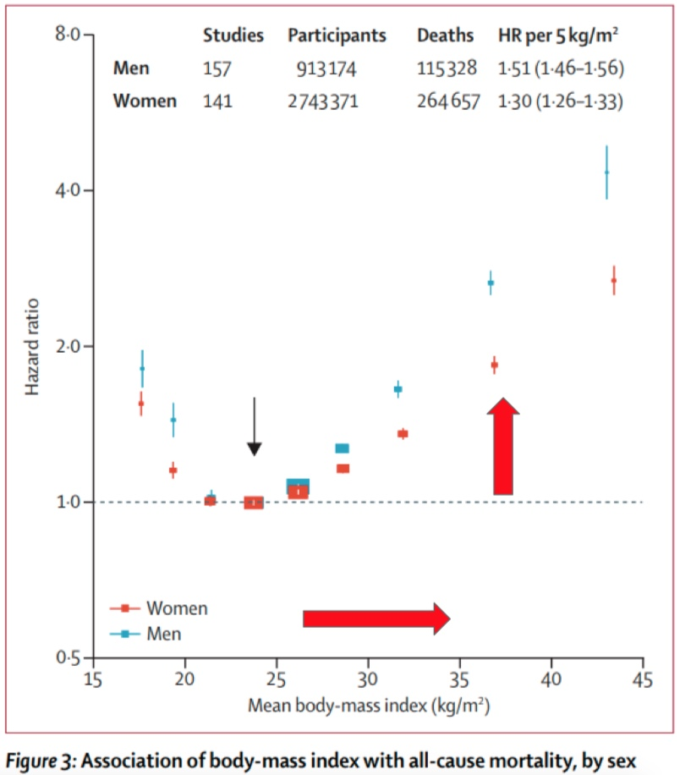
Weight & Mortality:

Slide 17
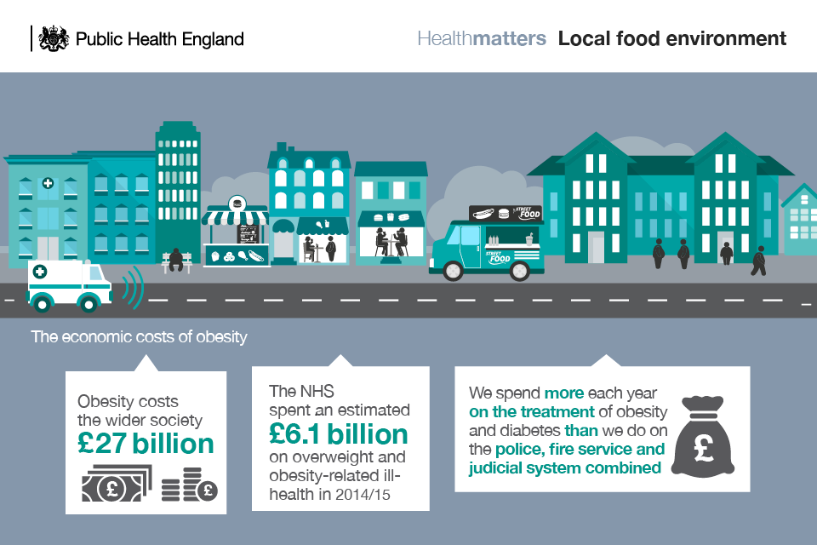
Cost of Obesity on UK

Slide 18
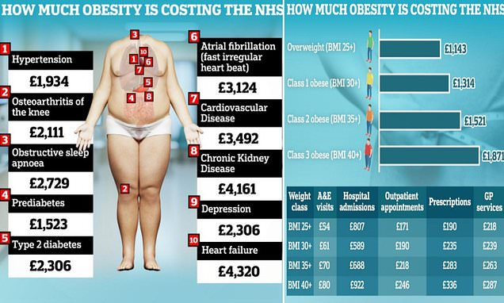
Cost of Obesity on UK - Daily Mail

Slide 19
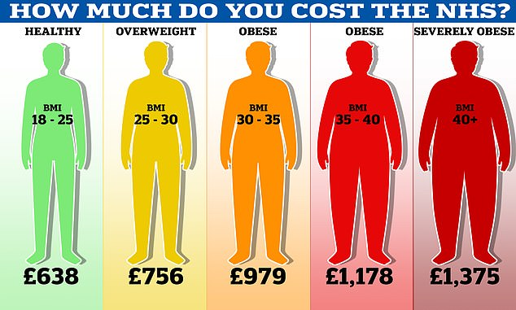
Cost of Obesity on UK - Daily Mail

Slide 20
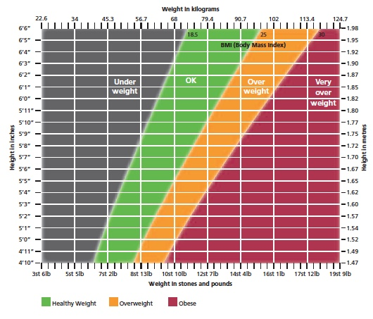
Weight Loss Options
6’2”
95Kg
BMI = 27
Pre-Obese

Slide 21
Weight Loss Management Options
Classification | BMI (kg/m²) | Waist Circumference |  | Co-Morbidities
 |  | Low | High
 |  | Men < 94cm Women < 80cm | Men > 94cm Women > 80cm | Typ2 Diabetes Hypertension CVS Disease Dyslipidaemia Sleep Apnoea Fatty Liver Disease Osteoarhthritis
Healthy | 18.5 - 24.9
Overweight | 25 - 29.9
Obesity 1 | 30 - 34.9
Obesity 2 | 35 - 39.9
Obesity 3 | > 40
BMI Classification
Tier 1 | Diet & Exercise +/- Balloon
Tier 2 | Diet & Exercise & Balloon +/- Orlistat
Tier 3 | Diet & Exercise & Balloon +/- Semaglutide (Wegovy or Ozempic) + Liraglutide
Tier 4 | Diet & Exercise & Balloon & Drugs & Surgery
Mx Options

Slide 22
Weight Loss Treatment Options
Active Ingredient | Trade Name | Form | How it works | How often
Orlistat | Orlistat | PO | Prevents absorption | 3x a day (with meals)
 | Xenicol | “ | “ | “
 | Alli | “ | “ | “
Bupropion-Naltrexone | MySimba | PO | Reduces appetite | 2x a day | Not available on NHS
Liraglutide | Saxenda | S/C | Reduces appetite | 1x a day | BMI >35 or BMI >30 + MedComps
Semaglutide | Ozempic | “ | “ | 1x a week | T2DM >3 Meds or SEx + BMI >35
 | Wegovny | “ | “ | “ | BMI >35 or BMI >30 + MedComps
Tirzepatide | Mounjaro | “ | “ | “ | Useful in T2DM BMI>30 or BMI >27 + MedComps

Slide 23
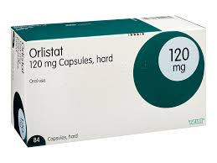
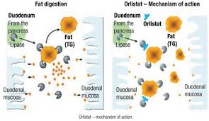
Orlistat
3x a day with meals

Slide 24
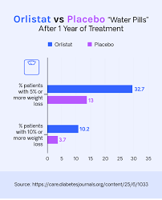
Orlistat Results
 | 8093 Patients % Experienced
Diarrhoea | 525 (6.5%)
Weight Gain | 239 (2.9%)
Intolerance | 120 (1.5%)
Unspecified SEx | 110 (1.4%)
Abdo Pain | 91 (1.1%)
Flatulence | 79 (1%)
Pregnancy | 75 (0.9%)
Malaise | 70 (0.9%)
GI Unspecified | 63 (0.8)
Faecal Incontinence | 62 (0.8%)
Safety profile of orlistat: Results of a prescription-event monitoring study
December 2006. International Journal of Obesity. 30(11):1645-52

Slide 25
GLP-1 - Glucagon Like Peptide 1
GLP-1 is normally produced in the small bowel post-prandially
Slows Gastric Emptying
Increases a sense of satiation
Increases pancreatic Insulin
Reduces pancreatic Glucagon
Reduces Glucose by decreasing Hepatic Gluconeogenesis

Slide 26
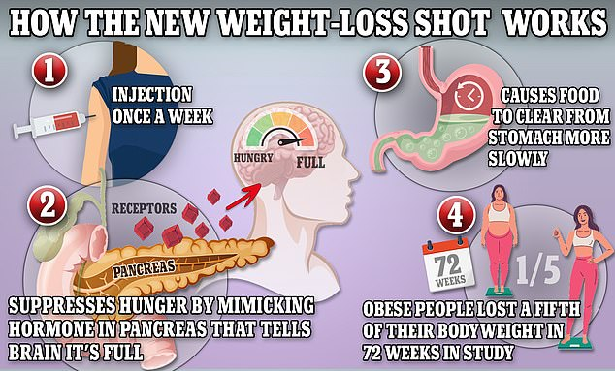
Mimics - Glugagon Like Peptide 1

Slide 27
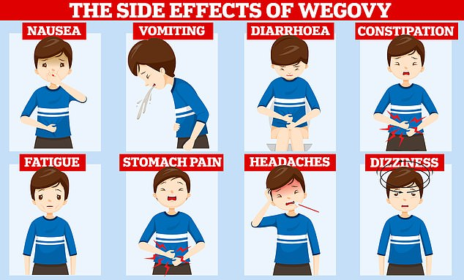
GLP1 mimickers - Side Effects seen in >10%
1% risk of Pancreatitis
0.1% risk of facial swelling + shortness of breath
0.01% risk of Anaphylaxis
Others include ;- Wildly ivid dreams / Metallic Taste in Mouth / Rapid Muscle loss / Bounce back weight / Odd food repulsions / Thyroid Cancer concern

Slide 28
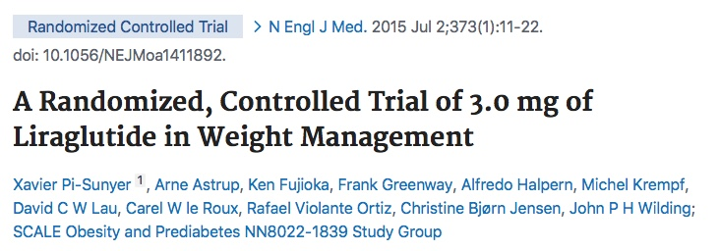
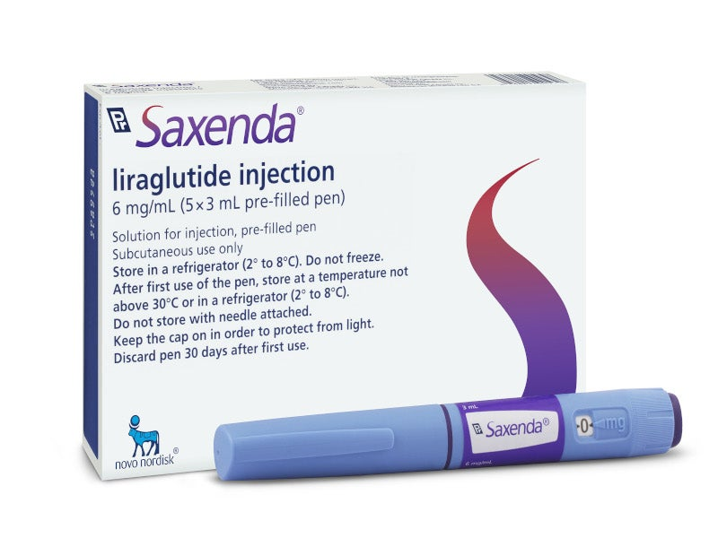
Saxenda: Liraglutide: GLP-1 - Glucagon Like Peptide 1
Daily Injection
GLP-1 is normally produced in the small bowel post-prandially
Slows Gastric Emptying
Increases a sense of satiation
Increases pancreatic insulin
Reduces Hepatic Glucogenesis thereby lowering glucose level

Slide 29
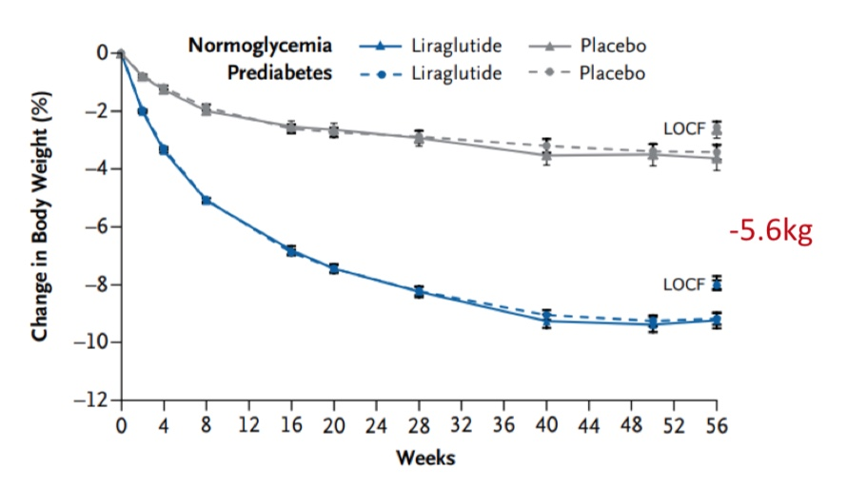
Saxenda: Liraglutide

Slide 30
Saxenda: Liraglutide Side Effects
 | Placebo % n=1,941 | Saxendra % n= 3,384
Nausea | 13.8 | 39.3
Vomiting | 3.9 | 15.7
Diarrhoea | 9.9 | 20.9
Constipation | 8.5 | 19.4

Slide 31
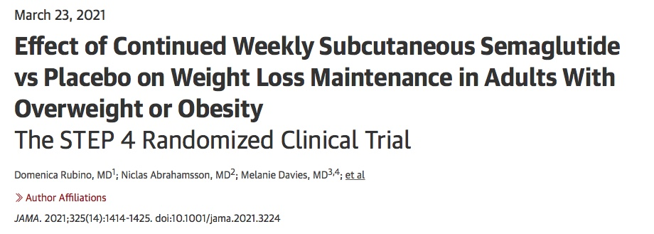
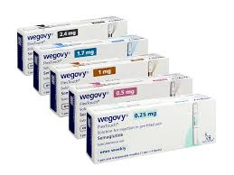
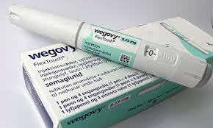
Wegovny: Semaglutide
Daily Injection
Weekly
Injection

Slide 32
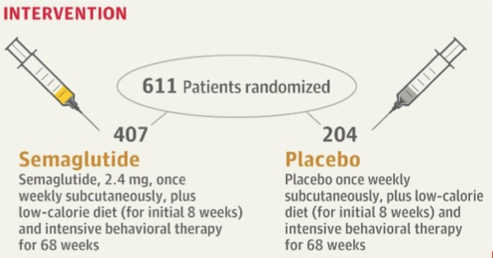
Wegovny: Semaglutide
Mimics post-prandially GLP-1 ;-
Slows Gastric Emptying / Decrease Appetite / Increase satiation
Reduces Hepatic Glucogenesis thereby lowering glucose level
Increases pancreatic insulin

Slide 33
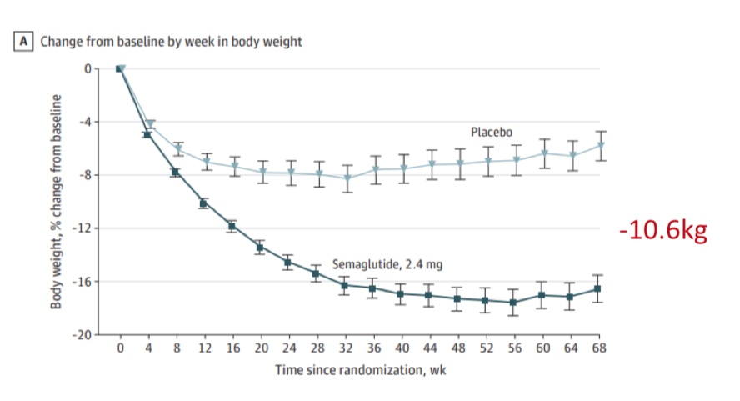
Wegovny: Semaglutide

Slide 34
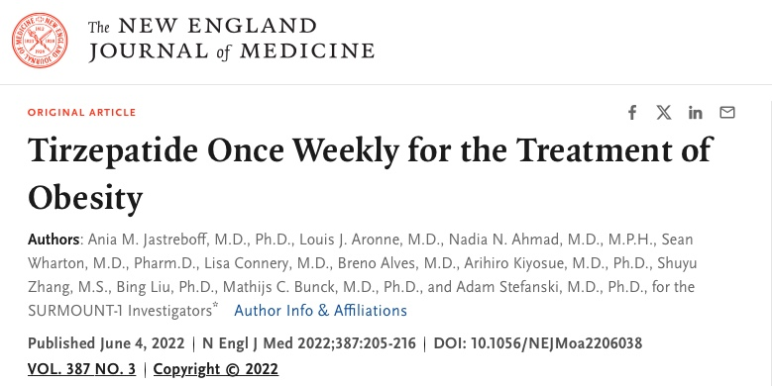
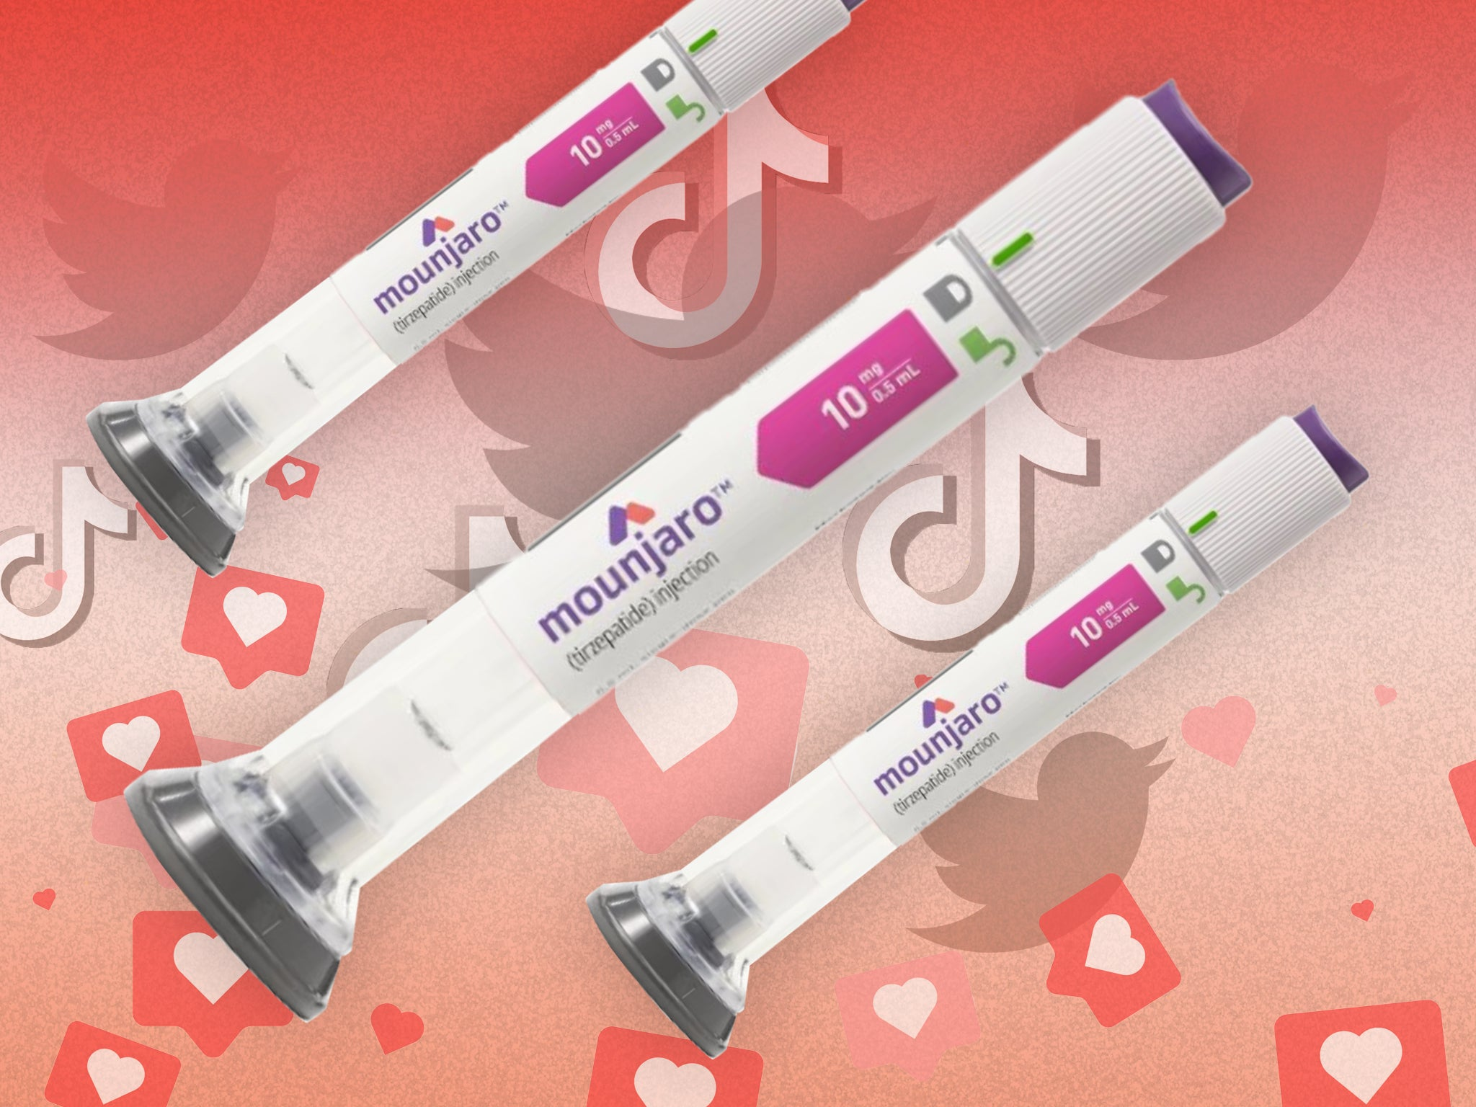
Mounjaro: Tirzepatide
Weekly
Injection

Slide 35
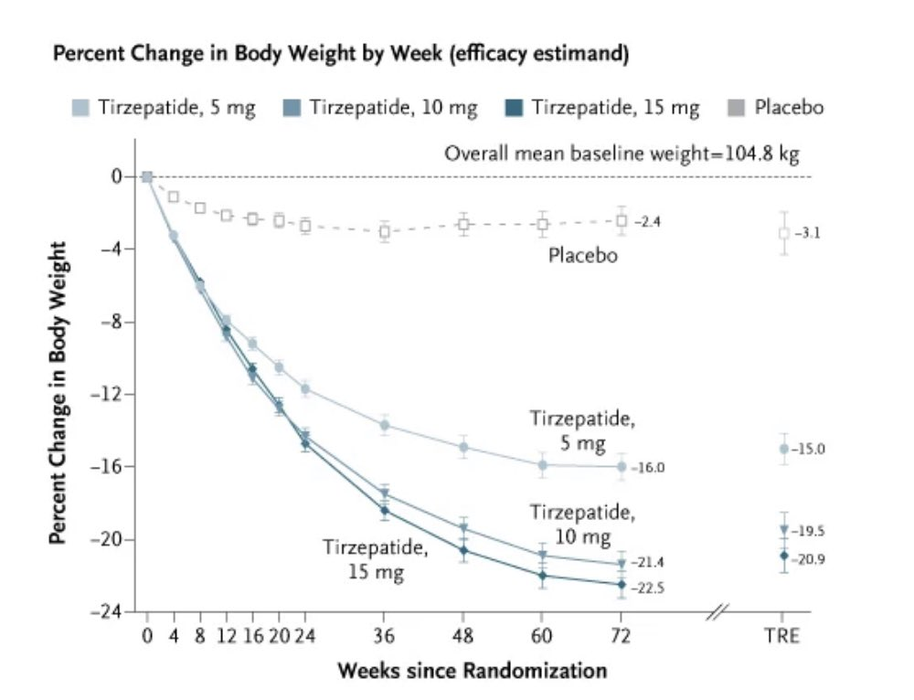
Mounjaro: Tirzepatide

Slide 36
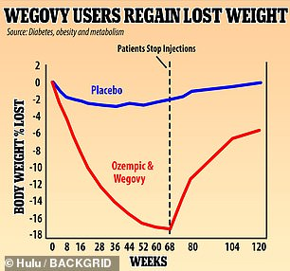
Wegovny: Semaglutide
18% weight loss in 68w but 2/3rds regain 12% in <1y

Slide 37

BBC - Weight loss Risks
Nurse’s death linked to drug loss drug
Health Secretary Wes Streeting hailed the jabs (Tirzepatide (Mounjaro) as "game-changing"
Government supported Manchester trial (250,000)
plans to roll it out to unemployed people to help get them back to work
UK Yellow Card System
Tirzepatide (Mounjaro) - Jan -May 2024
208 SEx, 31 Severe SEx, 1 death (+1)
Semaglutide (Wegovny + Ozempic)
21 suspected deaths since 2019

Slide 38
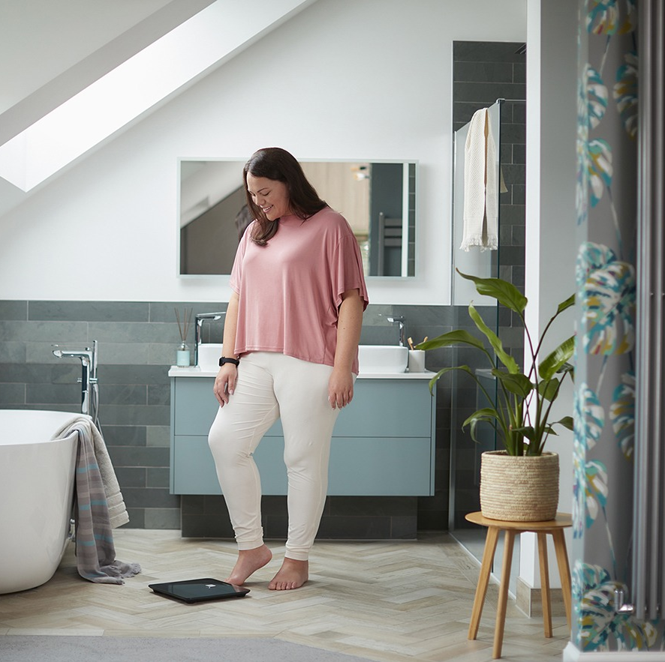
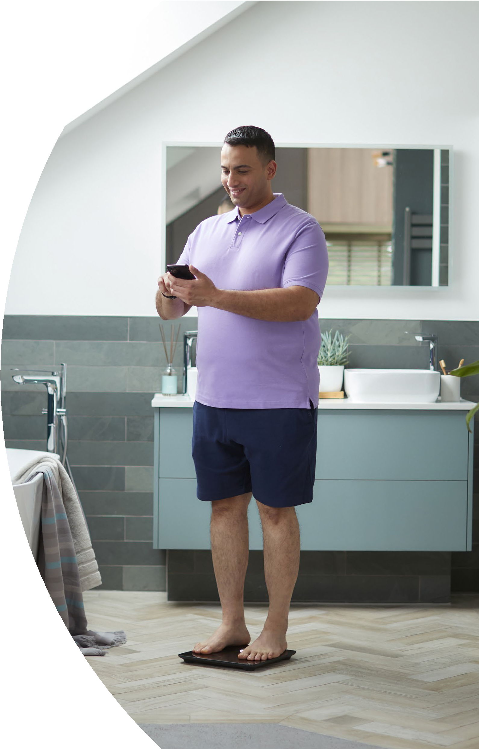
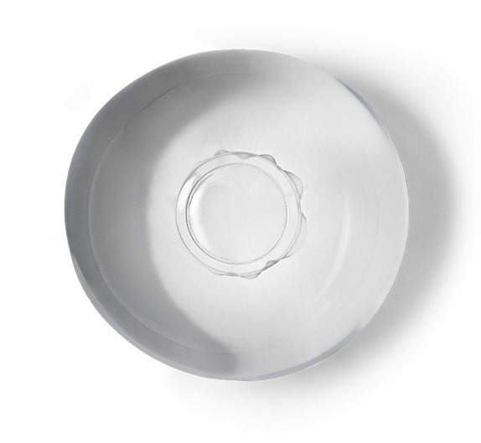
The fast and sustainable way to lose weight.
Start your Allurion journey today.
*In rare cases, the Allurion Balloon may require endoscopic or surgical intervention for removal.
The program
How it works
Placement
Support
Safety
Results
About Allurion
Next steps

Slide 39


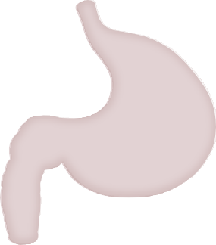








How does it work?
6
The Allurion Balloon takes up space in your stomach, leaving less room for food. This is designed to help you feel fuller faster and for longer. It reduces your appetite and portion sizes, aiding weight loss
The Allurion Balloon is easily placed during a 15-minute walk-in appointment
The balloon and your lifestyle change program work together to help you create healthier habits that last a lifetime
The program
How it works
Placement
Support
Safety
Results
About Allurion
Next steps

Slide 40
The only gastric balloon requiring no endoscopy for placement or removal*
7
What happens on placement day
01 - Swallow
You swallow a capsule that contains the balloon attached to a thin tube. You will have an X-ray to make sure the capsule is in the right position.
02 - Fill
Once in your stomach, your doctor will use the tube to fill the balloon with liquid.
03 - Disappear
At approximately 4 months after placement, the Allurion Balloon self-empties and passes naturally.*
You will have a second X-ray to confirm the balloon is filled. The doctor will then gently remove the tube and you’ll be on your way. With the balloon in your stomach, you can eat less without feeling hungry.
99.9% of
patients can swallow the device¹
Sources:
1. Ienca, R et al. Obesity surgery vol. 30,9 (2020): 3354-3362
*In rare cases, the Allurion Balloon may require endoscopic or surgical intervention for removal.
The program
How it works
Placement
Support
Safety
Results
About Allurion
Next steps

Slide 41

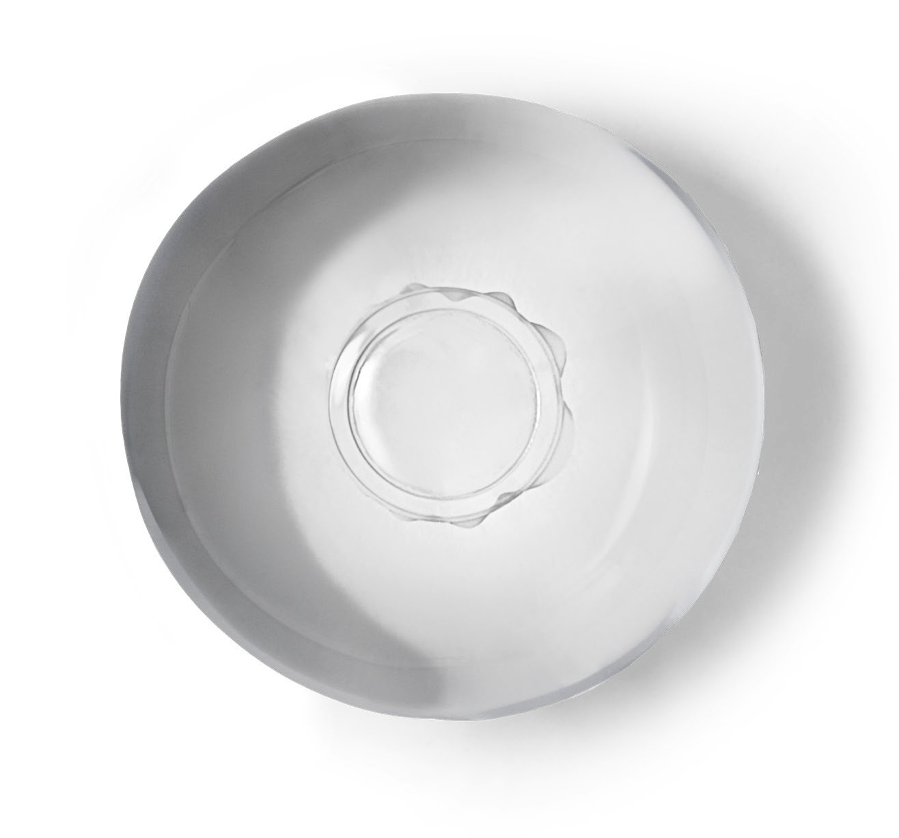
Superior safety outcomes compared to endoscopicially placed balloons
11
01
Unlike endoscopic
balloons, the Allurion Balloon conforms to to the shape of the stomach – an oval shape like a grapefruit, with two flat surfaces
03
Unlike endoscopic balloons, the Allurion Balloon, being malleable, flexes
and adapts to the shape of your stomach
02
Made from polyurethane, a material that is much thinner and more flexible than the silicone material in endoscopic balloons¹
04
Significantly lower intolerance rates compared to 12-month endoscopic balloons (1-3% vs 14.4%)^{2,3}
Sources:
Ienca et al. Obes Surg 2020
Jamal MH, et al. Obes Surg. 2022 F|
Abu Dayyeh et al. Lancet. 2021
The program
How it works
Placement
Support
Safety
Results
About Allurion
Next steps

Slide 42
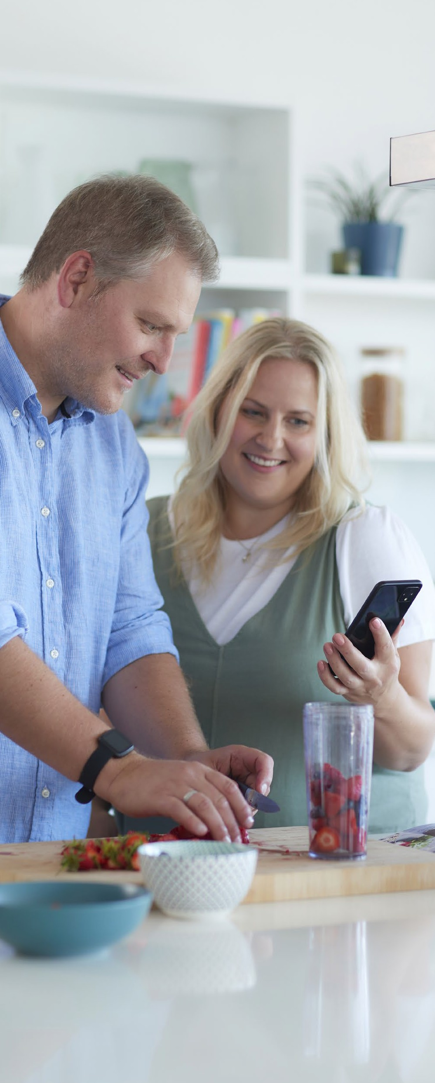




The gastric balloon program for fast, effective weight loss and healthier lifestyle habits
4
Simple and safe
No surgery,
no endoscopy* and placed
in 15 minutes
Effective results
Average weight loss:
Lifestyle modification
Shift towards healthier and sustainable lifestyle habits
Digital tools
A suite of digital tools to help you monitor your progress, connect with your clinical team and achieve your goals
10-15%
In approximately 4 months with
1 balloon¹
Passes naturally after approximately 4 months
Weight-loss maintenance:
96%
of average weight loss may be sustained at 1-year follow-up³
23%
Over 12-18 months with the extended 2-balloon program²
Sources:
Ienca, et al. Presentation at IFSO 2023, Naples, Italy
Ienca et al. presented at TOS Obesity Week, 2020
Ienca et al. Presented at the EASO Congress, 2022.
*In rare cases, the Allurion Balloon may require endoscopic or surgical intervention for removal.
The program
How it works
Placement
Support
Safety
Results
About Allurion
Next steps

Slide 43

How much weight can you expect to lose?
16
BMI of +27
BMI of 35-40
BMI of +40
patients
on average lose 10-15% of their body weight¹
patients
on average lose 15% of their body weight²
patients
on average lose 20% of their body weight³
During the initial month following the Allurion Balloon placement, patients typically experience an impressive 7% body weight loss.
Source
Ienca R. et al. presented at Obesity Week 2022
Ienca et al. presented at TOS Obesity Week, 2020
Raftopoulos Y aet al. Presented at ASMBS, 2023.
The program
How it works
Placement
Support
Safety
Results
About Allurion
Next steps

Slide 44







Everyone’s weight-loss journey is unique. The Allurion Program offers three options to meet your individual needs and goals.
15
6-month
Allurion Program
The Results
10-15% average weight loss
73% weight loss sustained at 1 year
Included in the program
1 balloon
Medical support
6 months in clinic
and digital
Nutrition coaching
6 months
Digital tools Technology to use and keep
12-month
Allurion Program
The Results
10-15% average weight loss
96% weight loss sustained at 1 year
Included in the program
1 balloon
Medical support
12 months in clinic
and digital
Nutrition coaching
12 months
Digital tools Technology to use and keep
12-18 month extended
Allurion Program
The Results
23% average weight loss after a 2-balloon program
Included in the program
2 balloons
Medical support
Nutrition coaching
12-18 months
Digital tools Technology to use and keep
The program
How it works
Placement
Support
Safety
Results
About Allurion
Next steps

Slide 45
Allurion Balloon Side Effects
8th Aug
ANSM suspends Allurion gastric balloons in France
Due to
No. of reported adverse events over 2y
Lack of monitoring
Lack of training in the Mx of complications outside of the insertion centres
Advertising non-compliance
Allurion Response;-
Safety and effectiveness are well-established in 20 peer-reviewed journal articles
> 150,000 patients treated around the world
Serious adverse event rate of 0.34% for the Allurion Balloon was published by Ienca et al. in 2020 in a multi-center study of 1,770 patients

Slide 46
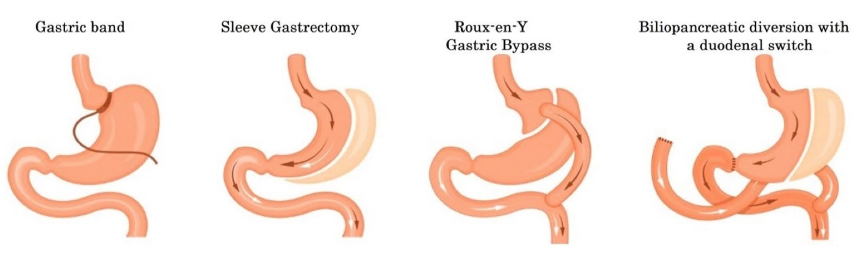
Weight Loss Surgeries
BMI > 40

Slide 47
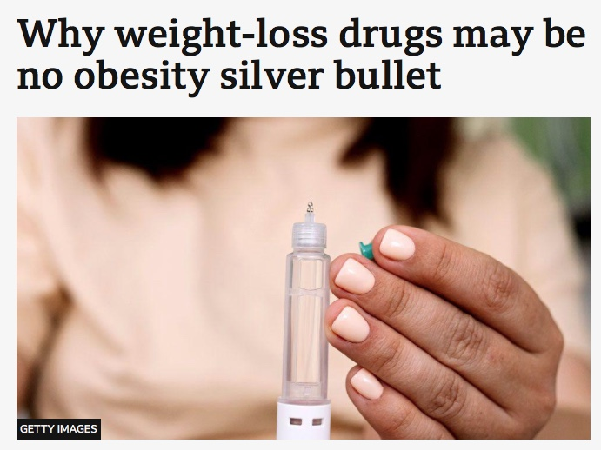
Reliance on a Skinny Jab - BBC
Obesity-related illness costs the NHS an estimated £11bn a year – about 8% of its spending. Add in lost productivity, or 4% of gross domestic product (GDP)
There is also concern the drugs could encourage a "dependency culture", where people do not bother with healthy eating and exercise
something Streeting himself has acknowledged.

Slide 48
The Future of Weight loss Management ??

