Slide 1
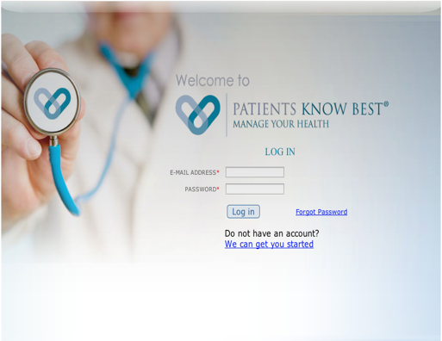
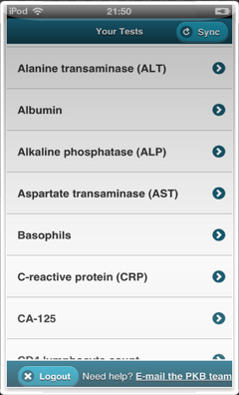
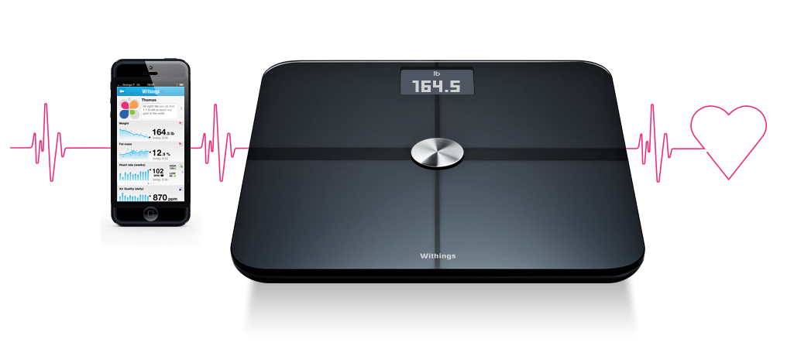
Coeliac - Supported, Self Help And Management Programme (C-SSHAMP); UK’s first remote web-based management system for stable coeliac patients.
MW Johnson, K.Rostami, M.Marsh, P.Ciclitira.
Gastroenterology, Luton & Dunstable FT University Hospital., UK
Introduction
The 1:150 prevalence of coeliac patients in UK carries an economic burden and has created a dilemma for the NHS in how best to deal with the increasing numbers. The 2010 BSG guidelines on the “Management of coeliac disease in UK” {1}, advocates that all coeliac patients should receive longterm review with someone experienced in coeliac management. Many Clinical Commissioning Groups have therefore recommended discharging these patients for GP community review. Unfortunately, we often find that these patients have not received the appropriate care and support they need, and are being re-referred back to the hospital once potentially avoidable long-term complications have already occurred. We set out to try and prevent this by developing an alternative, cost efficient, safe and effective method of managing our stable coeliac patients.
Aims
To develop a novel way of managing our coeliac patients in the community which meets the growing demands on our NHS service, conforms with our national guidelines and is more in tune with the lifestyle and choices of our patients today.
Method
A 7 year retrospective analysis of all serology, duodenal histology and dietetic referrals requested through the Luton & Dunstable University Hospital was used to create a database of all local coeliac patients. With the support of Coeliac UK and our own local Coeliac Forum Group, we have developed personalised web-sites, using Patient Knows Best (PKB), to assist with the remote management of community based coeliac patients, whilst still providing hospital based specialist over-view. With recommendations from leading coeliacologists a set of novel assessment tools had to be developed in order to fully document the status of each patient’s coeliac disease symptoms (S-CAS, Symptomatic - Coeliac Assessment Score) and secondary associations (A-CAS, Associative - CAS). A new Objective - CAS (O-CAS) was devised in order to standardise the annual assessments for each patient and allow monitoring and management by non-medical specialists with an interest in coeliac disease at the annual review.
Method
Results
We now have a database of 1264 coeliac patients. Since January 2014 we have steadily started moving our more stable patients on to our Coeliac - Supported, Self Help And Management Programme (C-SSHAMP). Presently this offers a personalised websites with a novel coeliac symptomatic monitoring system, an alert system if a patient score badly, a library of self help advice sheets and a record of their virtual consultations. The system provides a direct portal of access between patients and their specialists, can be converted into 14 different languages and has both iPhone or Android apps developed. Annually blood tests will be reviewed through a virtual (telephone) clinic to monitor and support patients.
Conclusion
C-SSHAMP is the first remote web-based management system in UK for stable coeliac disease patients. We believe we can automate much of the BSG guidance about annual review, whilst providing a “remote” presence which will act as a gentle reminder to improve compliance with acceptance and adjustment to a strict gluten free diet. By empowering our patients with the confidence and knowledge to monitor and manage their condition more effectively themselves, we aim to reduce the long term complication rate.
References
1) Ciclitira P, Dewar DH, McLaughlin SD, et al. The Management of Adults with Coeliac Disease. London: British Society of Gastroenterology, 2010.
 | Points | Date
Small bowel cancer lymphoma (past or present) | 3
Type 1 Diabetes | 2
Auto immune thyroiditis (hypo or hyper) | 2
IgA deficiency | 2
Dermatitis herpetiformis | 2
Osteopenia / Osteoporosis (< 45y of age) | 2
1st degree relatives (with coeliac or ? other AI conditions) | 1
2nd degree relatives (with coeliac disease) | 1
Irritable Bowel Syndrome | 1
Eczema / Contact Dermatitis | 1
Fybromyalgia | 1
Peripheral neuropathy | 1
Chronic fatigue syndrome | 1
Non-ulcer dyspepsia | 1
Infertility / Multiple miscarriages | 1
Lactose intolerance | 1
Asthma / allergies | 1
Anxiety | 1
Depression | 1
Osteopenia / Osteoporosis (> 45y of age) | 1
Short stature / Delayed growth | 1
Sjogrens syndrome | 1
Primary Biliary Cirrhosis | 1
Auto-Immune Chronic Active Hepatitis | 1
Non-Hodgkins Lymphoma | 1
Dental enamel defects (Chalky colour with visible groves - horizontal or vertical) | 1
Downs, Turners or Williams Syndrome | 1
A-CAS where a +ive score is >4
A range of bluetooth gadgets upload directly onto the personalised websites
Symptoms | 0 = None | 1 = Rare (<15% of the time) | 2 = Intermittent (15-50% of time) | 3 = Frequent (>50% of time)
Tiredness / Lethargy
Oral mouth ulcers
Painful mouth sores (in + out)
Nausea
Indigestion
Abdominal bloating
Abdominal discomfort
Diarrhoea
or Constipation
or Both / Altered bowel habits
Muscle pains
Joint pains
Rashes
Headaches
Unexplained weight loss |  | X | X
Anxiety
Depression
Time off of work
 | Points | Date
+ive TTG or AEA | 2
Anaemia (Hb<12) | 1
Low Ferritin (<30) | 1
Low Folate | 1
Low B12 (<150) | 1
Low Calcium | 1
Low Magnesium | 1
Low Vitamin D | 1
Abnormal TFT | 1
Diabetes (Glu>11) | 1
Osteopenia | 1
Osteoporosis | 1
S-CAS where a score of >20 is +ive
O-CAS were a score of 2 = implies Active and 3 = Severe
Abstract No. PTU-315

