Slide 1
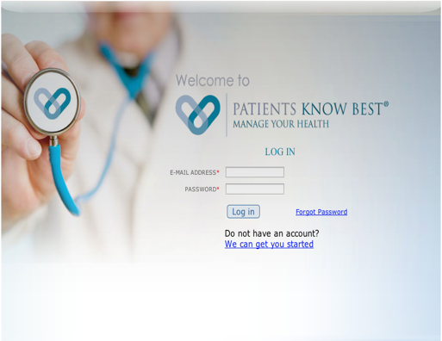
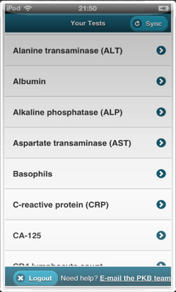
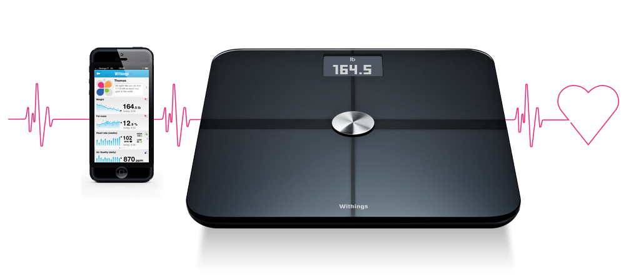
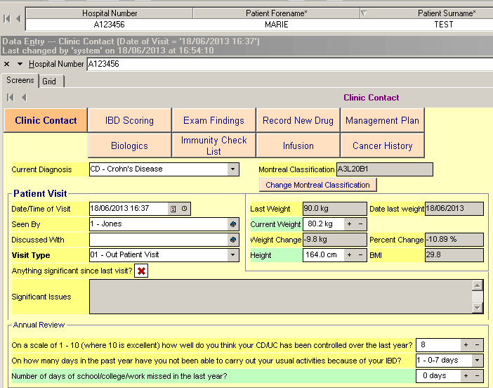
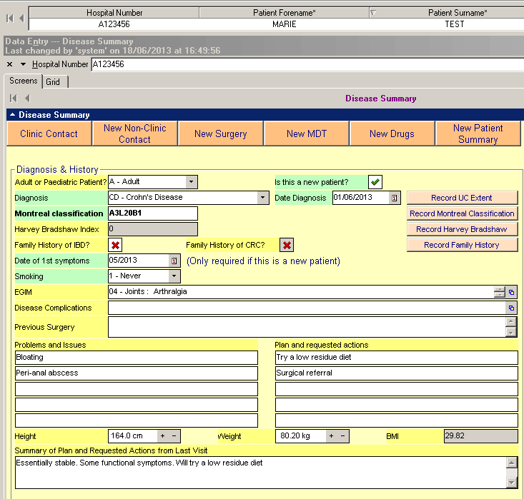
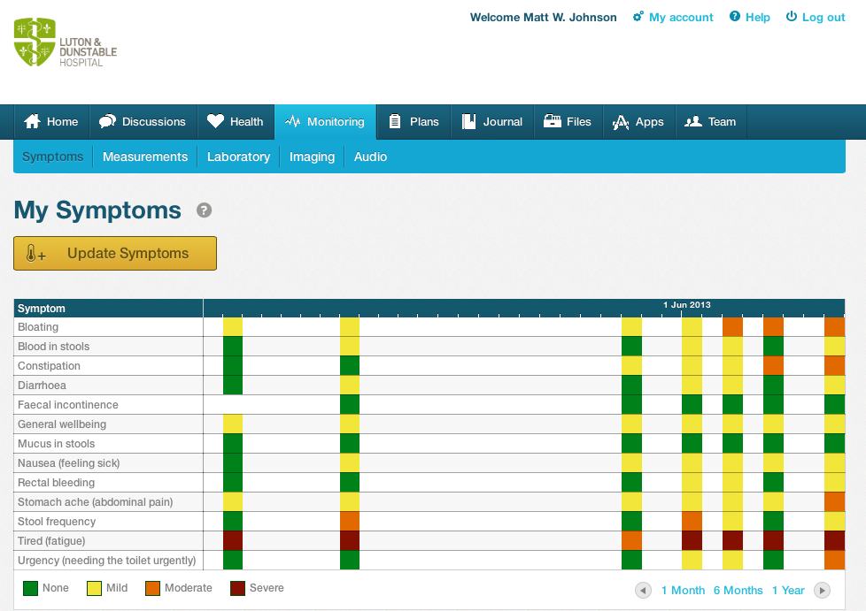
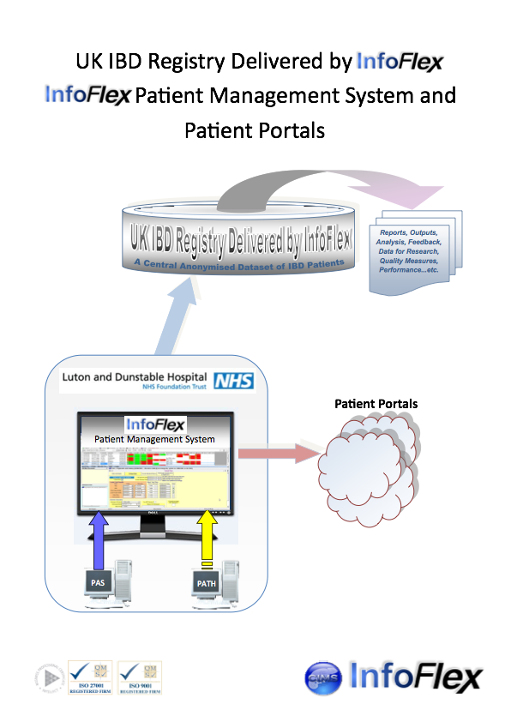
The outcomes and benefits of moving stable IBD patients from a paper based self management system to a supported self help and management programme (SSHAMP) with specialist overview
MW Johnson, K.Lithgo, T. Price.
Gastroenterology, Luton & Dunstable FT University Hospital., UK
Introduction
Self management in Inflammatory Bowel Disease (IBD) has proven itself to be a safe and cost effective method of managing the more stable IBD patients. It is not without issues. In February 2012 we introduced our IBD Supported ,Self Help and Management Programme (IBD-SSHAMP) with specialist nursing and consultant support to try an avoid some of the issues inherent on relying on self management alone. We now have 3 years experience in running IBD-SSHAMP with regular virtual telephone clinics and personalised web-site supported management. Some of the outcomes seen in transferring patients from self management to a supported self management system are presented here.
Aims
To develop a novel way of managing our IBD patients in the community that meet the growing demands on our NHS service, conformed with our national guidance and was more in tune with the lifestyle and choices of our patients today.
Method
In total 425 of our more stable IBD patients are now managed in the community on IBD-SSHAMP. Using hospital coding data, Evolve (the hospital's electronic record system), the National IBD Registry and HICSS (the endoscopy reporting software) we reviewed the following aspects;- number of flares, steroid courses, emergency outpatient clinics, and hospital admissions. By continuing to keep them under a close monitoring system we were interested to know if improvements would be seen in their compliance with prophylactic medication and their uptake on surveillance colonoscopy.
Method
Results
In 3 years just 43 flares were experienced in this cohort, and most of these were successfully guided in self management using mesalazines alone. Steroids were however required in 16 of these patients, most of which was directed by telephone consultation. In that 3 year period only 8 urgent outpatient appointments (OPAs) were required and no patients needed hospital admission. Many patients on pure self management had been lost to follow up and had avoided surveillance colonoscopy. Unfortunately after bringing these patients back into a monitored and supported management system we have subsequently found 3 colorectal cancers (ascending, sigmoid and ano-rectal) within this group. Most of these patients were overdue their surveillance colonoscopy, but despite the known risks 114 still declined surveillance. Other cancers were also found amongst this cohort, including; 2 breast cancers, one prostrate cancer and one skin cancer. Most were happy with the new IBD-SSHAMP, but 3 patients chose to attend standard hospital based OPAs.
Conclusion
IBD-SSHAMP has been shown to be a highly efficient and cost effective method of keeping community based IBD patients under close specialist review. Reductions in flares, emergency outpatient appointments and in-patient hospital admissions have been seen. It has been well received by the patients who prefer to be supported rather than discharged to self manage alone. Through closure contact, education and ongoing active community based monitoring we hope the IBD-SSHAMP patients will engage more with surveillance.
The opening page for PKB
A range of bluetooth gadgets upload directly onto the personalised websites
Opening page of the IBD - Registry
Summary page of the IBD - PMS
Record of the symptom scores on PKB
Integration of PKB with IBD-R
Abstract No. PWE-062

