Slide 1
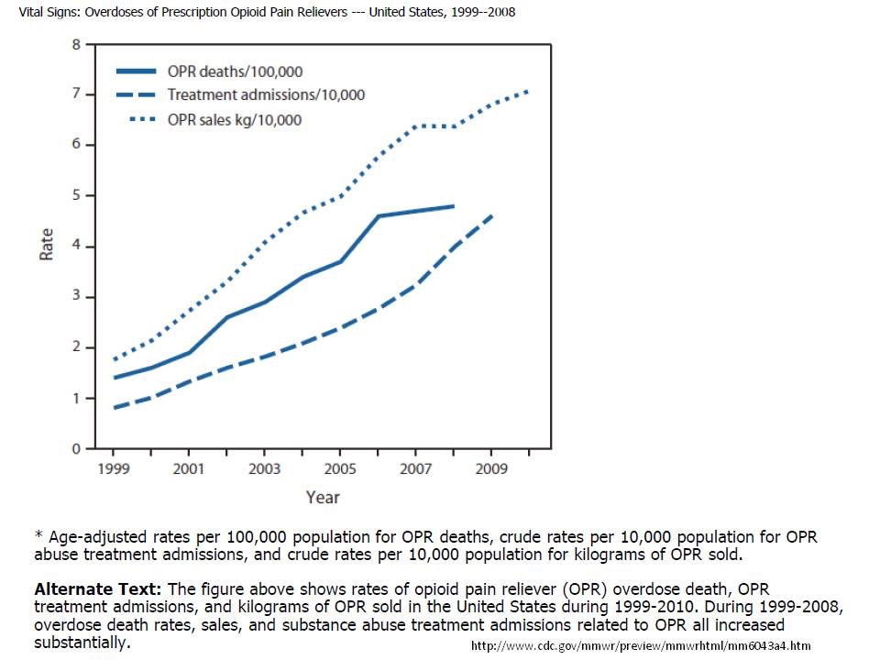
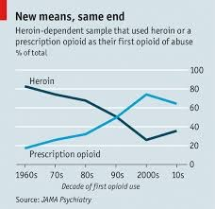
The financial burden of Narcotic Bowel Syndrome:
A local experience
M.W. Johnson, T. Prouse, M.Gibbons
Gastroenterology, Luton & Dunstable FT University Hospital., UK
Introduction
Narcotic drugs are widely prescribed by both GPs and hospital physicians, but little consideration is afforded to the potential longterm issues when starting patients off on these addictive therapies. Opioid prescribing has escalated throughout UK. Between June – November 2014, 32,956 prescriptions had been provided for strong opioid therapy in the Luton CCG catchment area. A European review in 2014 estimated the number of prescribed orders in UK to be 38.3 million, with 50.8 million being used in France and 81.9 million in Germany. Not only is this a costly unchecked market, but much of this is taken for abdominal pain.
The number of people being admitted to hospital with drug related issues is increasing in Britain. NBS is a subset of the opioid bowel dysfunction that we see, characterised by chronic or frequently recurring abdominal pain that worsens with continued or escalating dosages of narcotics. Narcotic Bowel Syndrome (NBS) is under recognised and believed to be increasing in prevalence worldwide.
Aims
To assess some of the financial cost implications of this condition on our local district general hospital in 2014.
Method
In 2014 we started to collect the names of patients seen in gastroenterology clinics or during hospital admission where the clinician felt the patient was suffering from NBS. This was either thought to be the main cause or contributing factor to their symptomatology. During that year a retrospective analysis was performed reviewing the burden and cost of outpatient appointments and inpatient hospital admissions, using the hospital coding system and financial analysis.
Results
A database collated the names of 41 patients with NBS. From the 1st of January to the 31st of December 2014, this cohort of patients made 78 hospital admissions annually (1.9 per patient) with an average length of stay (LOS) of 4.1 days. This was costed at £91,310, or an average of £2,227 per patient per year. In addition to that the same 41 patients made 159 outpatient appointments annually (3.9 per patient), costing £15,639, or an average of £381 per patient per year. This small group of 41 patients cost a total of £106,949 in 2014 or an average of £2,608 per patient per year, in hospital inpatients admissions and outpatient appointments alone, before adding in their prescription costs, GP attendances and visits to other hospitals.
Conclusion
NBS is a poorly recognised condition that places a huge demand on the NHS system with regards to time, resources and finances. The prevalence of this condition is thought to be increasing. Early recognition could prevent a costly and potentially fatal pathway of deterioration. On average the annual financial cost of hospital base care for each NBS patients is £2,608.
NB - Whilst we have been able to present some of our own local data, we were also well aware that this may be just the tip of the iceberg as many of these patients were also visiting neighbouring hospitals
Discussion
On a more worrying note the prescribing of these addictive drugs does not appear to be monitored well within the community, with many patients receiving ongoing opioid prescriptions for years. There appears to be no alert system to question why such medications are being recurrently prescribed
Further work is clearly needed in this field as it is a growing and costly problem. A nationally agreed definition and set of diagnostic criteria is needed to help guide future research in this area.
Trends in prescribing opioids in UK
Rate of ODs using
prescribed opioids
Graph 1 - 2014 The cost burden of the 41 NBS patients
Graph 2 - 2014 The cost burden per NBS patient
UK prescribed drug related deaths
New suggested origin
for drug addictions
Abstract No. PWE-244

