Slide 1
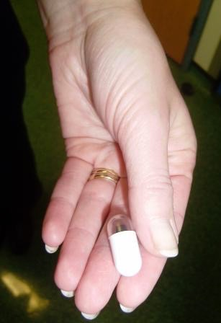
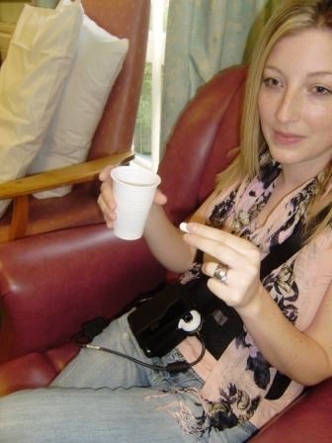
Is a false positive faecal calprotectin,
as false as you think?
D. Alzoubaidi¹, L. Asser², T. Price¹, K. Lithgo¹,
D. Housley², MW Johnson¹
Gastroenterology¹ and Biochemistry², Luton & Dunstable Hospital., UK
Introduction
There is a clear need for a simple unambiguous test to differentiate between functional (e.g. Irritable Bowel Syndrome) and true organic diseases of the bowel (e.g. Inflammatory Bowel Disease). This would have the effect of reducing the number of unnecessary investigations such as colonoscopies, whist helping to reduce the total health service costs. Faecal calprotectin is a well validated non-invasive faecal inflammatory marker capable of differentiating functional from organic disease. A recent BMJ meta-analysis suggested that it had 93% sensitivity and 96% specificity, with a false positive rate of 9% in adults. The false positives were labelled as patients with a high faecal calprotectin who had subsequently undergone normal gastroscopy and colonoscopy with terminal ileal biopsies.
Aims
We decided to investigate this false positive rate further by reviewing the patients we had seen at capsule endoscopy who had been found to have positive faecal calprotectin levels in the presence of normal endoscopies (OGD + Colonoscopy).
Method
All the patients who had undergone a small bowel capsular endoscopy in our unit from 2011 to 2014 were identified. Patients with an unexplained positive faecal calprotectin were selected (regardless of their referral indication). A retrospective analysis of the capsule findings was then made in those patients who had already undergone normal endoscopic investigation. All patients with positive endoscopic findings were excluded. This left us with 21 patients who had unexplained positive faecal calprotectin levels in the presence of normal endoscopic investigations, where the assumption would have been that the calprotectin results were due to a false positive result. The small bowel capsule assessments of these 21 patients were analysed for pathology missed by the endoscopies that could have explained these recurrently high calprotectin levels.
Results
A total of 206 patients underwent capsule endoscopy between 2011 and 2014. Of these 46 had raised faecal calprotectin levels and 185 had positive endoscopic findings. Subsequent analysis revealed 21 patients with raised faecal calprotectin (average 499) and normal endoscopic investigations, labelled as false positives.
Within this group 71.4 % were found to have small bowel pathology including 12 (57.14 %) patients with small bowel enteropathy of which Crohn’s disease was a possibility, 2 (9.52 %) patients had angiodysplasia and 1 (4.76 %) with small bowel malignancy (Table 1). It was thought most likely that the raised calprotectin levels seen in the angiodysplasia and small bowel malignancy were at least in part due to microscopic blood loss into the lumen of the intestines.
Conclusion
The documented false positive rate of 9 % may not be as accurate as we previously thought. In our unit capsule endoscopy highlighted a pathological explanation in 71.4 % and possible small bowel Crohn’s Disease in 57.14 % of these patients. Further assessments would be needed with larger numbers, however, we would advocate SBCE in patients with unexplained raised calprotectin even if they have had normal endoscopic procedures.
References
van Rheenen PF, Van de Vijver E, Fidler V. Faecal calprotectin for screening of patients with suspected inflammatory bowel disease: diagnostic meta-analysis. BMJ. 2010 Jul 15;341:c3369
 | Number | %
sb enteropathy | 12 | 57
Angiodysplasia | 2 | 9.5
sb malignancy | 1 | 5
Normal | 6 | 28.5
Total | 21 | 100
Capsule Team in 2011 with 1st two patients
Capsule
Abstract No. PWE-060

