Slide 1


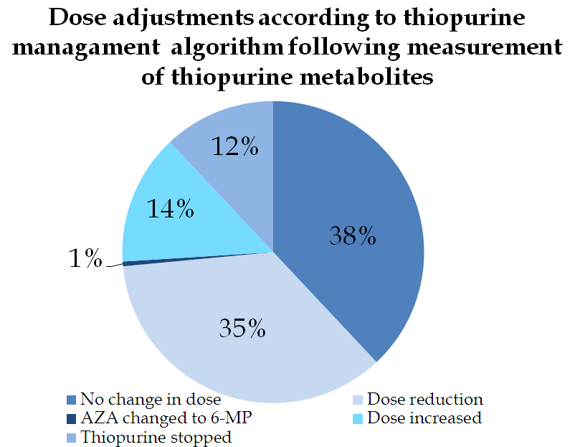
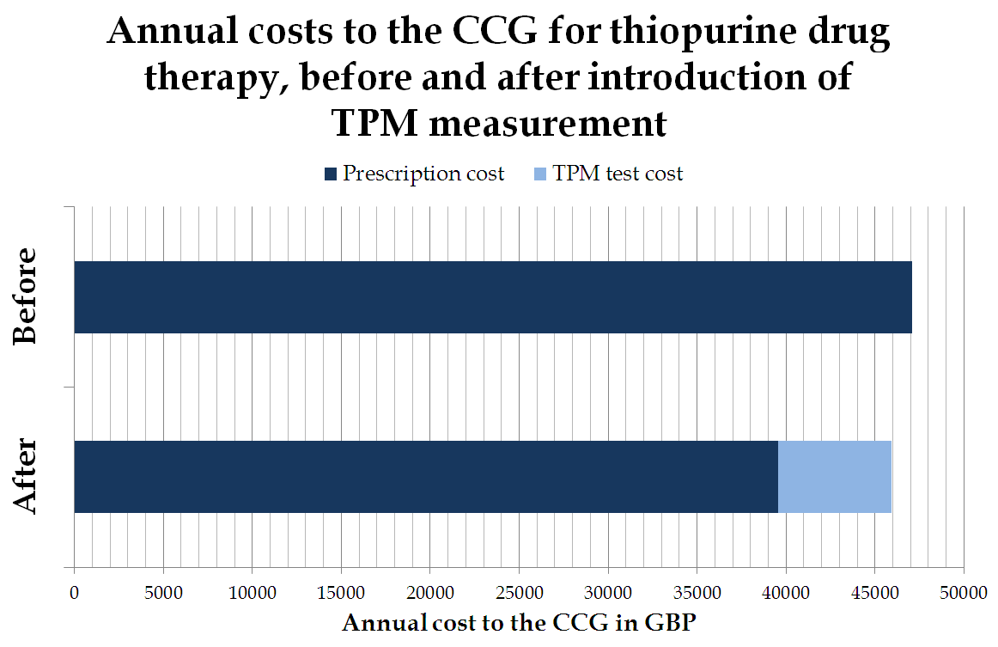
The cost savings seen after introducing a thiopurine metabolite service into a DGH
R. Leyland ¹, T. Price ², K. Lithgo ², D. Housley ¹, M. W. Johnson ²
¹Biochemistry, ²Gastroenterology, Luton & Dunstable FT University Hospital, Luton, United Kingdom
Introduction
A significant number of patients with inflammatory bowel disease (IBD) are treated with thiopurine immunomodulators. Patients are commenced on a standard dose of Azathioprine (AZA) or 6-Mercaptopurine (6-MP) which are titrated up to 2.5mg/kg and 1.25mg/kg, respectively. Dose adjustments are based on clinical assessment, tolerability and evidence of toxicity e.g. myelosuppression or abnormal liver function tests. Due to the complex pathway of thiopurine drug metabolism there is significant inter-individual variation in dose requirements and little correlation between dose-response and dose-toxicity. Measurement of thiopurine metabolites (TPM), 6-Thioguanine (6-TGN) and 6-Methylmercaptopurine (6-MMPN), can be used to guide management of patients taking thiopurine drugs. The therapeutic range for 6-TGN is 235-450 pmol/8x10⁸ RBCs and provides optimal therapeutic efficacy. The cut-off of >5700 pmol/8x10⁸ RBCs for 6-MMPN is associated with an increased risk of hepatotoxicity.
Aims
To determine the overall cost of measuring TPMs, and to assess any resulting cost savings the subsequent results might have on future prescribing costs, using a universal guide to thiopurine drug management.
Method 1
The Luton & Dunstable gastroenterology department identified 406 patients with IBD on thiopurine medication. These patients were sent a letter requesting blood tests inclusive of a TPM assessment before the end of January 2015. The patient’s samples were sent to Birmingham City Hospital for measurement at a cost of £32. Based on published data a thiopurine management algorithm (Table 1) was designed.
Method 2
If a change in prescription was recommended by the results the annual prescription cost for the CCG was calculated using the following drug tariff costs: Azathioprine 25mg (28 tablets) £2.96, Azathioprine 50mg (56 tablets) £3.19 and 6-Mercaptopurine 50mg (25 tablets) £50.47.
Results
Of the 406 patients who were sent a letter requesting they attend for a blood test 200 attended before the end of January 2015. Of the 200 who attended 156 patients were taking AZA and 44 were taking 6-MP. The TPM results determined a change in management for 124 patients (62%), with 76 patients (38%) having no change to their thiopurine drug dose and therefore annual prescription costs. Dose reduction was recommended in 35% of patients, 14% had their dose increased, 12% had their thiopurine drug therapy stopped, and 1 patient changed from AZA to 6-MP (Graph 1).
As depicted by Graph 2 the annual prescription cost for AZA and 6-MP for the patients in the study was originally £47,065.98. The use of the TPM results in the thiopurine management algorithm led to a reduction in prescription costs to £39,548.78. The total cost of the TPM tests was £6400.00 and therefore the overall saving for the first year of the service was £1117.20.
Conclusion
TPM assessment led to a dose adjustment in 62% of the IBD patients on thiopurine therapy. Essentially the cost of introducing this service was covered by the savings in the first year from personalised drug dosage adjustment. In addition to the first year overall saving of £1117.20, there is an on-going year on year prescription cost saving of £7517.20. Future studies will be needed to assess further cost savings if the personalised dose adjustments lead to improved disease control and reduction in complications.
Table 1 – Thiopurine management algorithm 6-TGN 6-Thioguanine nucleotide, 6-MMPN 6-Methyl mercaptopurine ribonucleotide
6 TGN (pmol/8x10⁸ RBCs, 235-450) | 6MMPN (pmol/8x10⁸ RBCs <5700) | Management Interpretation | Consider Action
<235 | <235 | Not taking | Encourage to take medication or Stop it
<235 | <5700 | Sub-therapeutic dose | Dose escalation
<235 | >5700 | Too sensitive, metabolize to 6-MMPN | Stop prescribing or consider Low dose AZA / Allopurinol
235-450 | <5700 | Accurate dose | Continue with current dose
235-450 | >5700 | Too sensitive, metabolized to 6-MMPN | Reduce dose or Stop prescribing or Low dose AZA/Allopurinol
>450 | <5700 | Unnecessarily high dose | Reduce dose
>450 | >5700 | Dose too high | Reduce dose or Stop prescribing or Low dose AZA / Allopurinol
Abstract No. PWE-061

